Slide 1
Fuhsing Impact Club
Club Introduction

Slide 2
Club Goals
社團目標
01
02
Expand our vision
Make an impact by ourselves
03
04
Visit different institutions to explore and learn related knowledge
Invite relevant experts and groups to be lecturers
拓展我們對於居住的環境與社會的概念和想法
用實際的行動為這個社會盡一份心力
參訪不同機構探討並學習相關知識
邀請相關專家與團體來當講師

Slide 3
Weekly Club Time 平常社課時間:
Discuss current societal and environmental issues-(projects)
探討社會或環境相關議題
Invite relevant experts and groups to be lecturers
邀請相關專家與團體來當講師並與他們學習
Prepare plans and activities for holidays, winter and summer vacations
籌備假日與寒暑假的計畫及活動
Prepare a project for cooperating with other clubs
準備跟其他社團合作的專案

Slide 4
Weekend 假日時間:
Regularly organize/participate in environmental cleanup and protection activities 定期舉辦/參加環境清理與保護的活動-
  Beach cleaning 淨灘
  Park and community cleanup 公園與社區清理
Regularly organize/participate in volunteer activities 定期舉辦/參加志工活動-
  Step30 舊鞋救命
  T.F.C.F 家扶基金會
  Book donation activity 捐書活動
  Charity sales 各式義賣
Visit different institutions to explore and learn related knowledge 參訪不同機構探討並學習相關知識-
  University 大學
  Related companies 相關產業公司
  Environmental Protection Station 環保站
  Plants and Ecological Park 植物生態園區

Slide 5
Activity Introduction
活動介紹

Slide 6
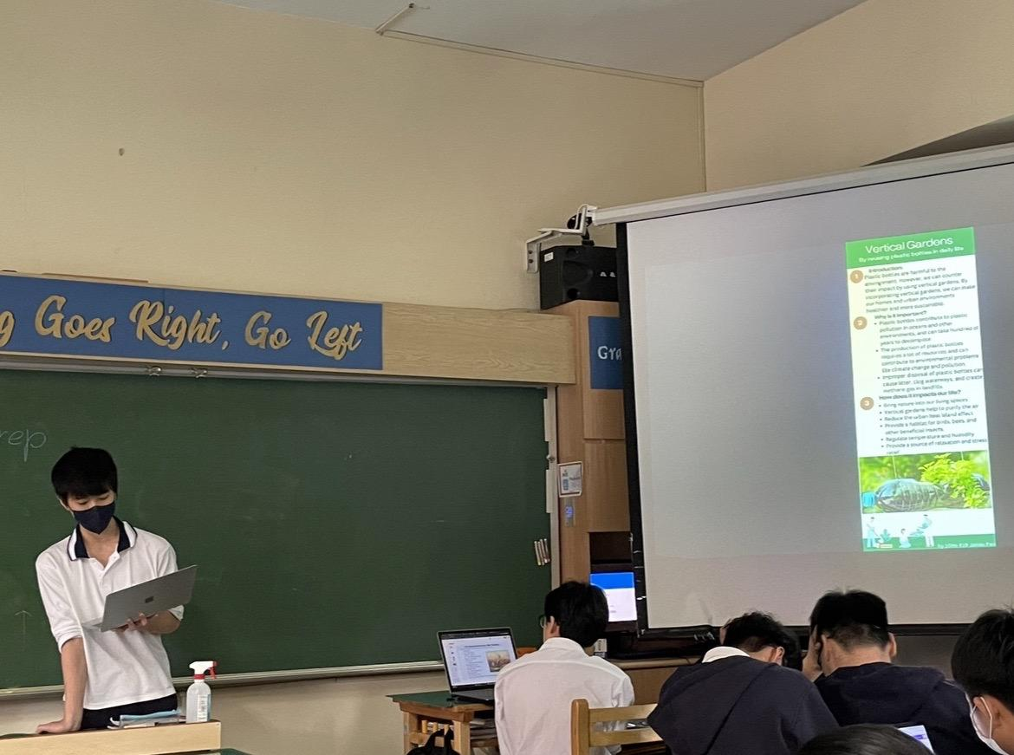
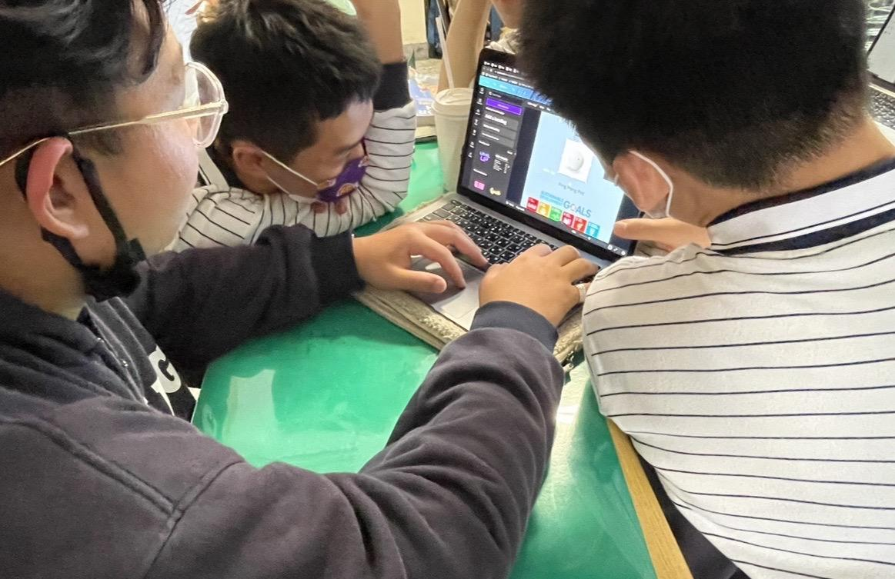
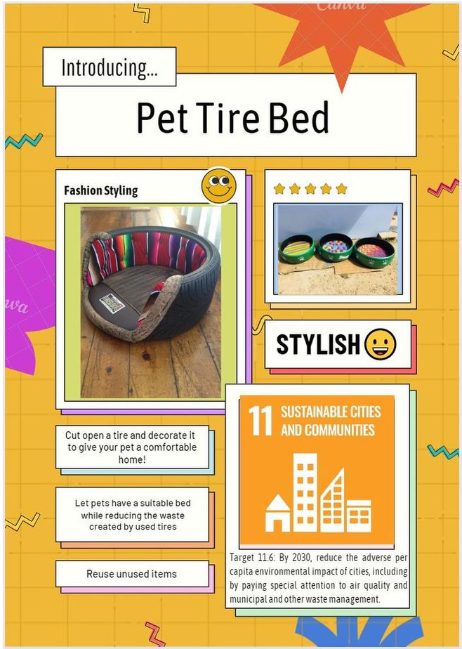
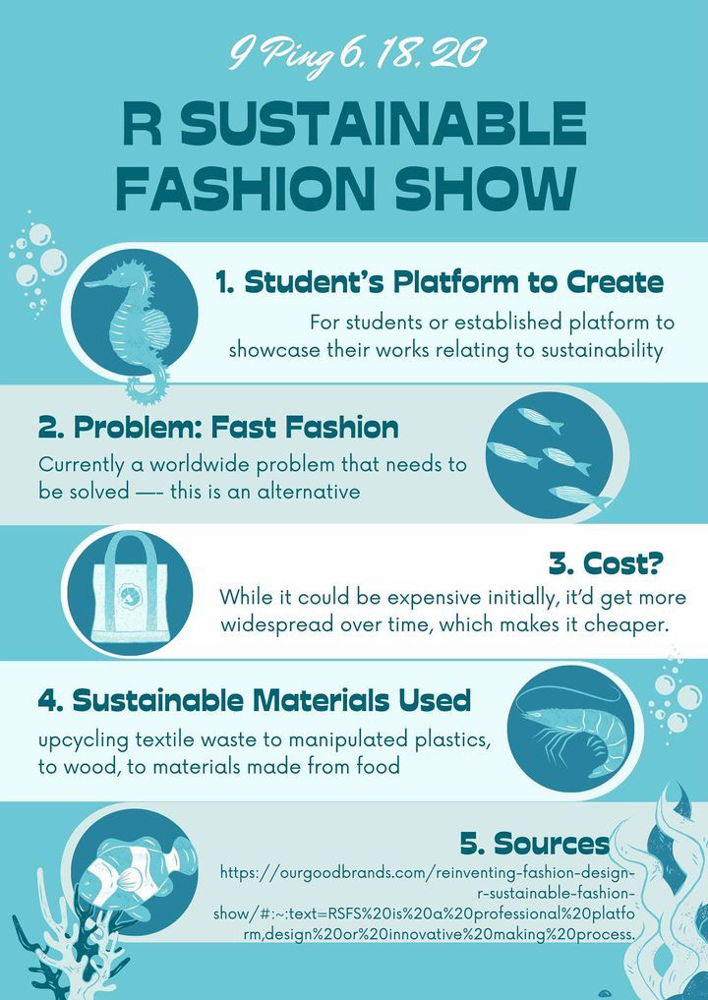
Club Projects

Slide 7
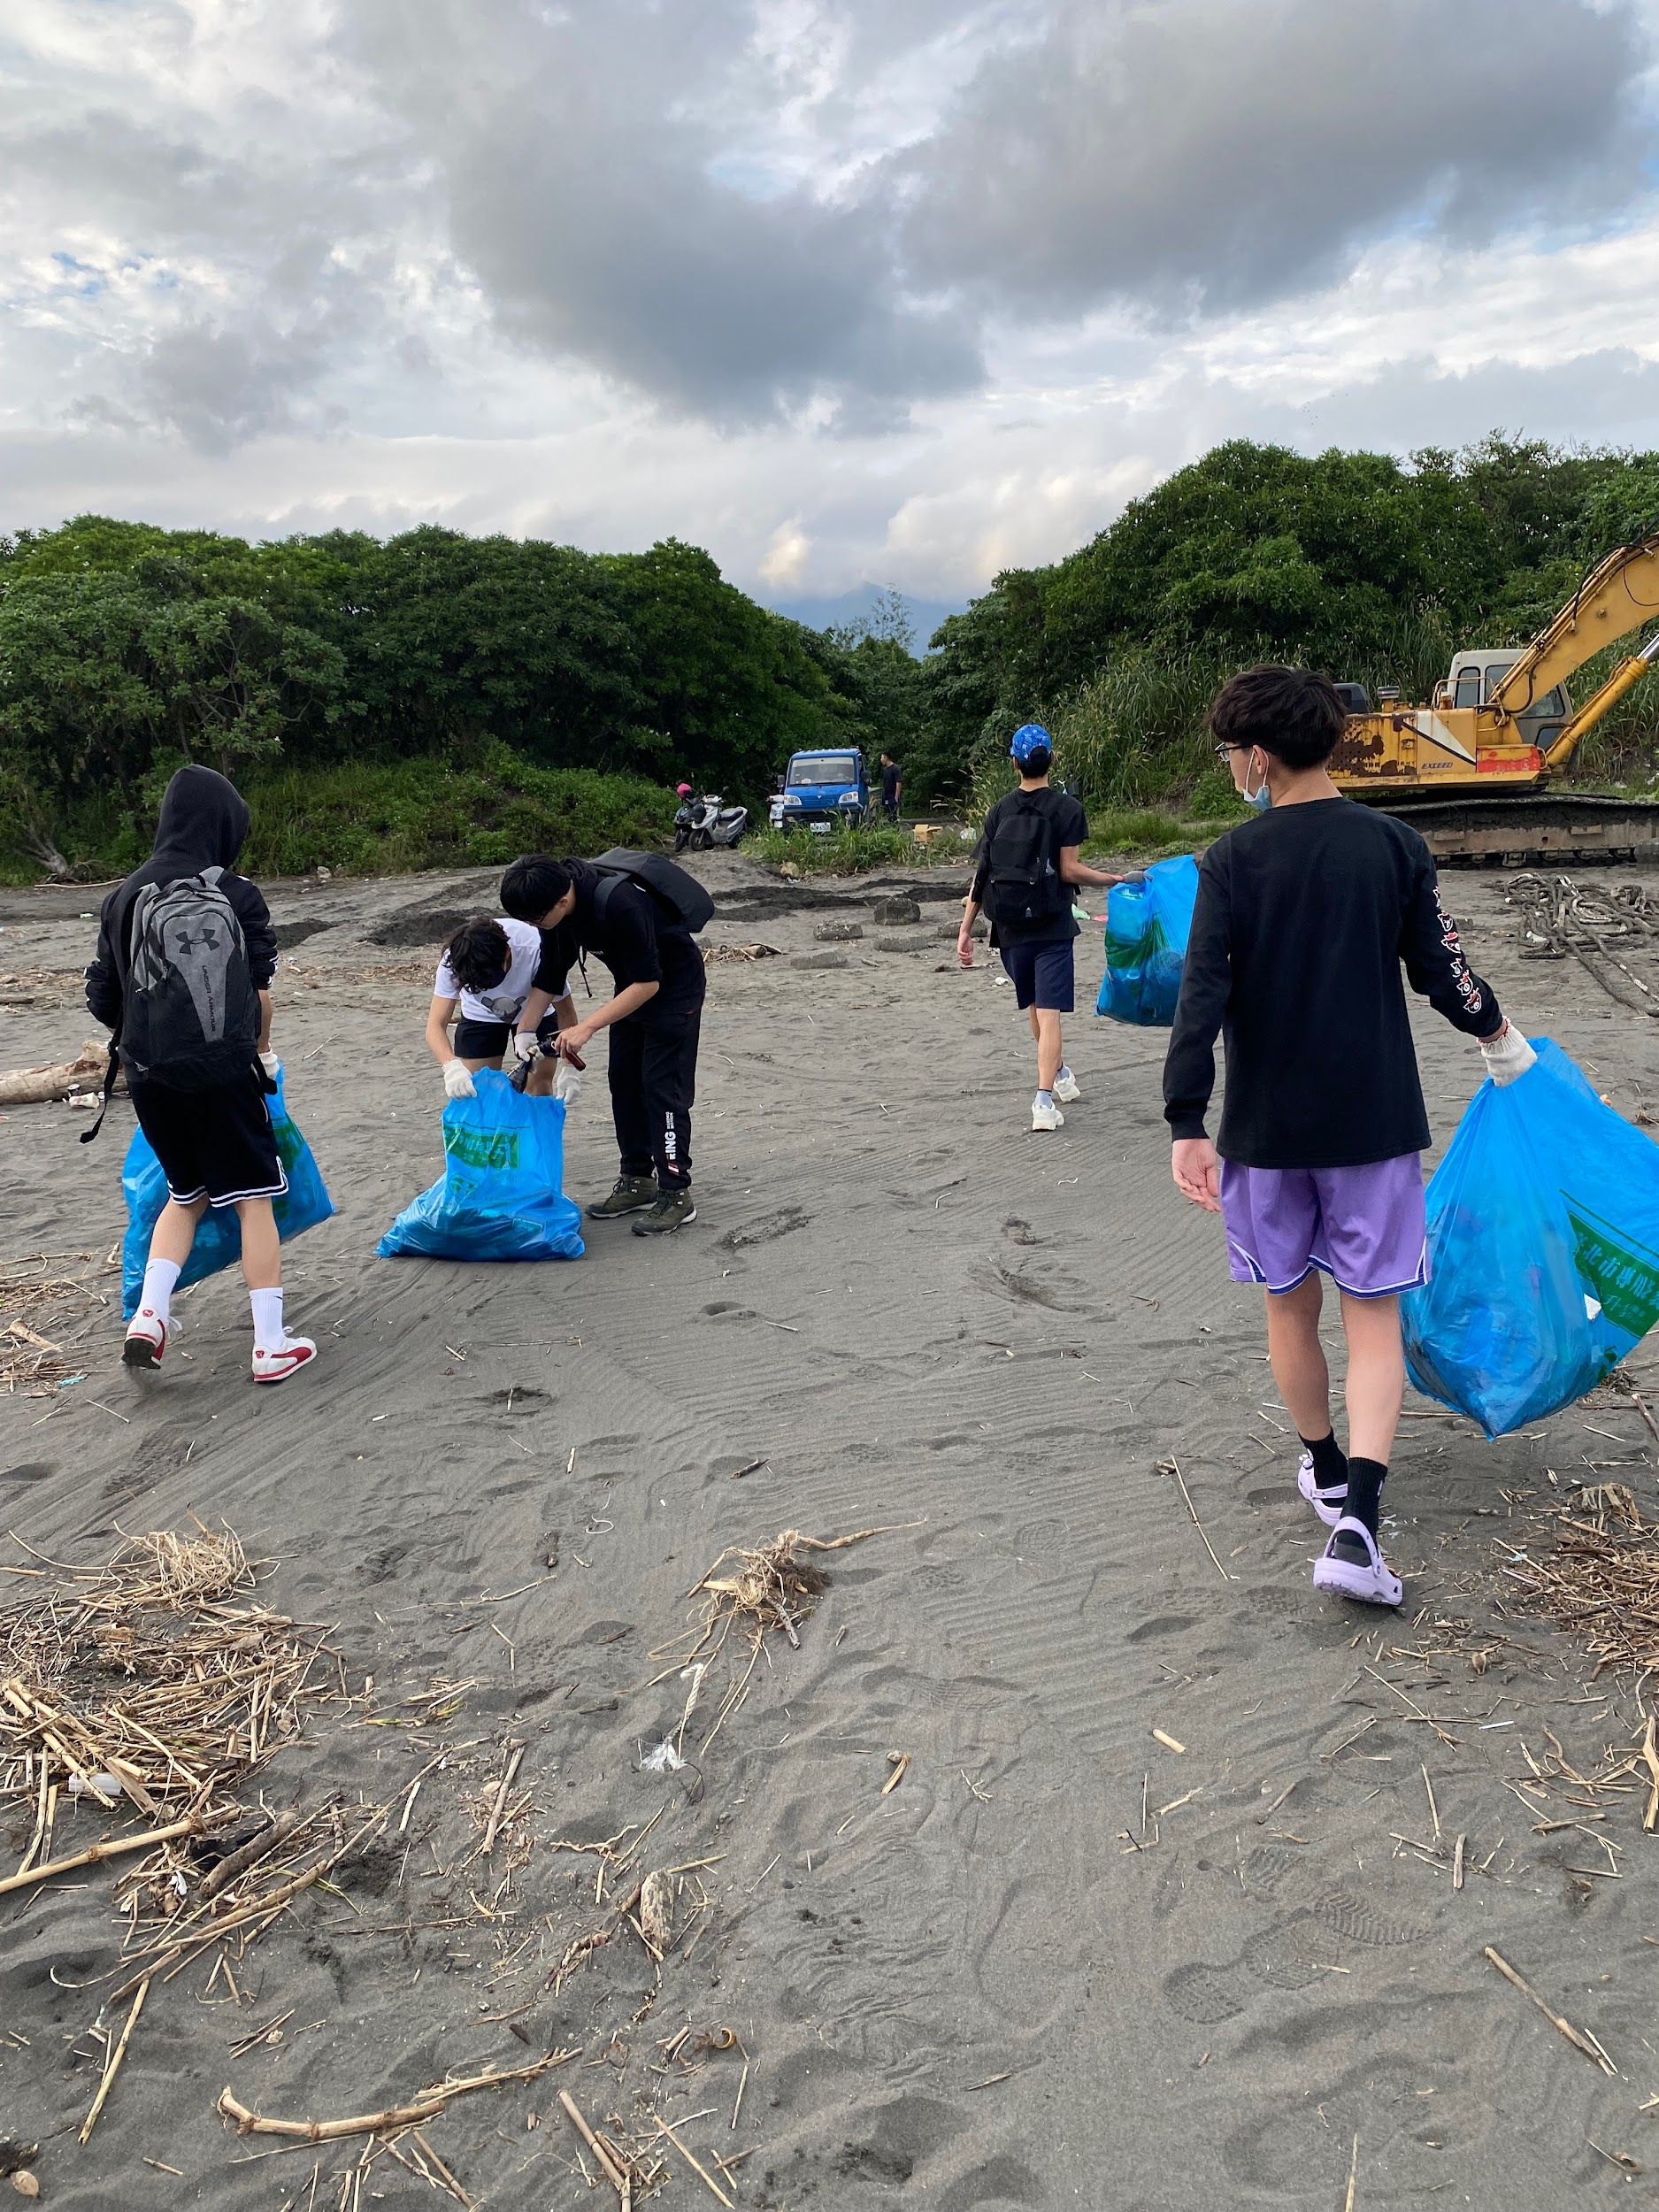
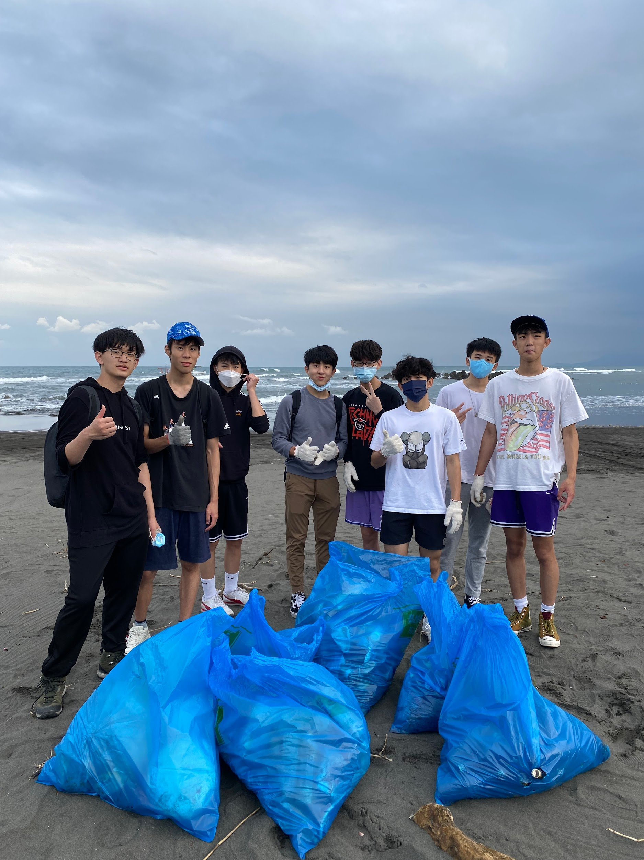
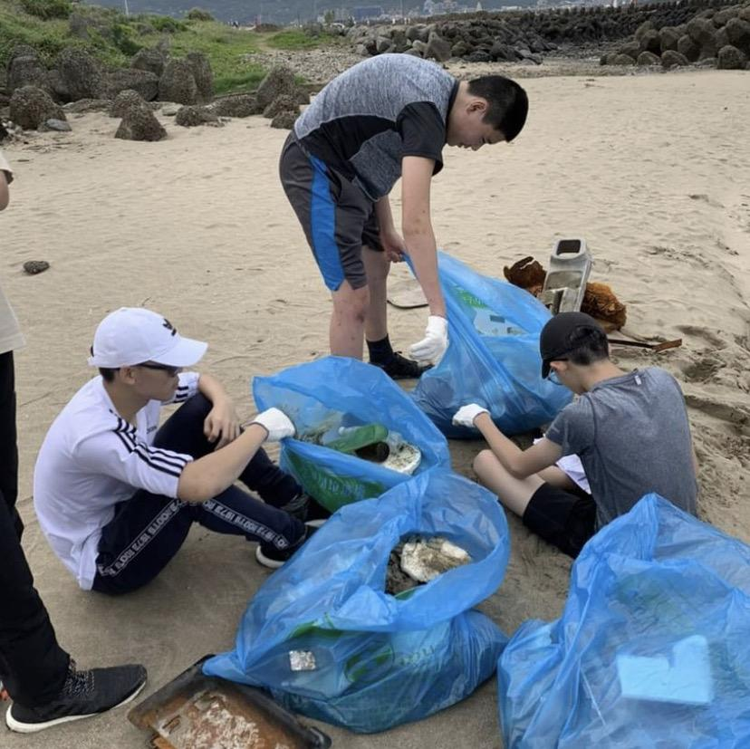
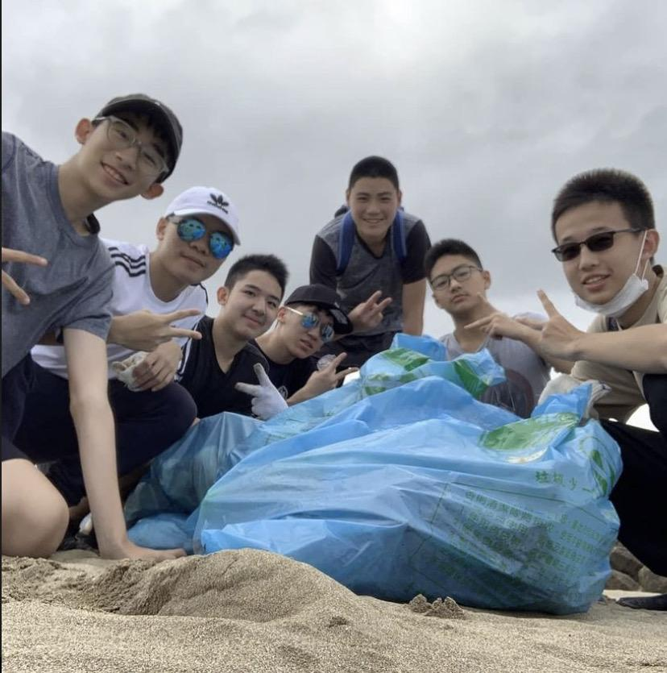
Beach cleaning 淨灘

Slide 8
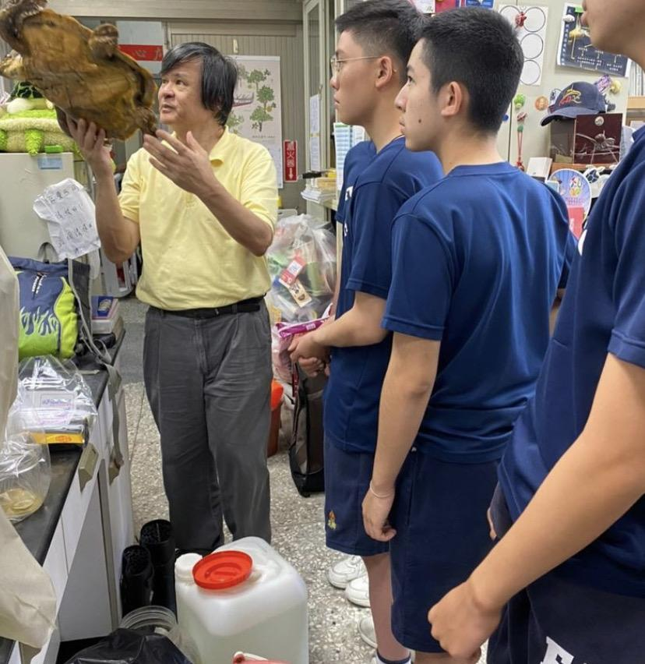
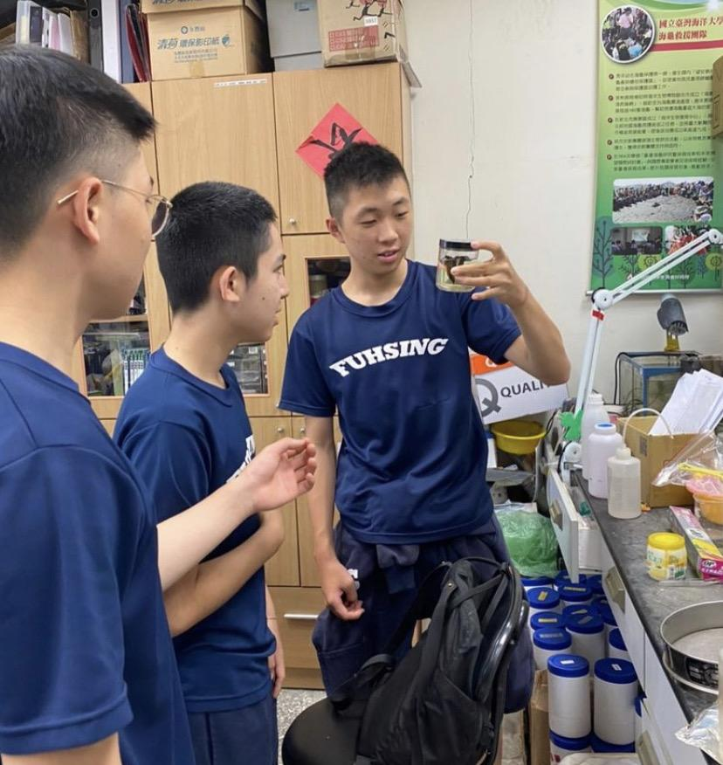
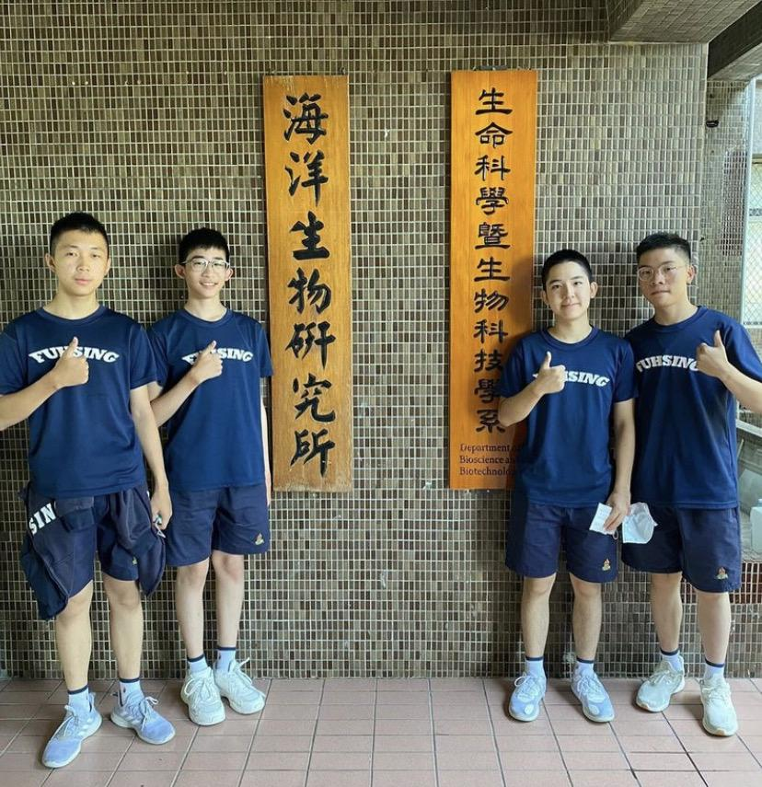
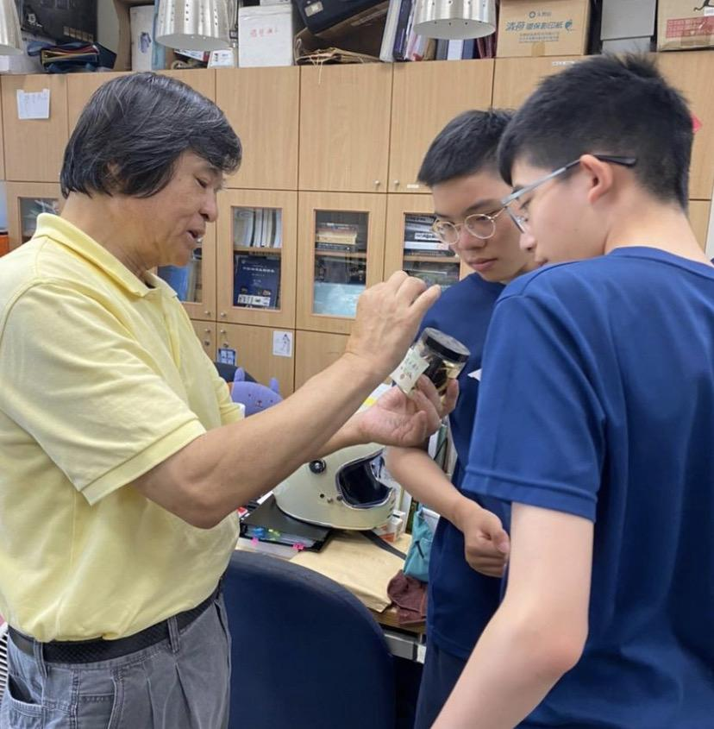
Visited National Taiwan Ocean University 參觀國立基隆海洋大學

Slide 9
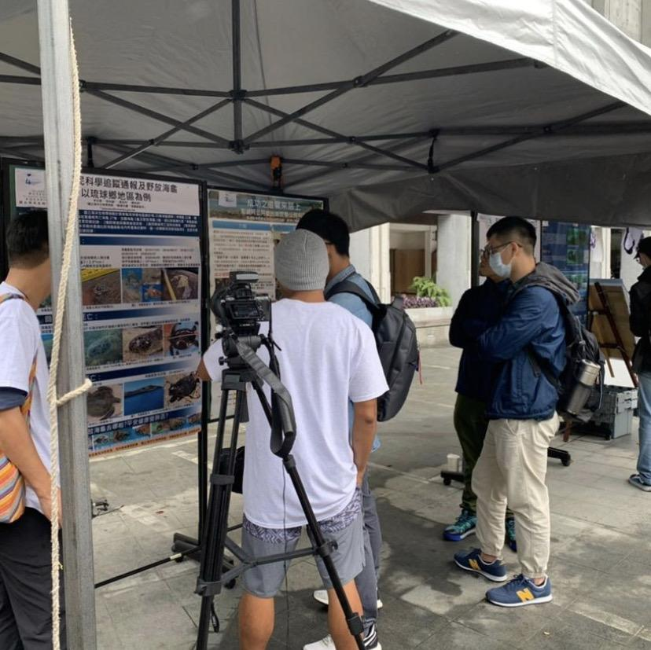
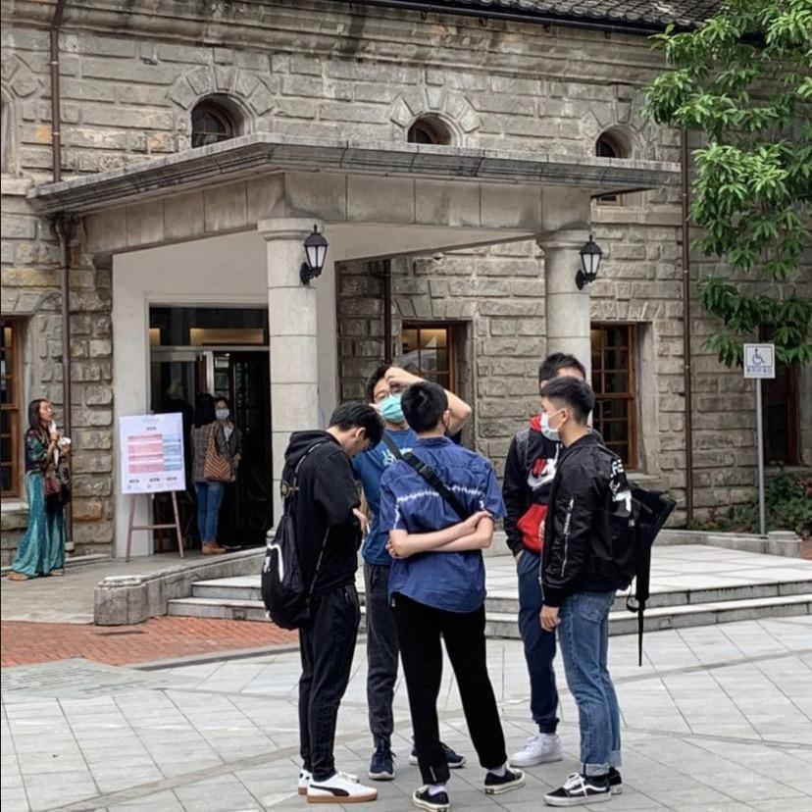
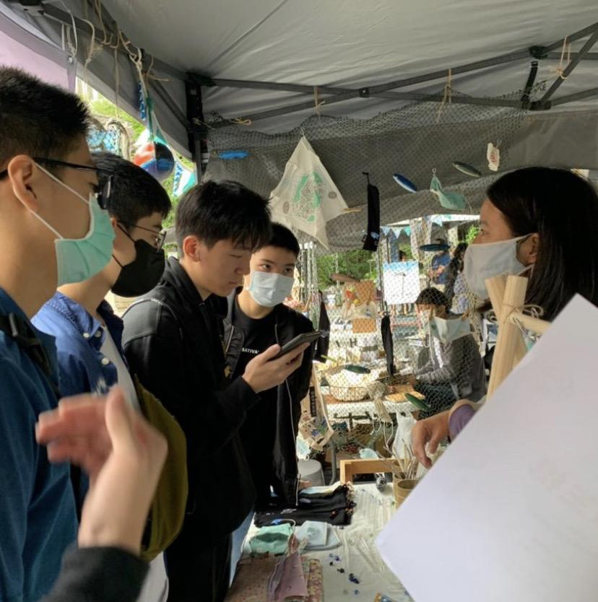
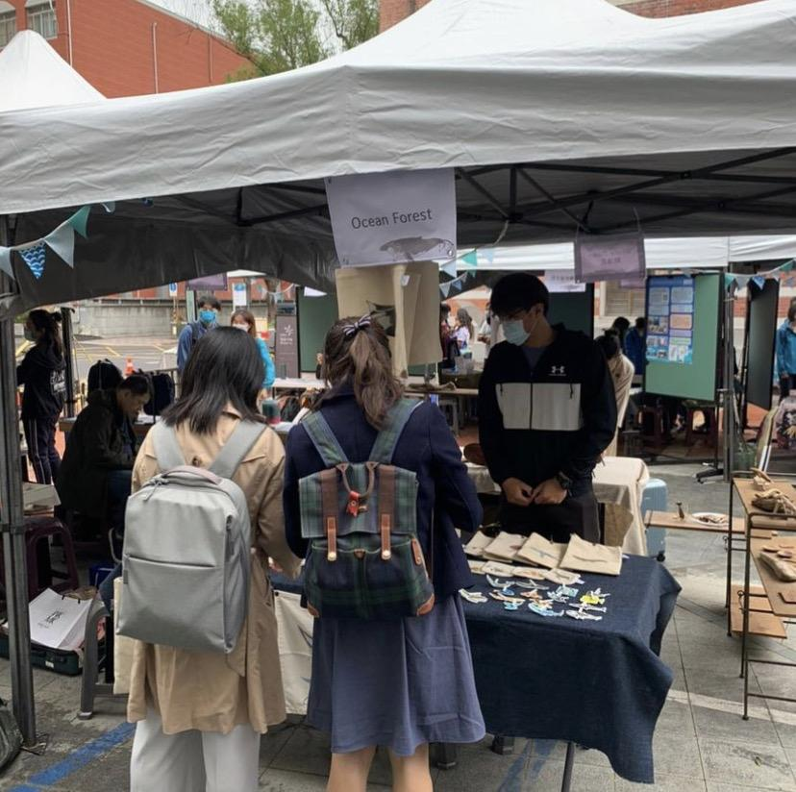
Ocean Carnival海洋嘉年華

Slide 10
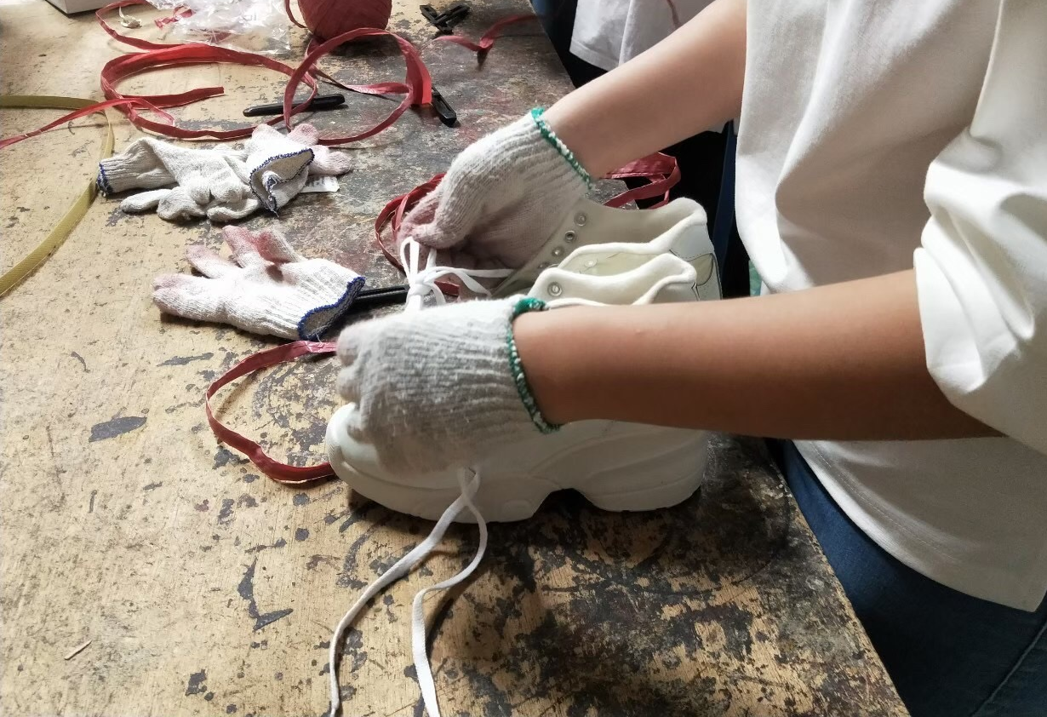
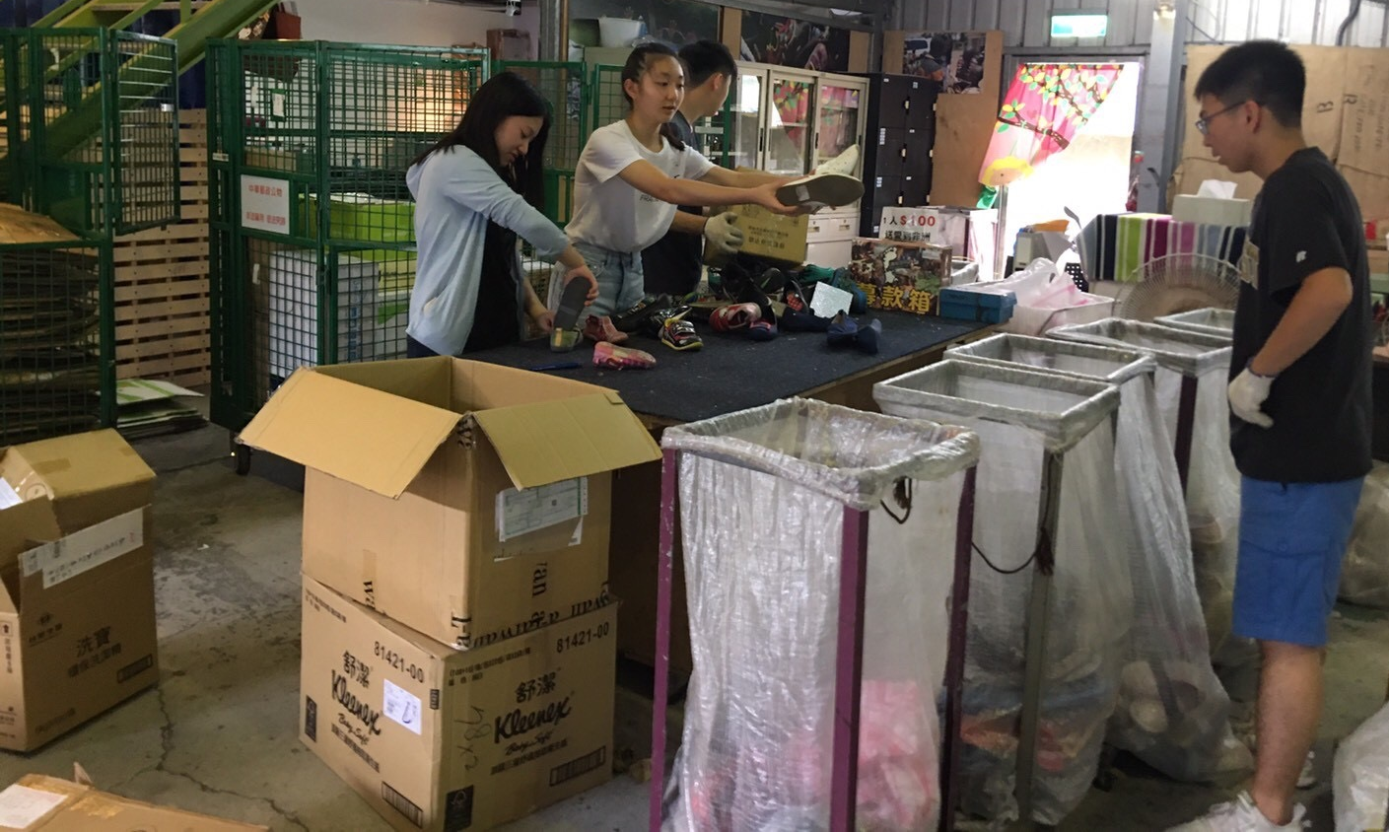
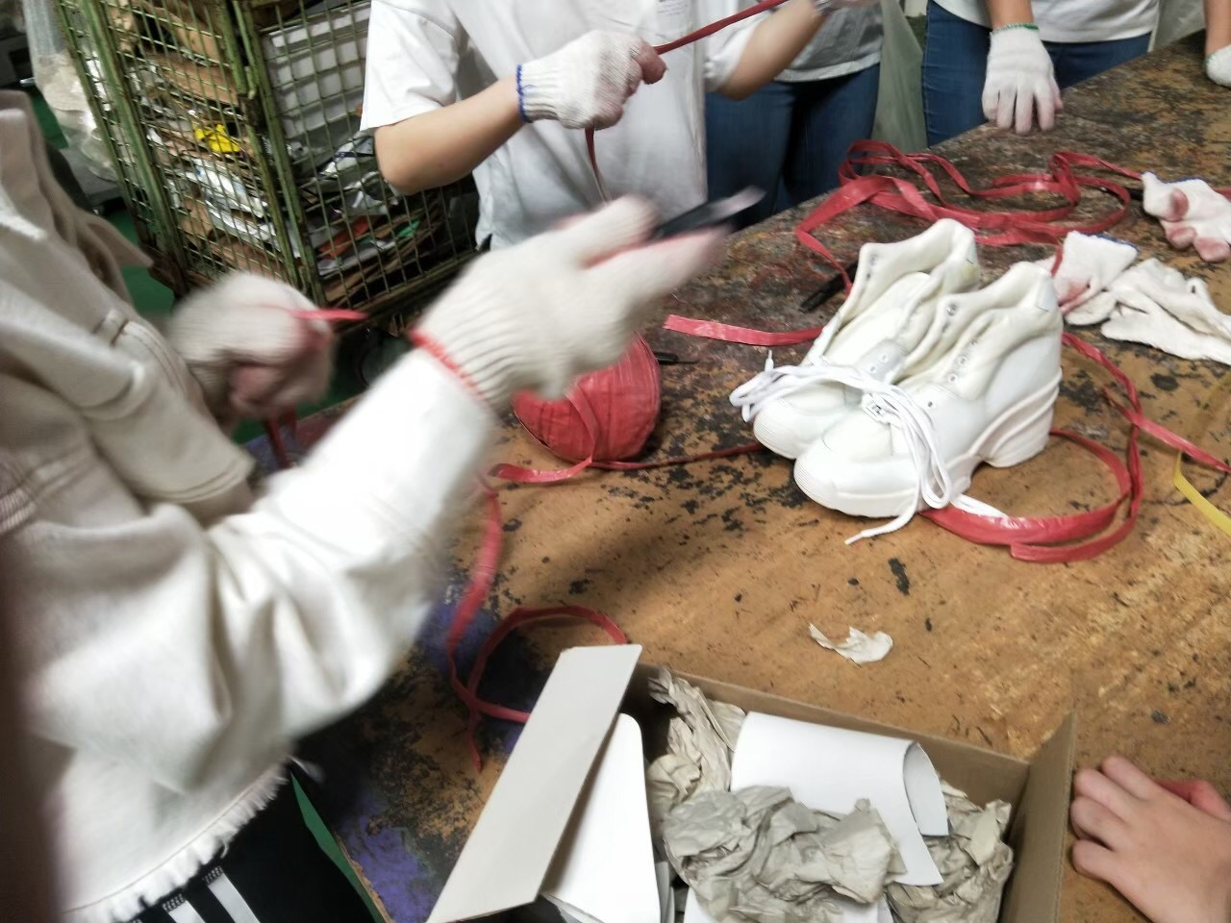
Step30 舊鞋救命

Slide 11
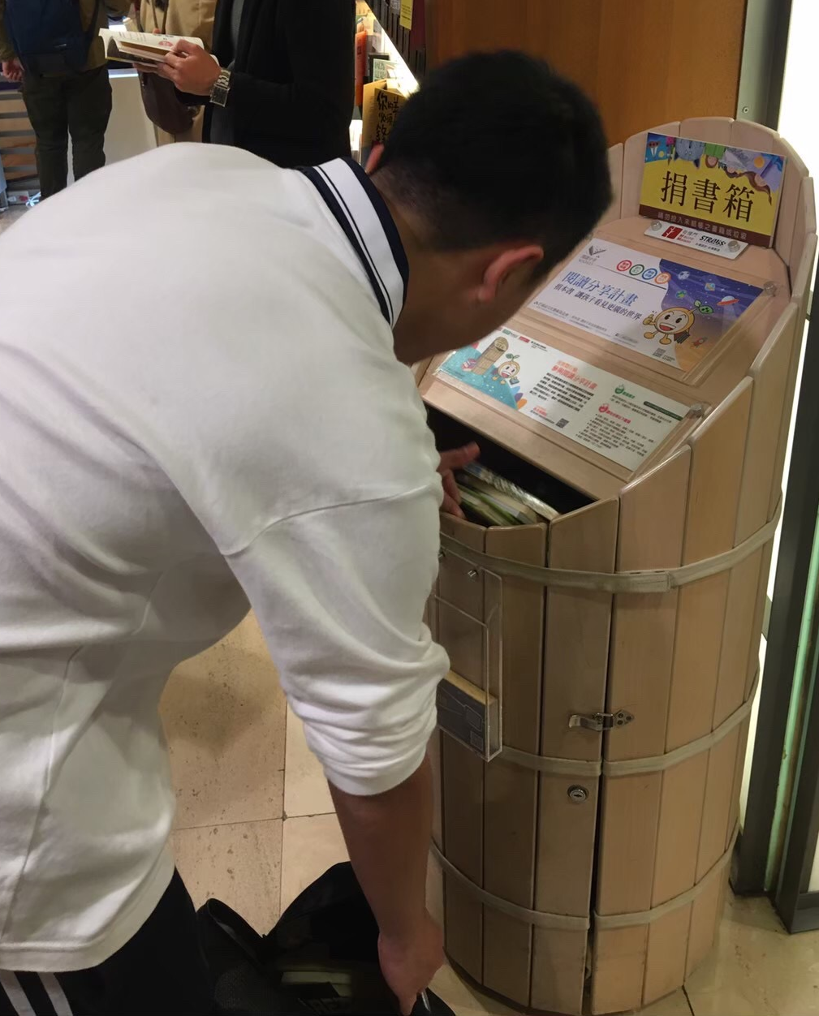
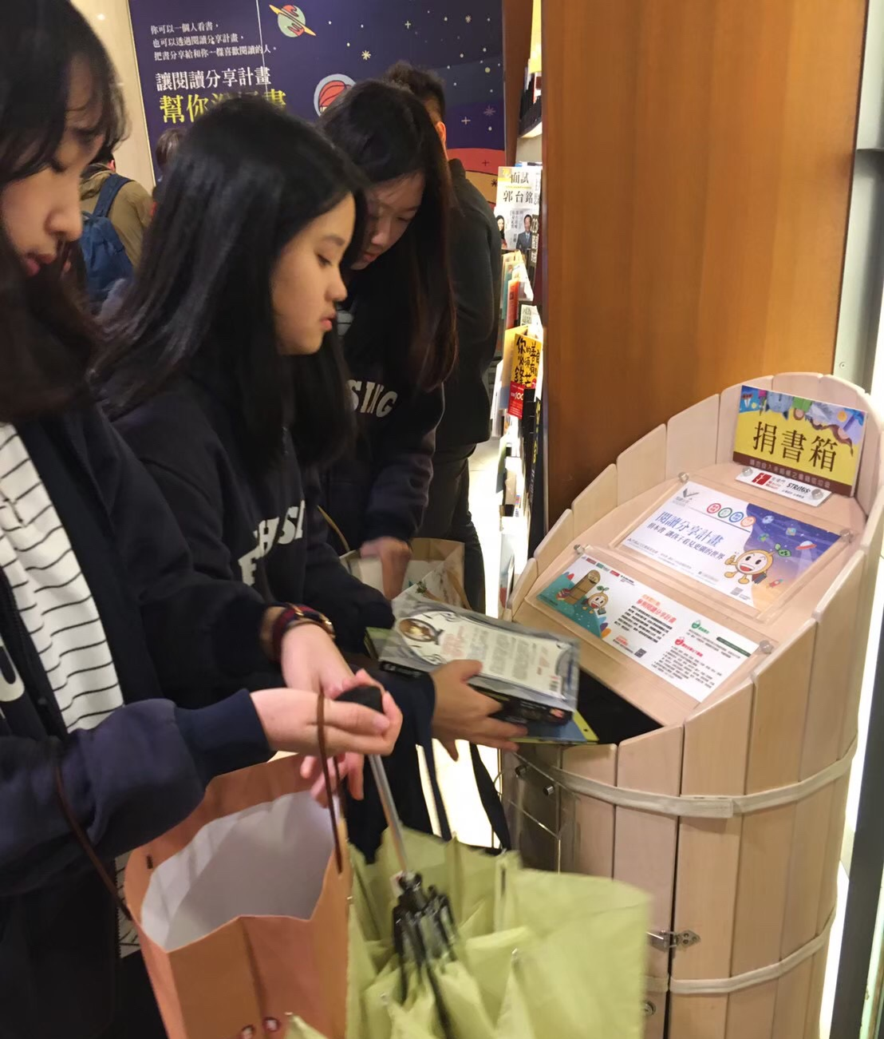
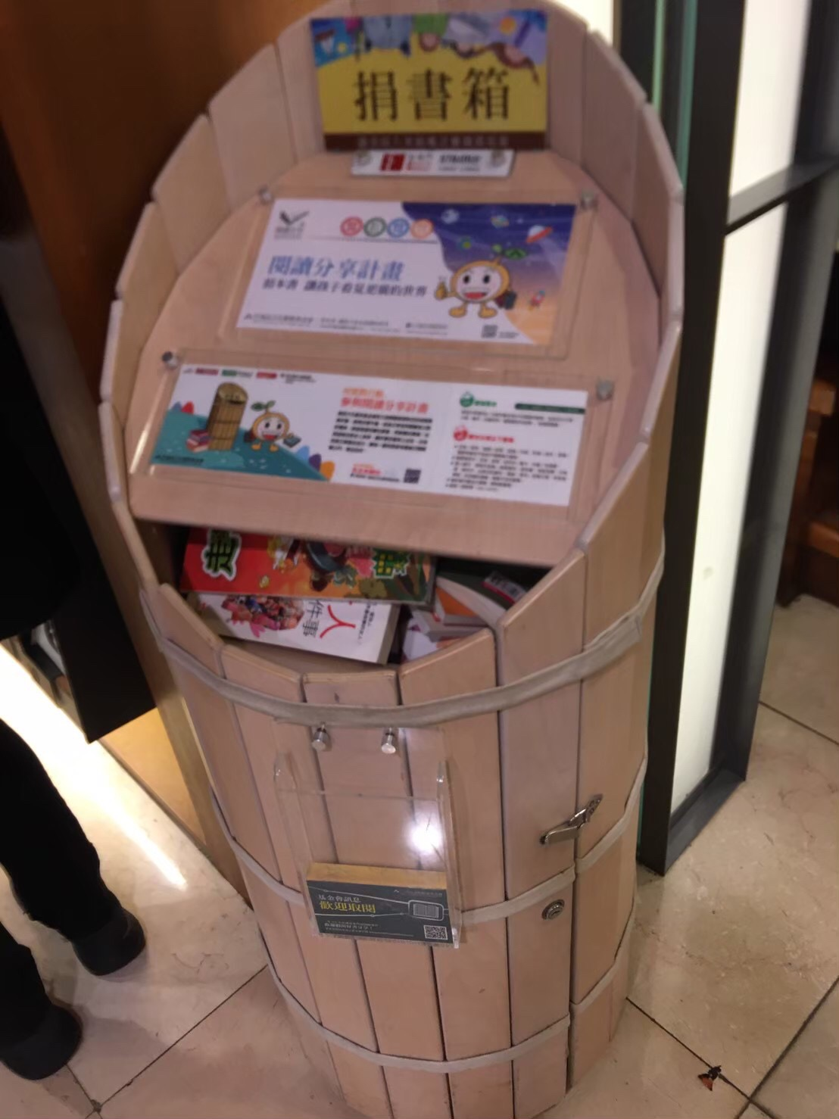
Book donation activity 捐書活動

Slide 12

Club Collaboration
喚起校內學生對全球議題的關注
不同的角度看待問題

Slide 13

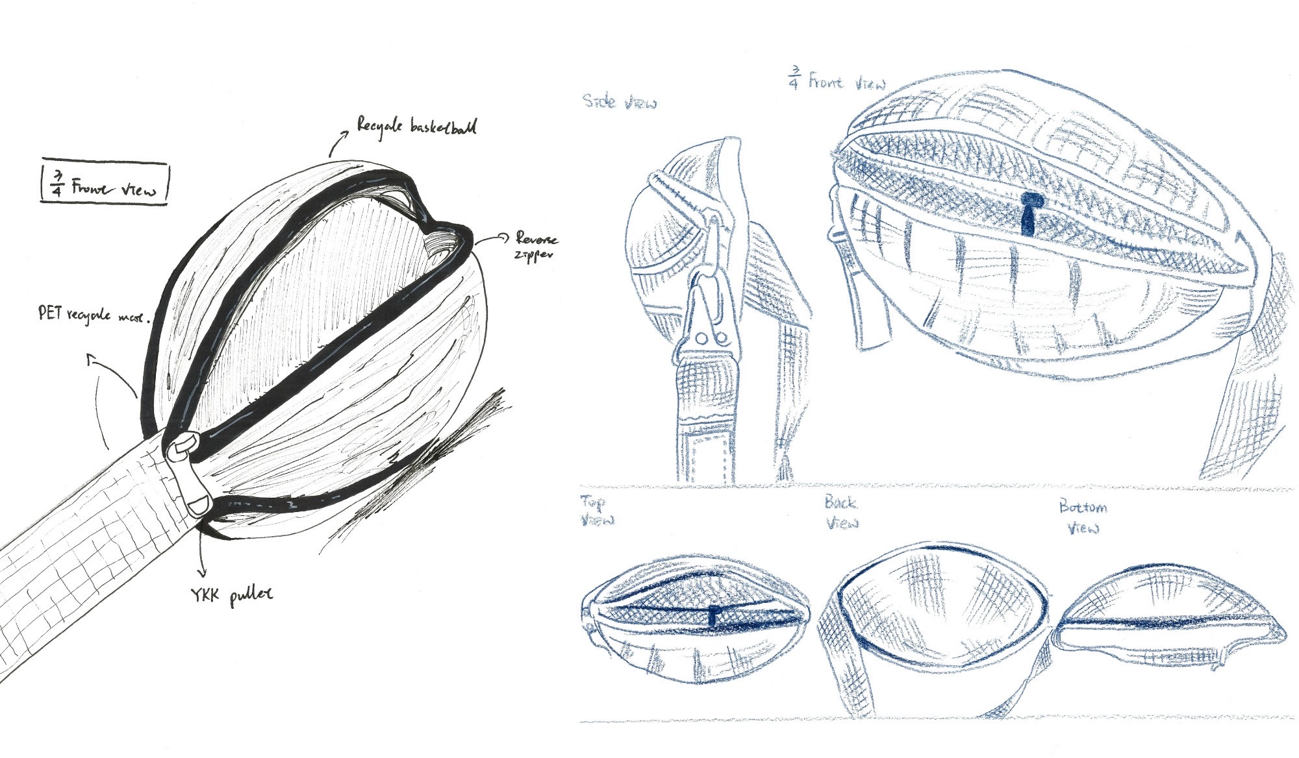
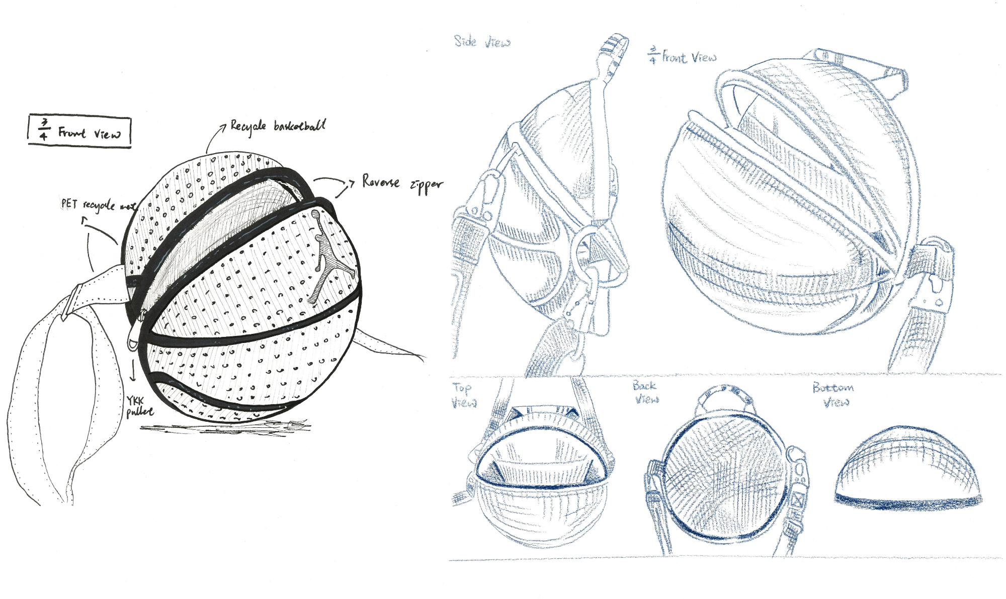
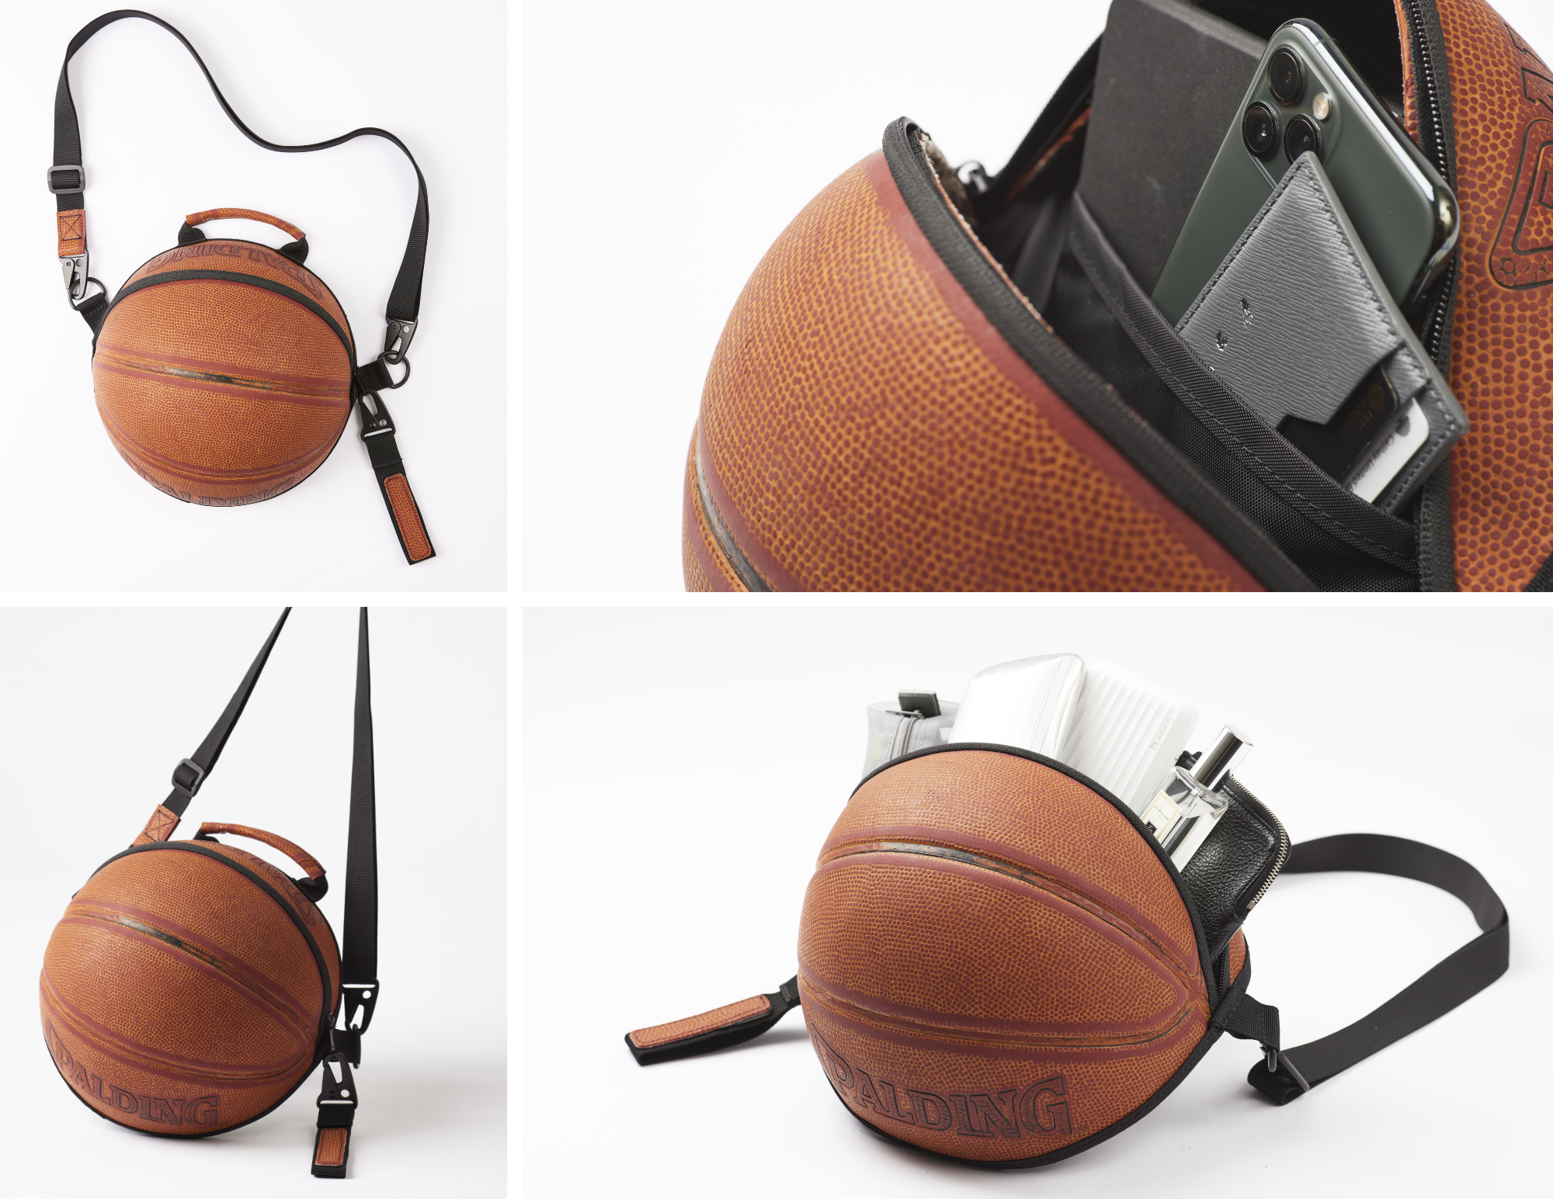
Reball project
Collect unwanted/poor conditions basketballs
Clean—>Redesign—>send to factories
Why:
  Passion+SDGs
  Not able to recycle (rubber, leather)
  with the new design, reuse about 80%
製作網頁
市場調查表單製作
social media acc run
準備打廣告
跟嘖嘖討論銷售計劃

Slide 14
Why Fuhsing Impact Club? 為什麼要來復興影響社呢?
Learn related knowledge
學習到相關知識
Helpful for application
對於升學有幫助
Diverse activities
多元的活動
Flexible and unburdened courses
彈性且無負擔的課程

Slide 15
Other Information其他資訊
Club fee社費
➠ 500$NTD/元
(Before the end of the semester, if there is any remaining club fees, it will be returned on average or activities will be held
在學期結束前如果有剩的社費會平均發回或開同樂會)
Notices注意事項
➠ Participate in club activities as much as possible on holidays 假日盡量多參加社團活動
➠ Please don’t chat and play with phones during club time 請不要在社課時聊天和玩手機
(Especially in classes with lecturers, pay more attention 尤其是有請講師的社課要更加注意)

Slide 16
Thanks!
Do you have any questions?
]]

