Slide 1
Taipei Fuhsing Robotics
復興機器人研究社
星期二社團 + 5:45PM ~ 7:30PM 機器人研習課程

Slide 2
Table of Contents
1
2
3
4
Introduction
The FRC Competition
Basic information about our club, philosophy, goals, and activities
Introduction to the annual FRC competition we participate in
Awards and Works
Club Expectations
Past results from the FRC and various activities
Expectations for students interested in joining the Robotics Club

Slide 3
For 8th Grade or Above…
Due to the course arrangement and administrative difficulties, starting from the next semester, our club will be changed to require a form interview.
Students who want to participate in the Tuesday evening 5:45PM-7:30PM program also need to participate in the Tuesday 8th period club class, and vice versa. This policy also applies to current club members.
因為課程安排以及行政上的銜接，從下學期開始加入機器人社的同學，更改為需要經過表單面試。
想要參加星期二晚上 5:45PM-7:30PM 社課的同學也需要參加星期二第8節社課，反之亦然。(此規定也適用於現任社員)
Notes:
V

Slide 4
Introduction
Our Robotics Club is Taiwan’s 4th FRC (FIRST Robotics Competition) team and is called Savage Tumaz, named after Taiwan’s aboriginal black bear “Tumaz”.

Slide 5
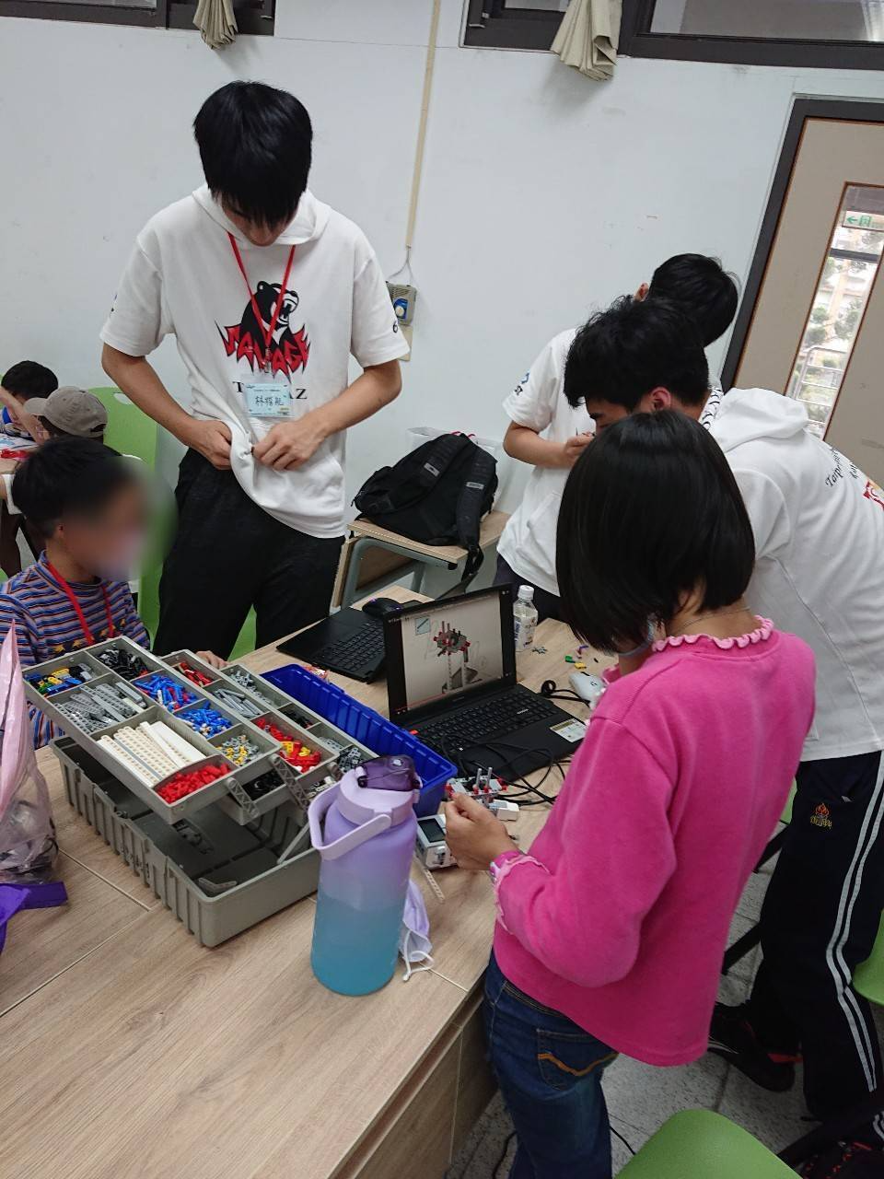
Our Activities
Tuesday Club Time
We provide Robotic learning opportunities during Tuesday Club
After School Activities
Every Tuesday 5:45PM-7:30PM, we host Robotic Programs
STEM Competitions
Regional and International FRC Competitions
Community Service
Hosting robotics camps with the Taiwan Fund for Children and Families
We are working with Fuhsing’s Interact Club to reach to joy of robotics into even more communities!
Notes:
V

Slide 6
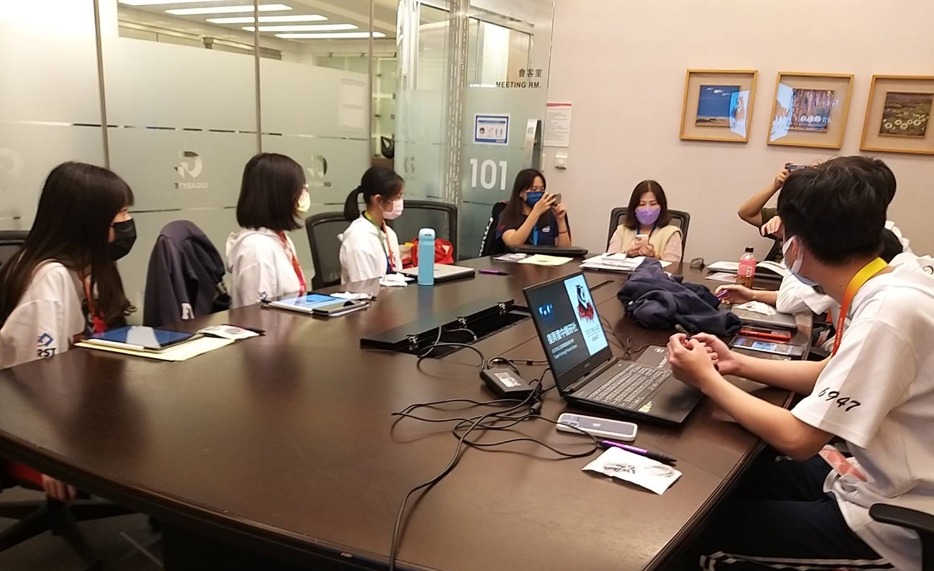
Our Goals
Participate in the FRC and a variety of STEM competitions
Helps members grow and find your passion among a broad range of possibilities (it doesn’t have to be in STEM or the field of Robotics!)
Establish members’ social impact through Community Services
Training critical thinking, problem-solving, and communicating skills

Slide 7
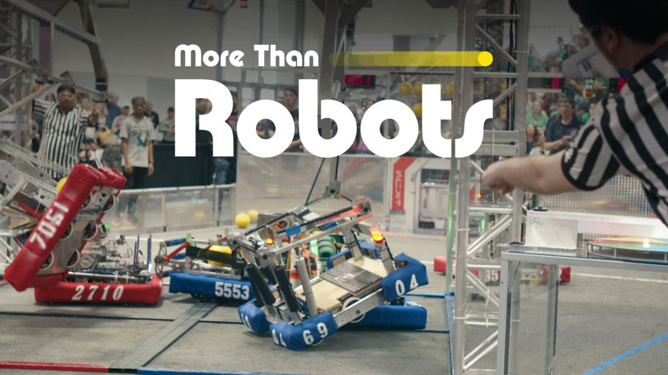
FRC is More than Robots
Literarily, it’s their slogan. We’re looking for…
Mechanics
anyone interested in robot-building
Social Media Managers
to communicate with other teams and help us enrich our digital presence
Designers
who aspire to make their ideas into life
Gamers
to control the robot during high-stress environments
Administrative Managers
Programmers
……….
The list continues! TLDR; if you are willing to participate, you’d probably find a place in our club!
Notes:
V

Slide 8
The FRC Competition

Slide 9
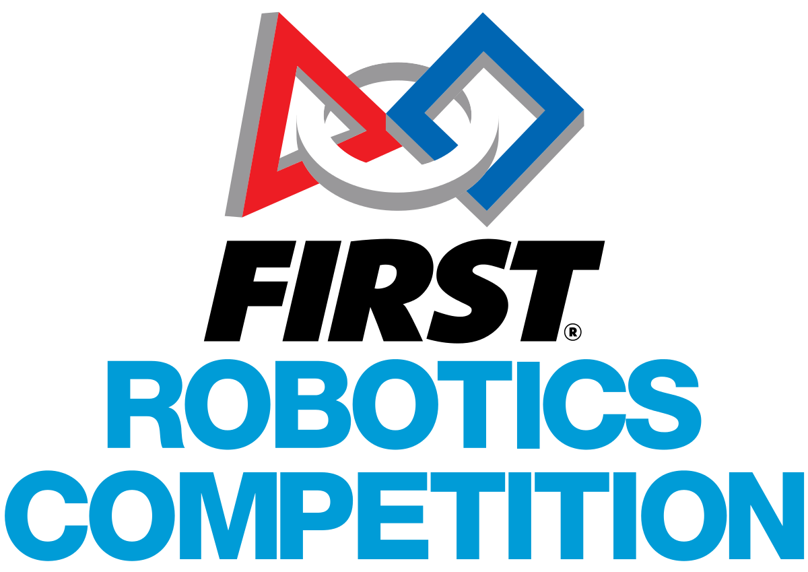
What is FRC?
The FRC is the FIRST Robotics Competition
Organizer: FIRST- For Inspiration and Recognition of Science and Technology
Each team makes 1 robot and program the robot to solve autonomous and remote-controlled tasks.
Usually takes place between March and May of each year, with each year’s prompt being released in late December -January
2020/2021 game animation- Infinite Recharge
2022 game animation- Rapid React
2023 game animation- Charged Up
2024 game animation- Cresendo
Notes:
build season時 打造 編譯程式
完成自動&手動的任務
2019-2022年的比賽題目的animation
但因為時間關係 我們就看看今年的比賽片段

Slide 10
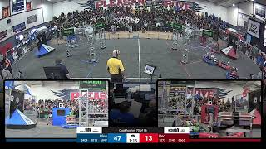
Timestamp: 1’30’’ - 2’25’’

Slide 11
Awards &
Works

Slide 12
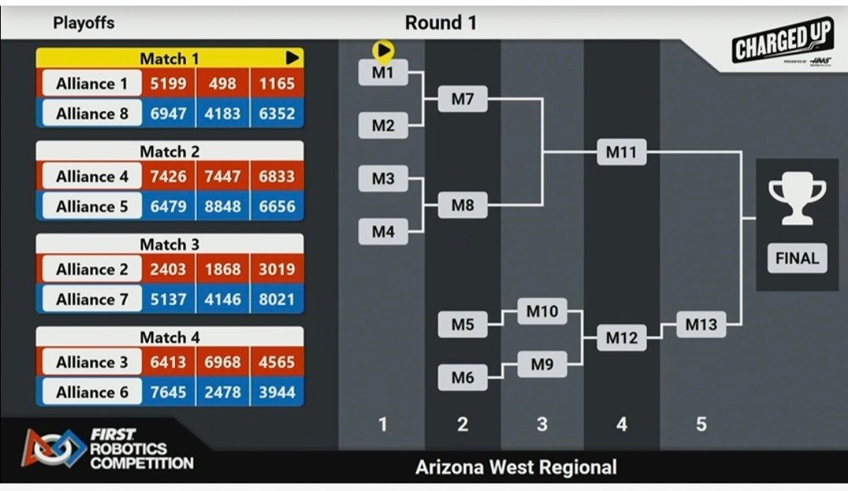
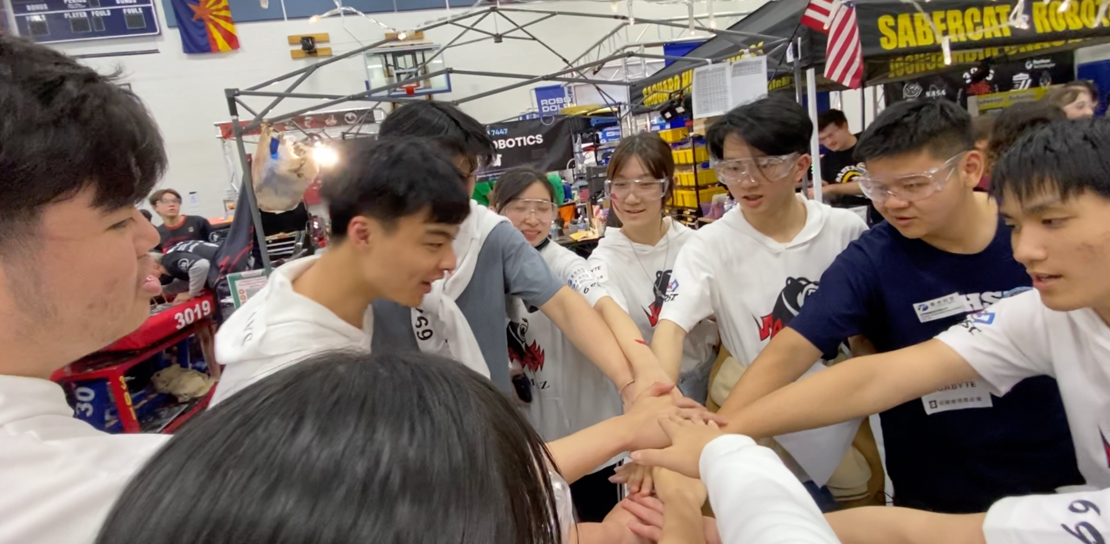
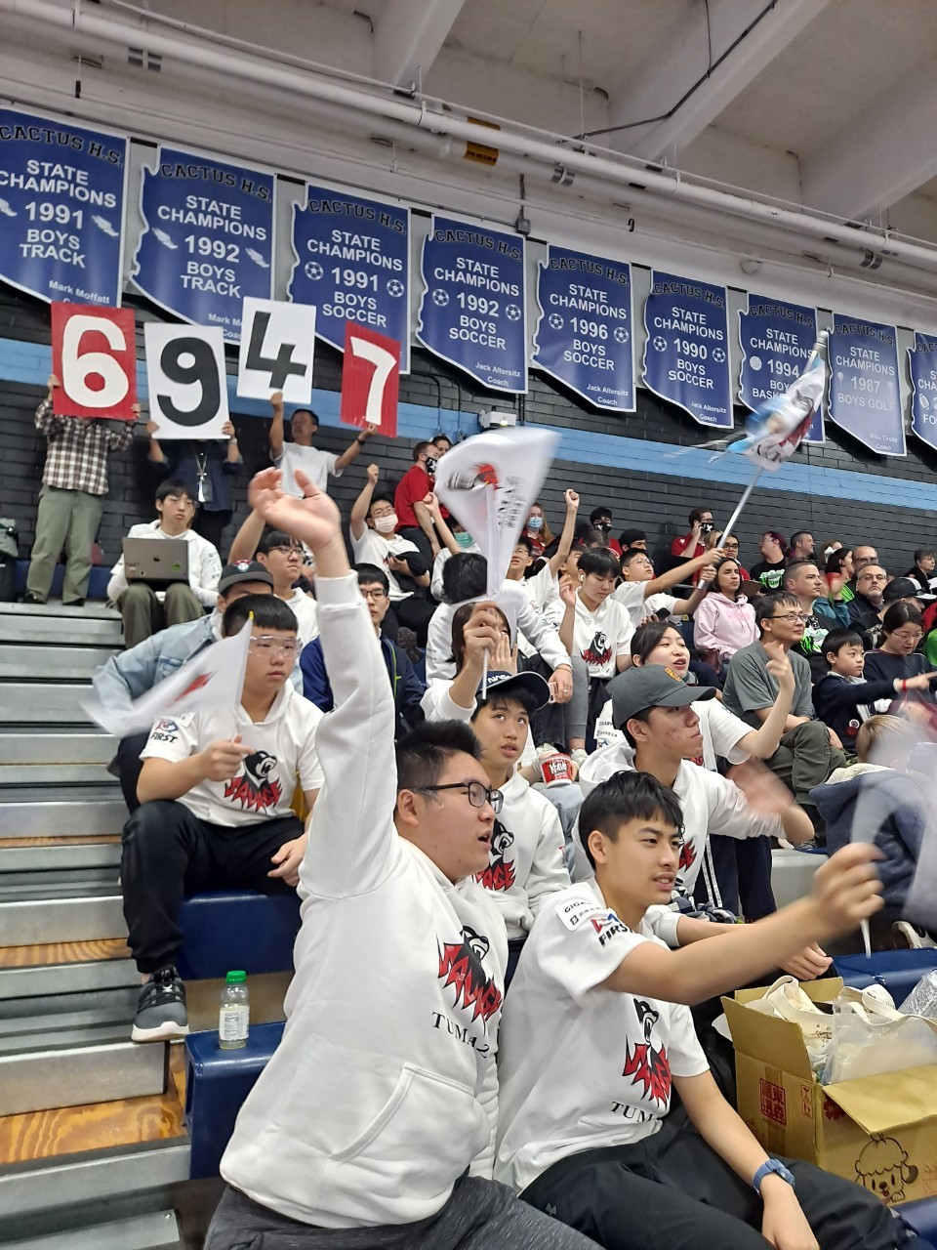
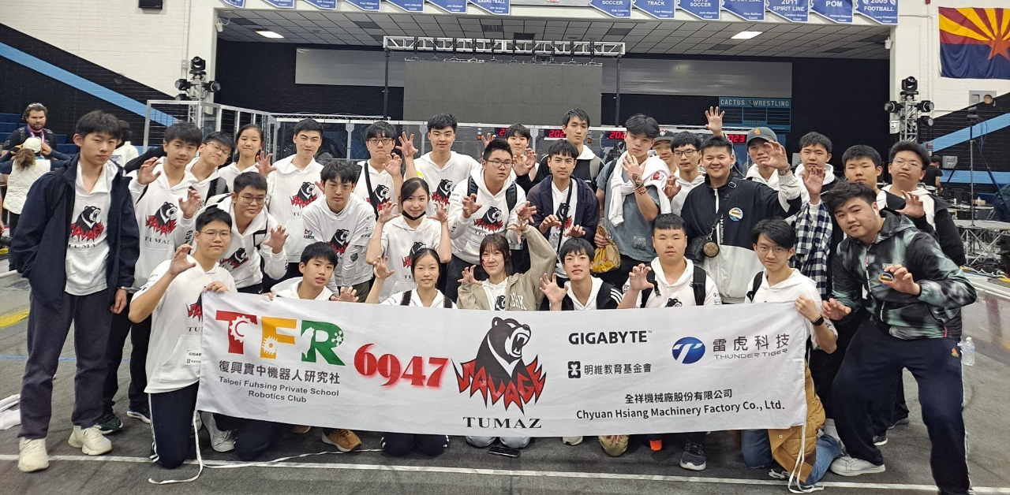
What we’ve won
FRC Competitions
2018 FRC Rookie-All Star
2019 Entrepreneurship Award
2020 Creativity Award
2020 Finalists
2021 Game Design- Imagery Award
2022 FRC Robot in 5 Weeks 影片競賽 第二名
2023 FRC Arizona West Regional Alliance 8 Captain
2024 FRC Sacramento Regional Autonomous Award
Notes:
2018年是參加比賽的地年 獲得了rookie all star
而今年獲得了影片競賽的第二名

Slide 13
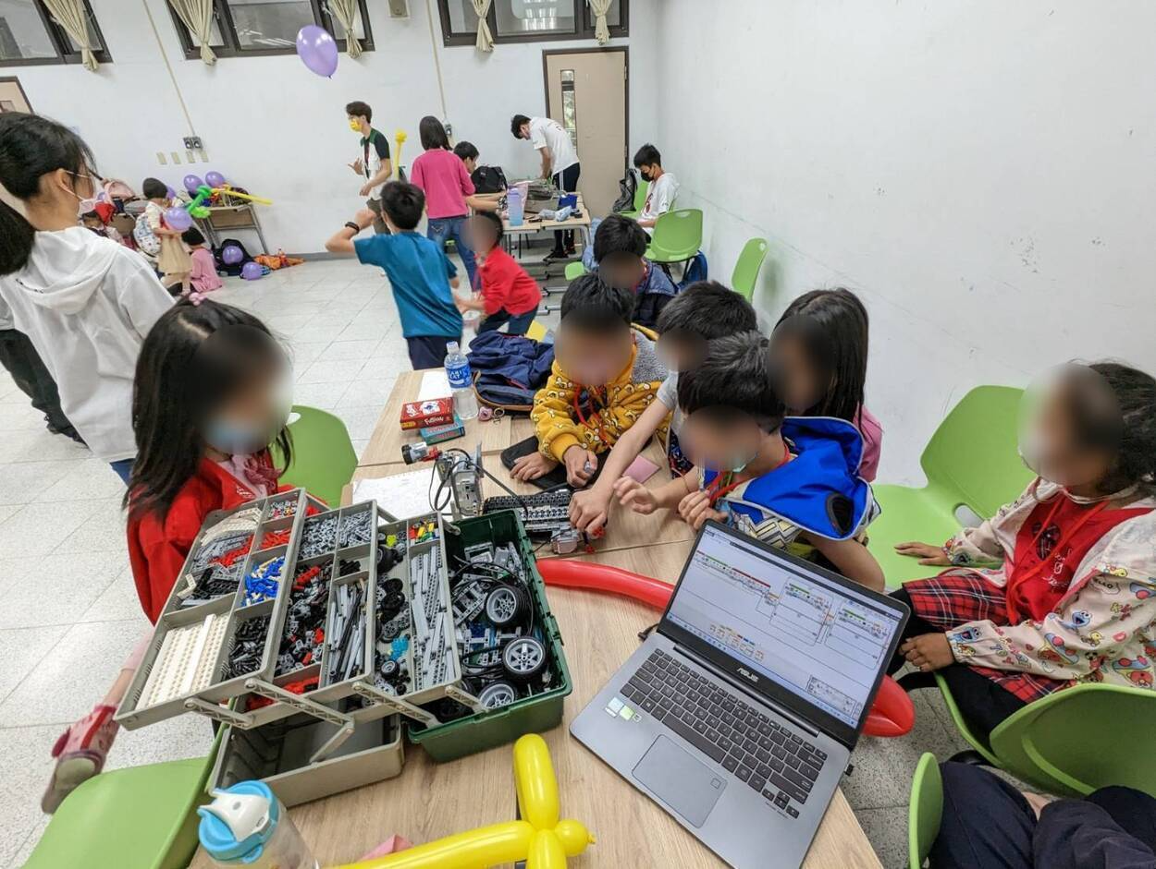
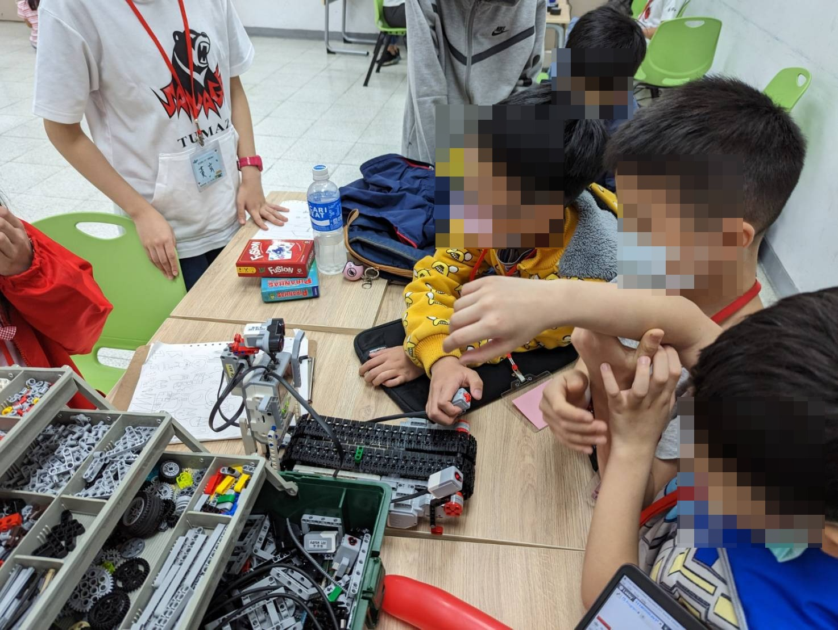
What we’ve done
Volunteering Services
We’ve collaborated with the Taiwan Fund for Children and Family Organization for over 5 years now, periodically hosting Lego EV3 robotics camps with 30+ club members volunteering and 100+ children participating throughout the past few years.
We are currently working with Fuhsing’s Interact Club to reach to joy of robotics into even more communities!
Notes:
志工活動
每年我們都會與家扶合作
這4年來 透過ev3和機器人教學 我們已經幫助了超過百位的小朋友
右邊是

Slide 14
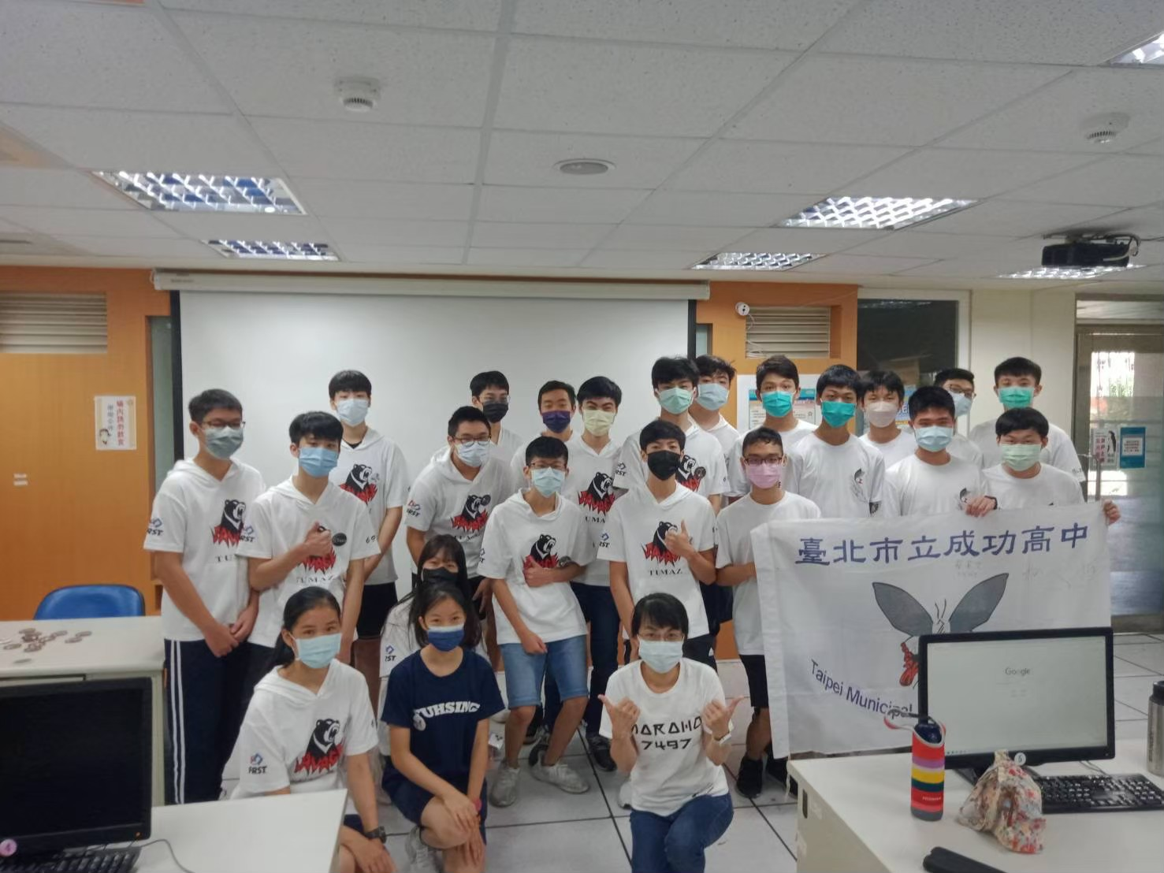
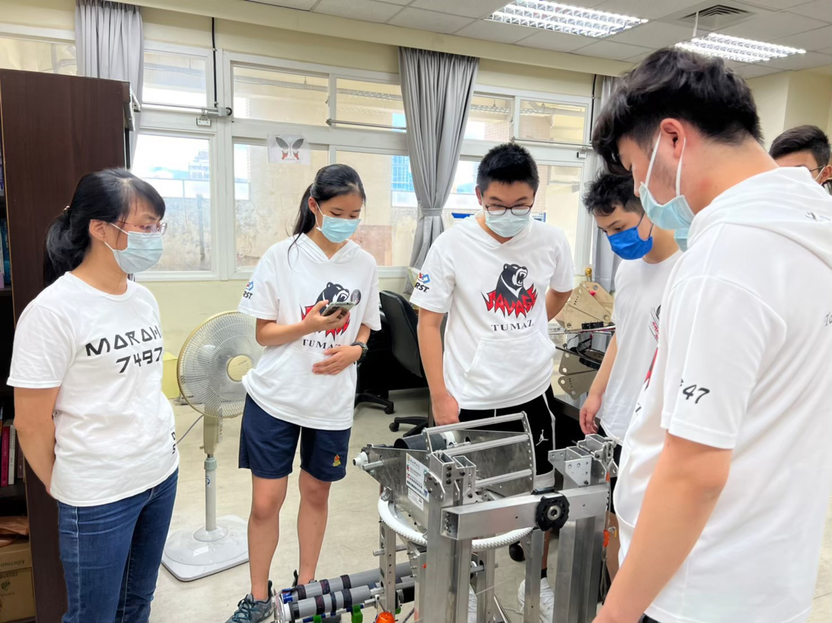
What we’ve done
Publicity & Socializing
As one of the first FRC teams in Taiwan, we’ve hosted seminars and experience-sharing events for budding FRC teams and furthered our mentorships for other newly created teams, such as Team CyberPunk from 建國中學, and 成功高中. Furthermore, we’ve been all around Taiwan, participating in different charity and competitive events to spread the FIRST spirit.
台北區域聯盟
Notes:
first lady
鼓勵女性參加stem相關的活動
另外 我們也和其他frc隊伍培養了豐厚的感情 我們曾經幫助建中和成功高中創立他們的frc隊伍，並且互相參觀學校，互相分享機器人的知識

Slide 15
Club
Expectations

Slide 16
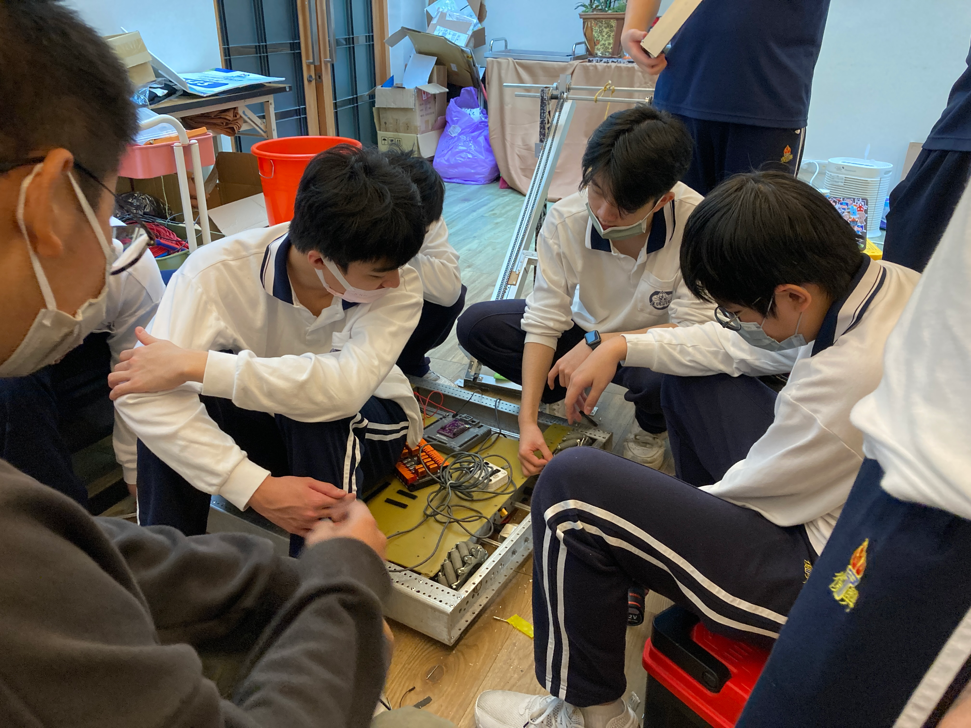
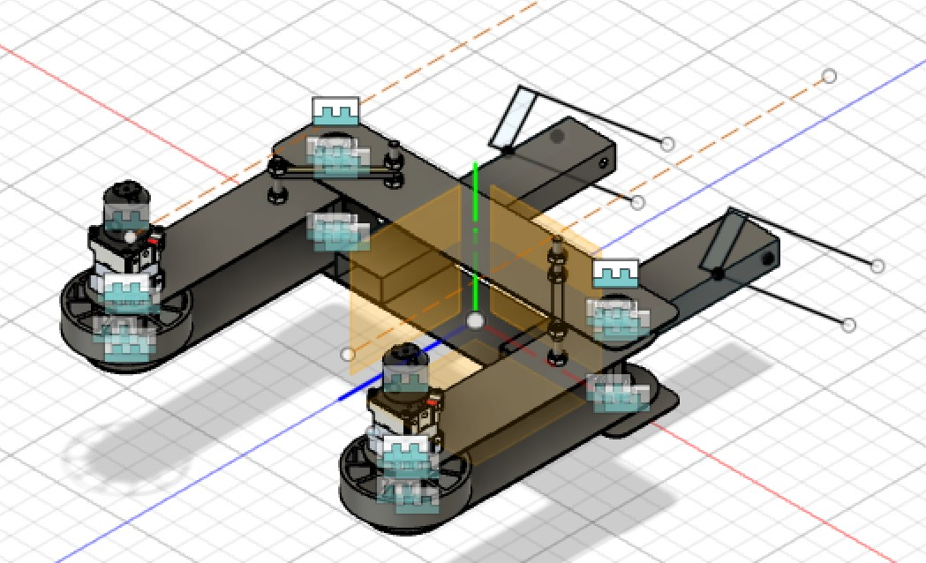
Club Expectations
Expect club activities (outside of school) to take up your time during winter break or weekends
Be willing to share your ideas and participate in discussions
Be ready to get your hands dirty and learn new skills with hands-on experience
Be on task and reach out/volunteer as much as possible. You are in charge of finding your own opportunities.
Notes:
V

Slide 17
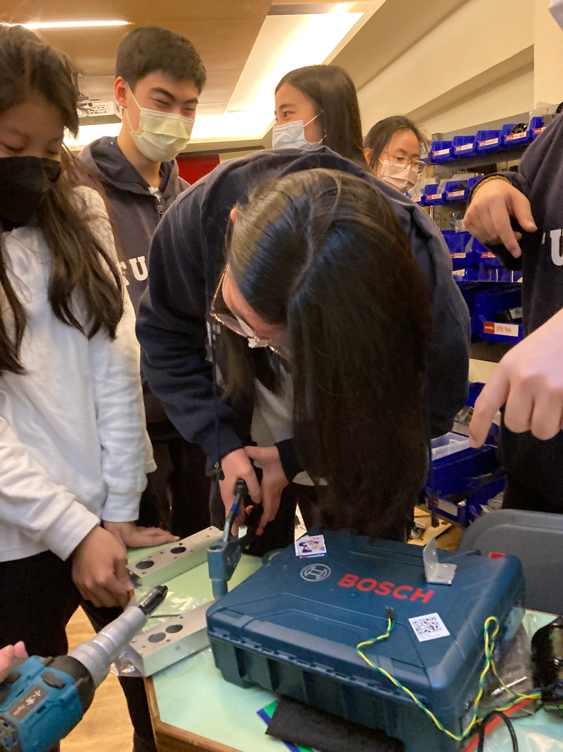
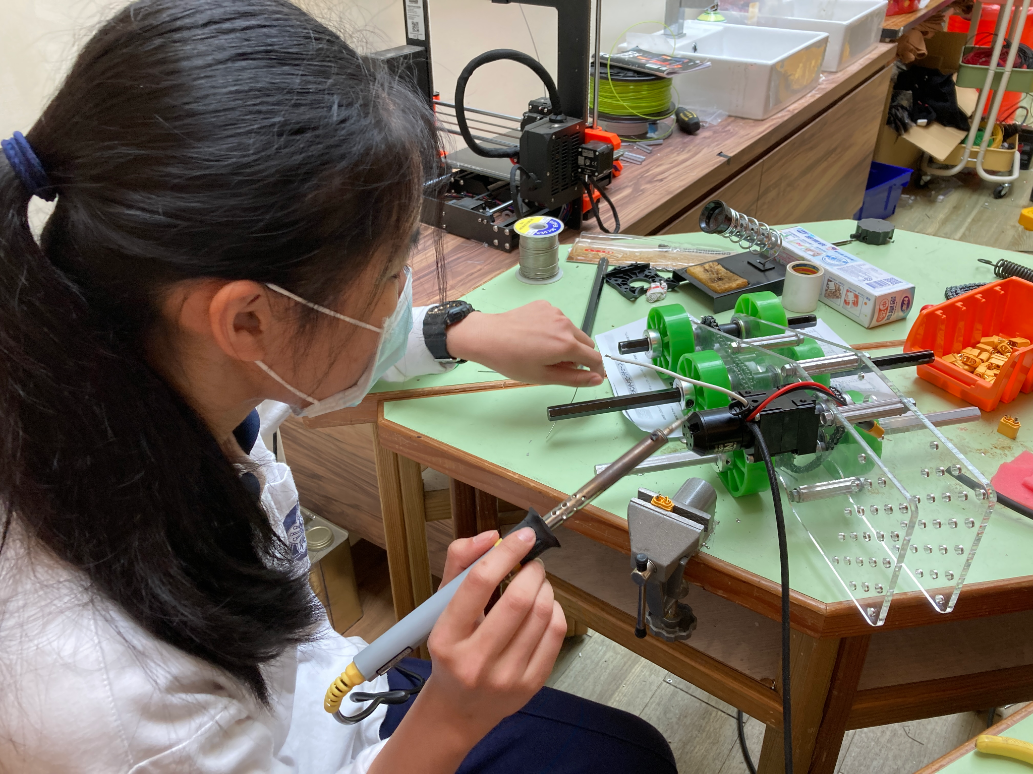
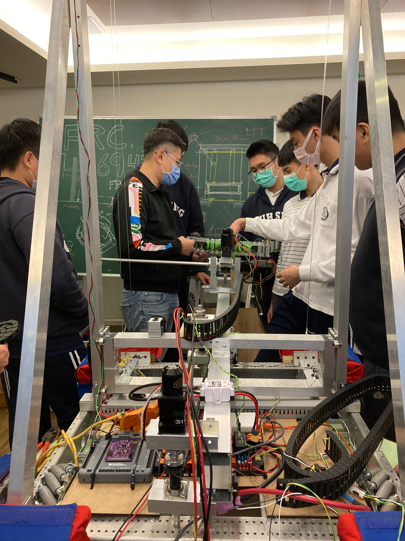
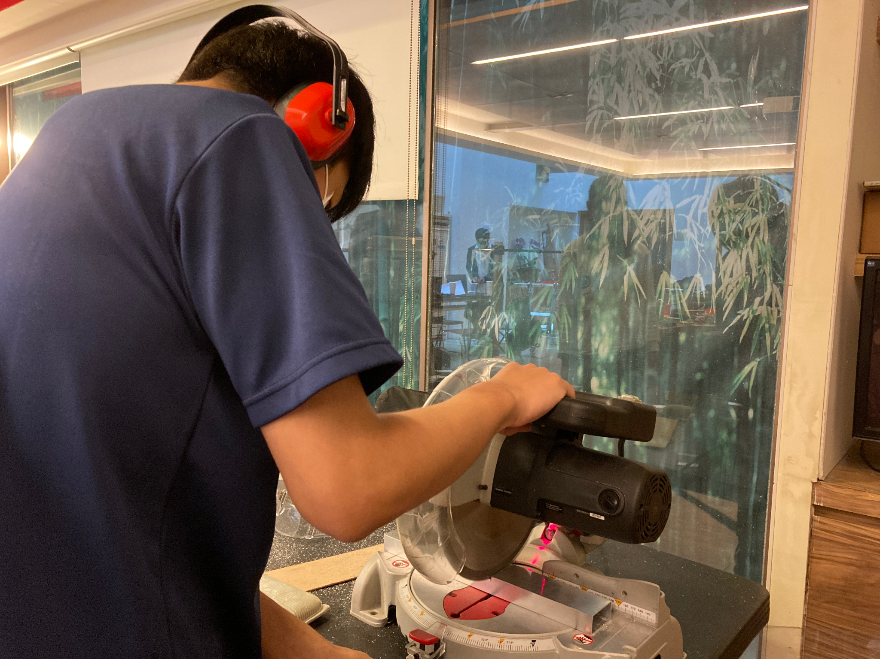
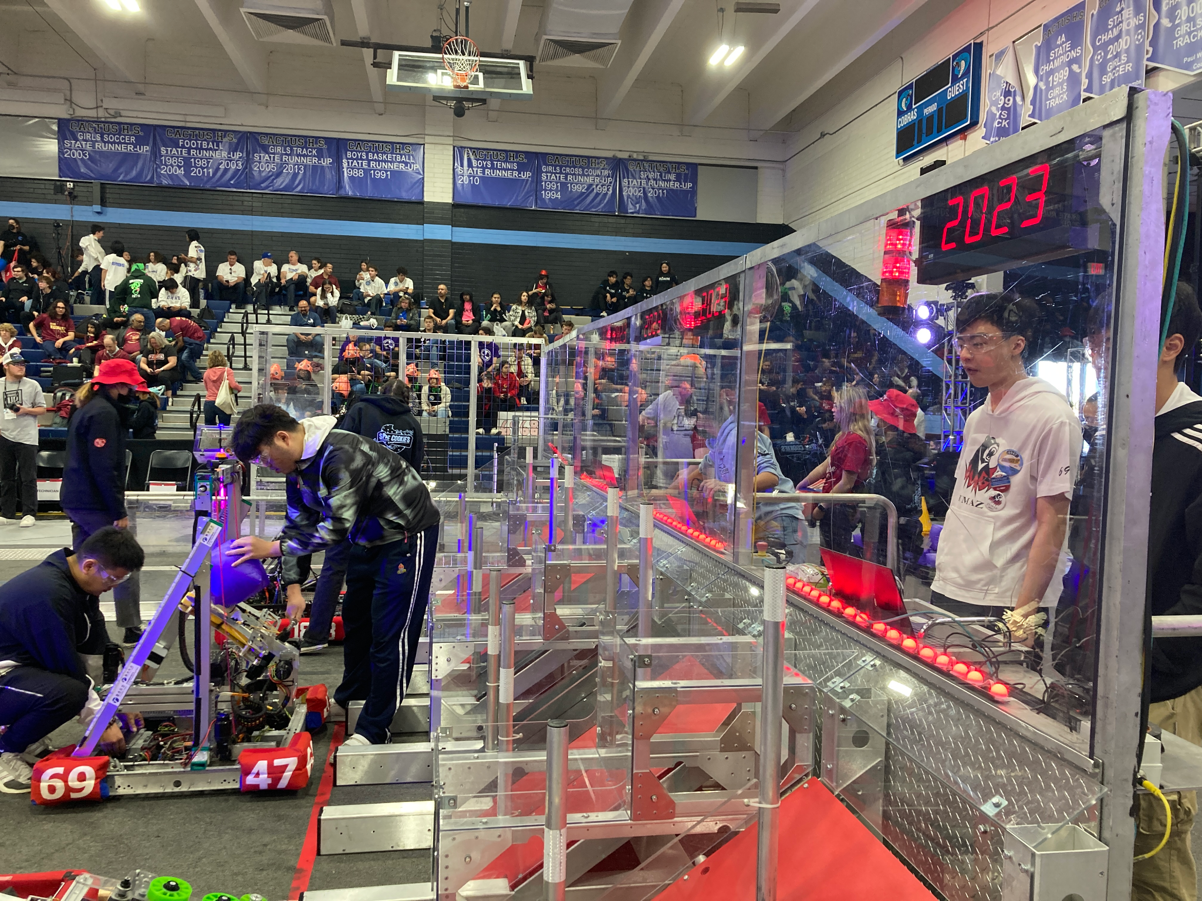
社團照片

Slide 18
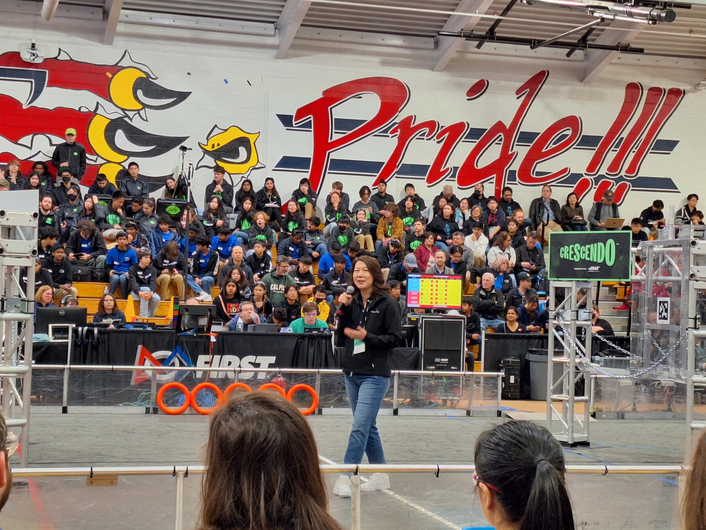
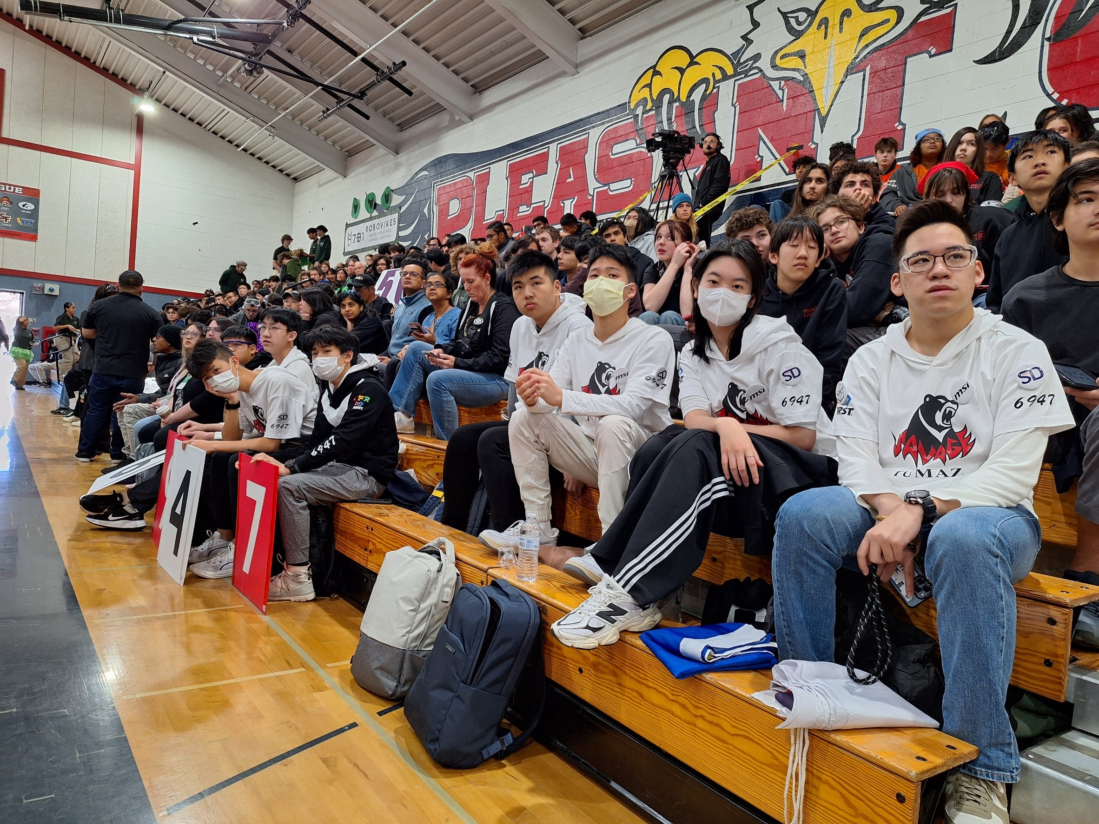
2024 FRC Sacramento Regional

Slide 19
40+
Students have committed to us. Contact us for more information!

Slide 20
SIGN UP NOW!
LINK:
https://forms.gle/AakssmLqcLT8ZiFj9
@savagetumaz_6947

