Slide 1
Photography
Club
SLIDESGO PHOTOGRAPHY CO
SLIDESGOPHOTO.COM
50MM F-0.95

Slide 2
前社長的 Photography

Slide 3
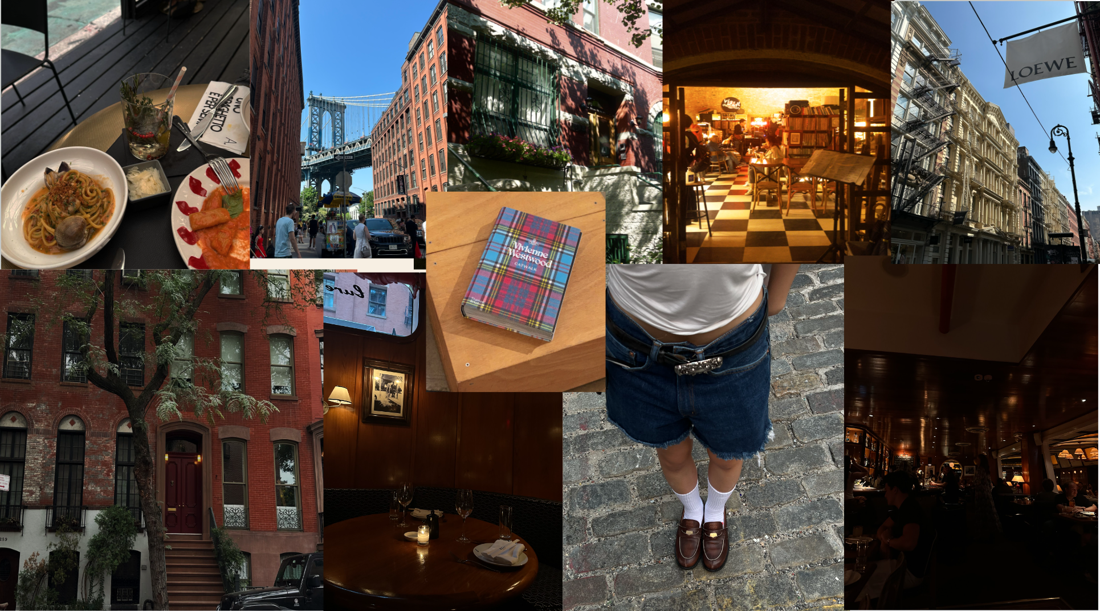

Slide 4
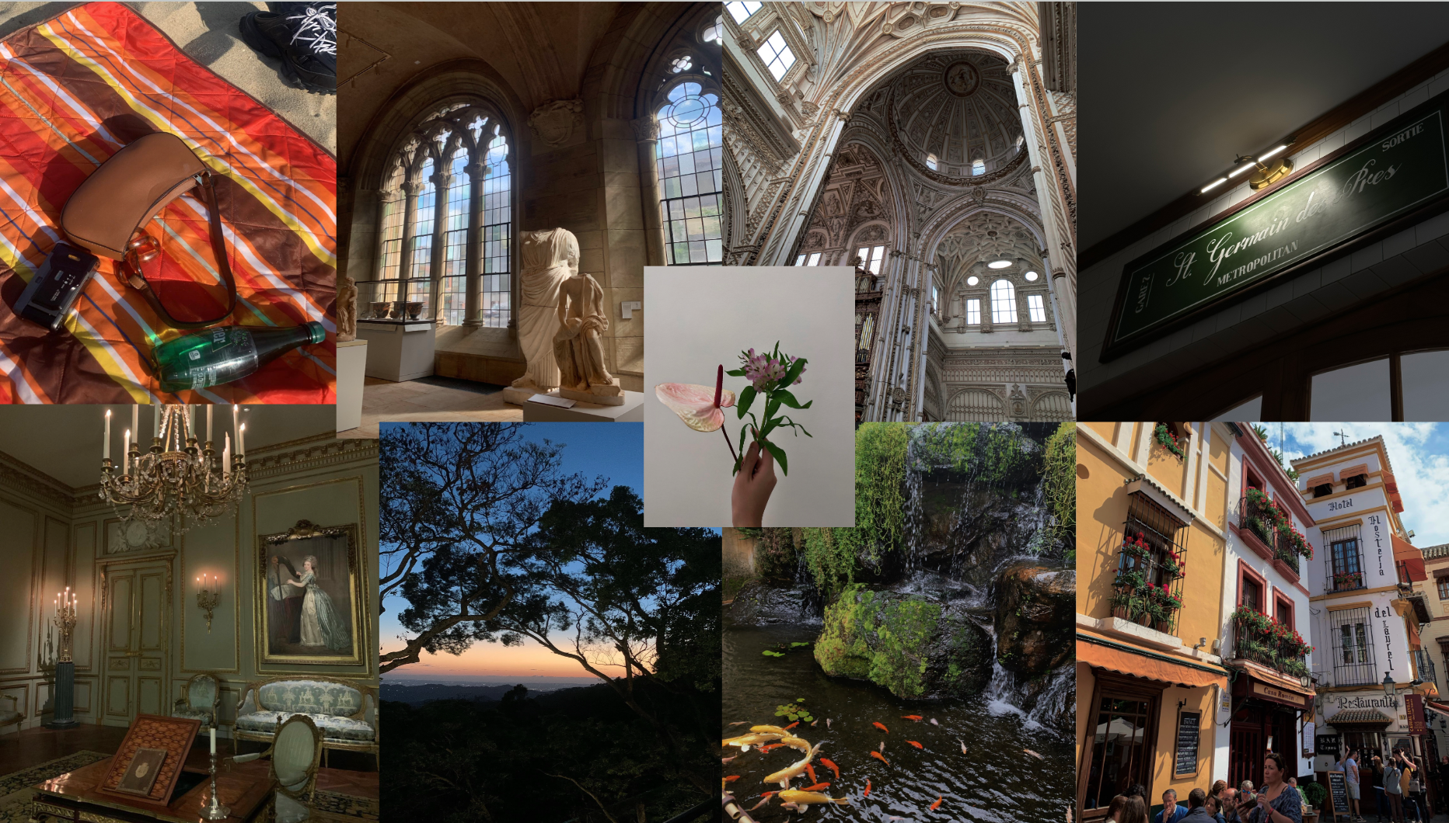

Slide 5
Table of Contents
SLIDESGO PHOTOGRAPHY CO
SLIDESGOPHOTO.COM
01
02
03
Introduction
Activities
Why join us?
Basic information about our club and goals
50MM F-0.95

Slide 6
Introduction
SLIDESGO PHOTOGRAPHY CO
SLIDESGOPHOTO.COM
The goal of photography club is to foster creativity, enhance technical skills, and promote artistic expression among students through the medium of photography. The club aims to provide a supportive environment where members can learn about various photography techniques, explore different styles and genres, and engage in hands-on practice.
50MM F-0.95

Slide 7
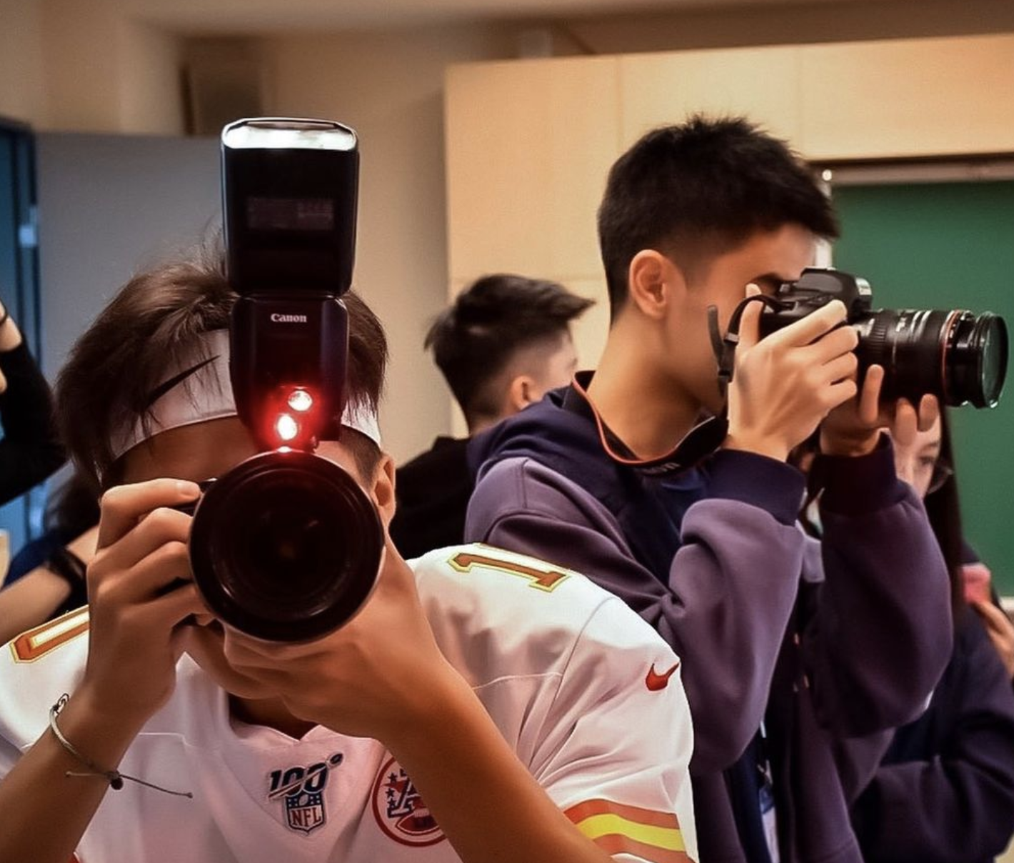
Class Breakdown
SLIDESGO PHOTOGRAPHY CO
SLIDESGOPHOTO.COM
希望各位是以實作為主，社團讓大家開開心心的過，不要一直坐著聽理論類的東西，所以：
15 min “lecture”
30 min 實作
社費 300元
50MM F-0.95

Slide 8
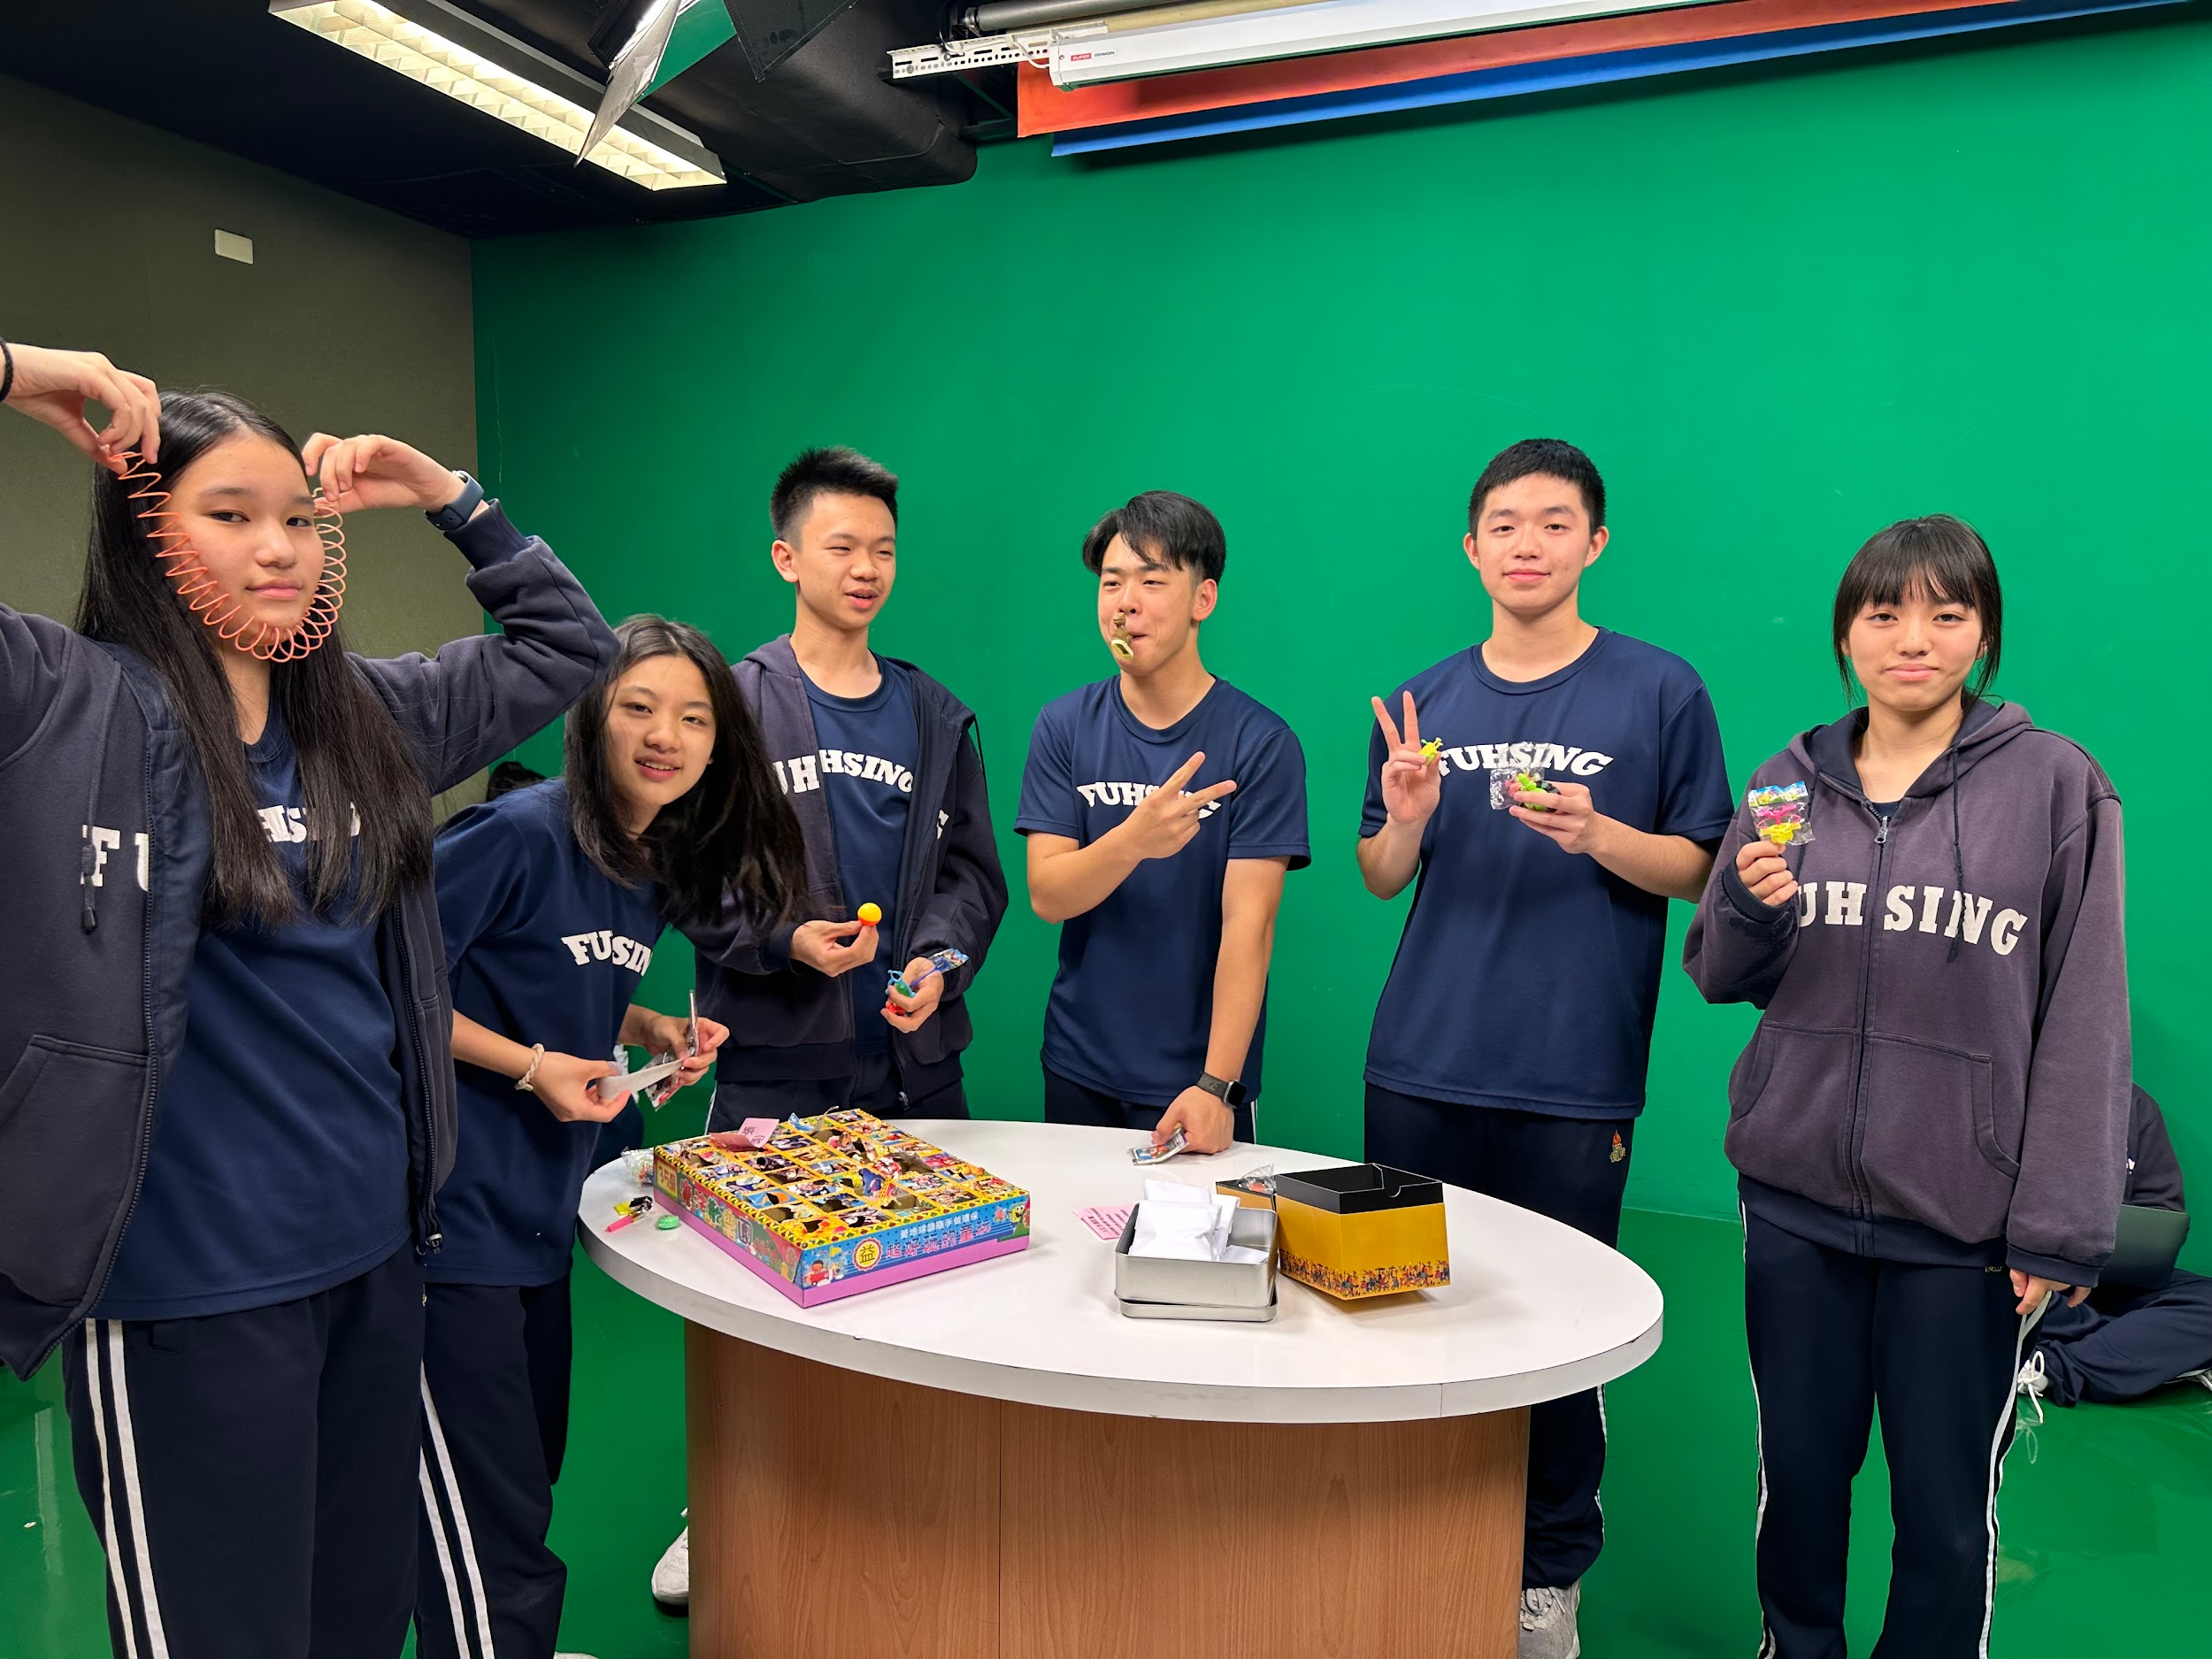
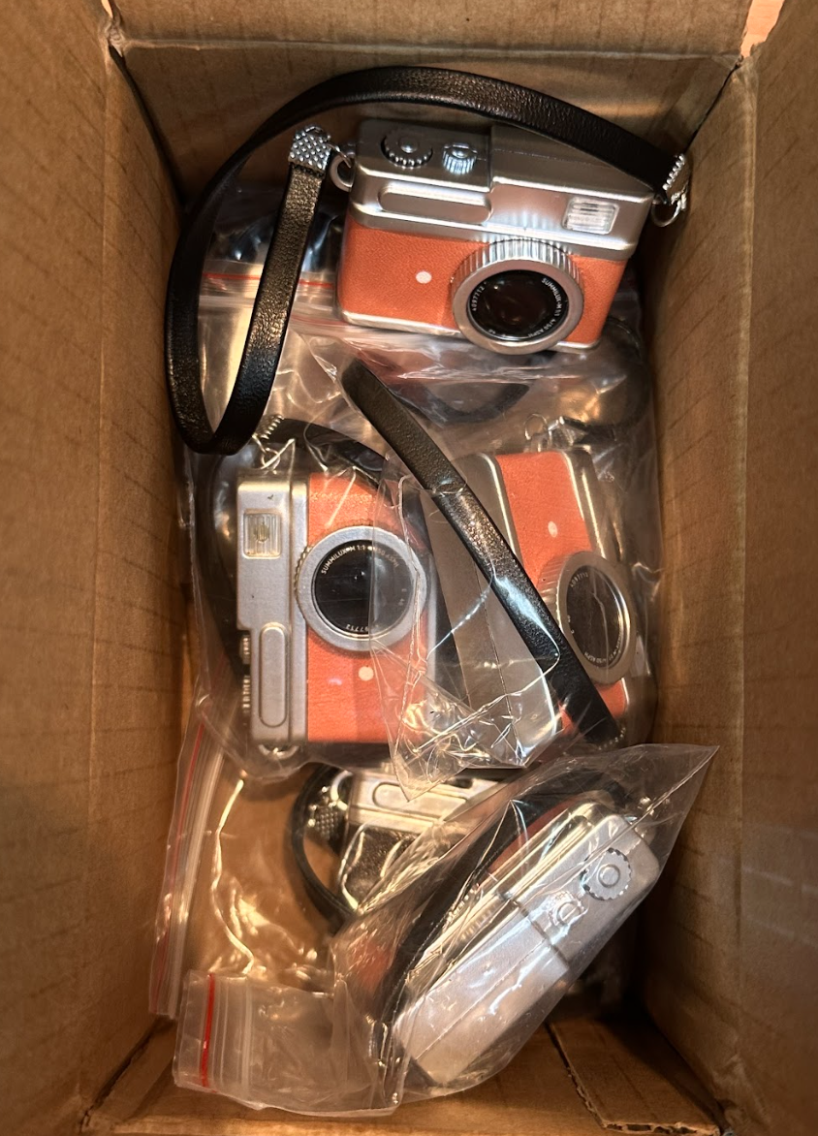
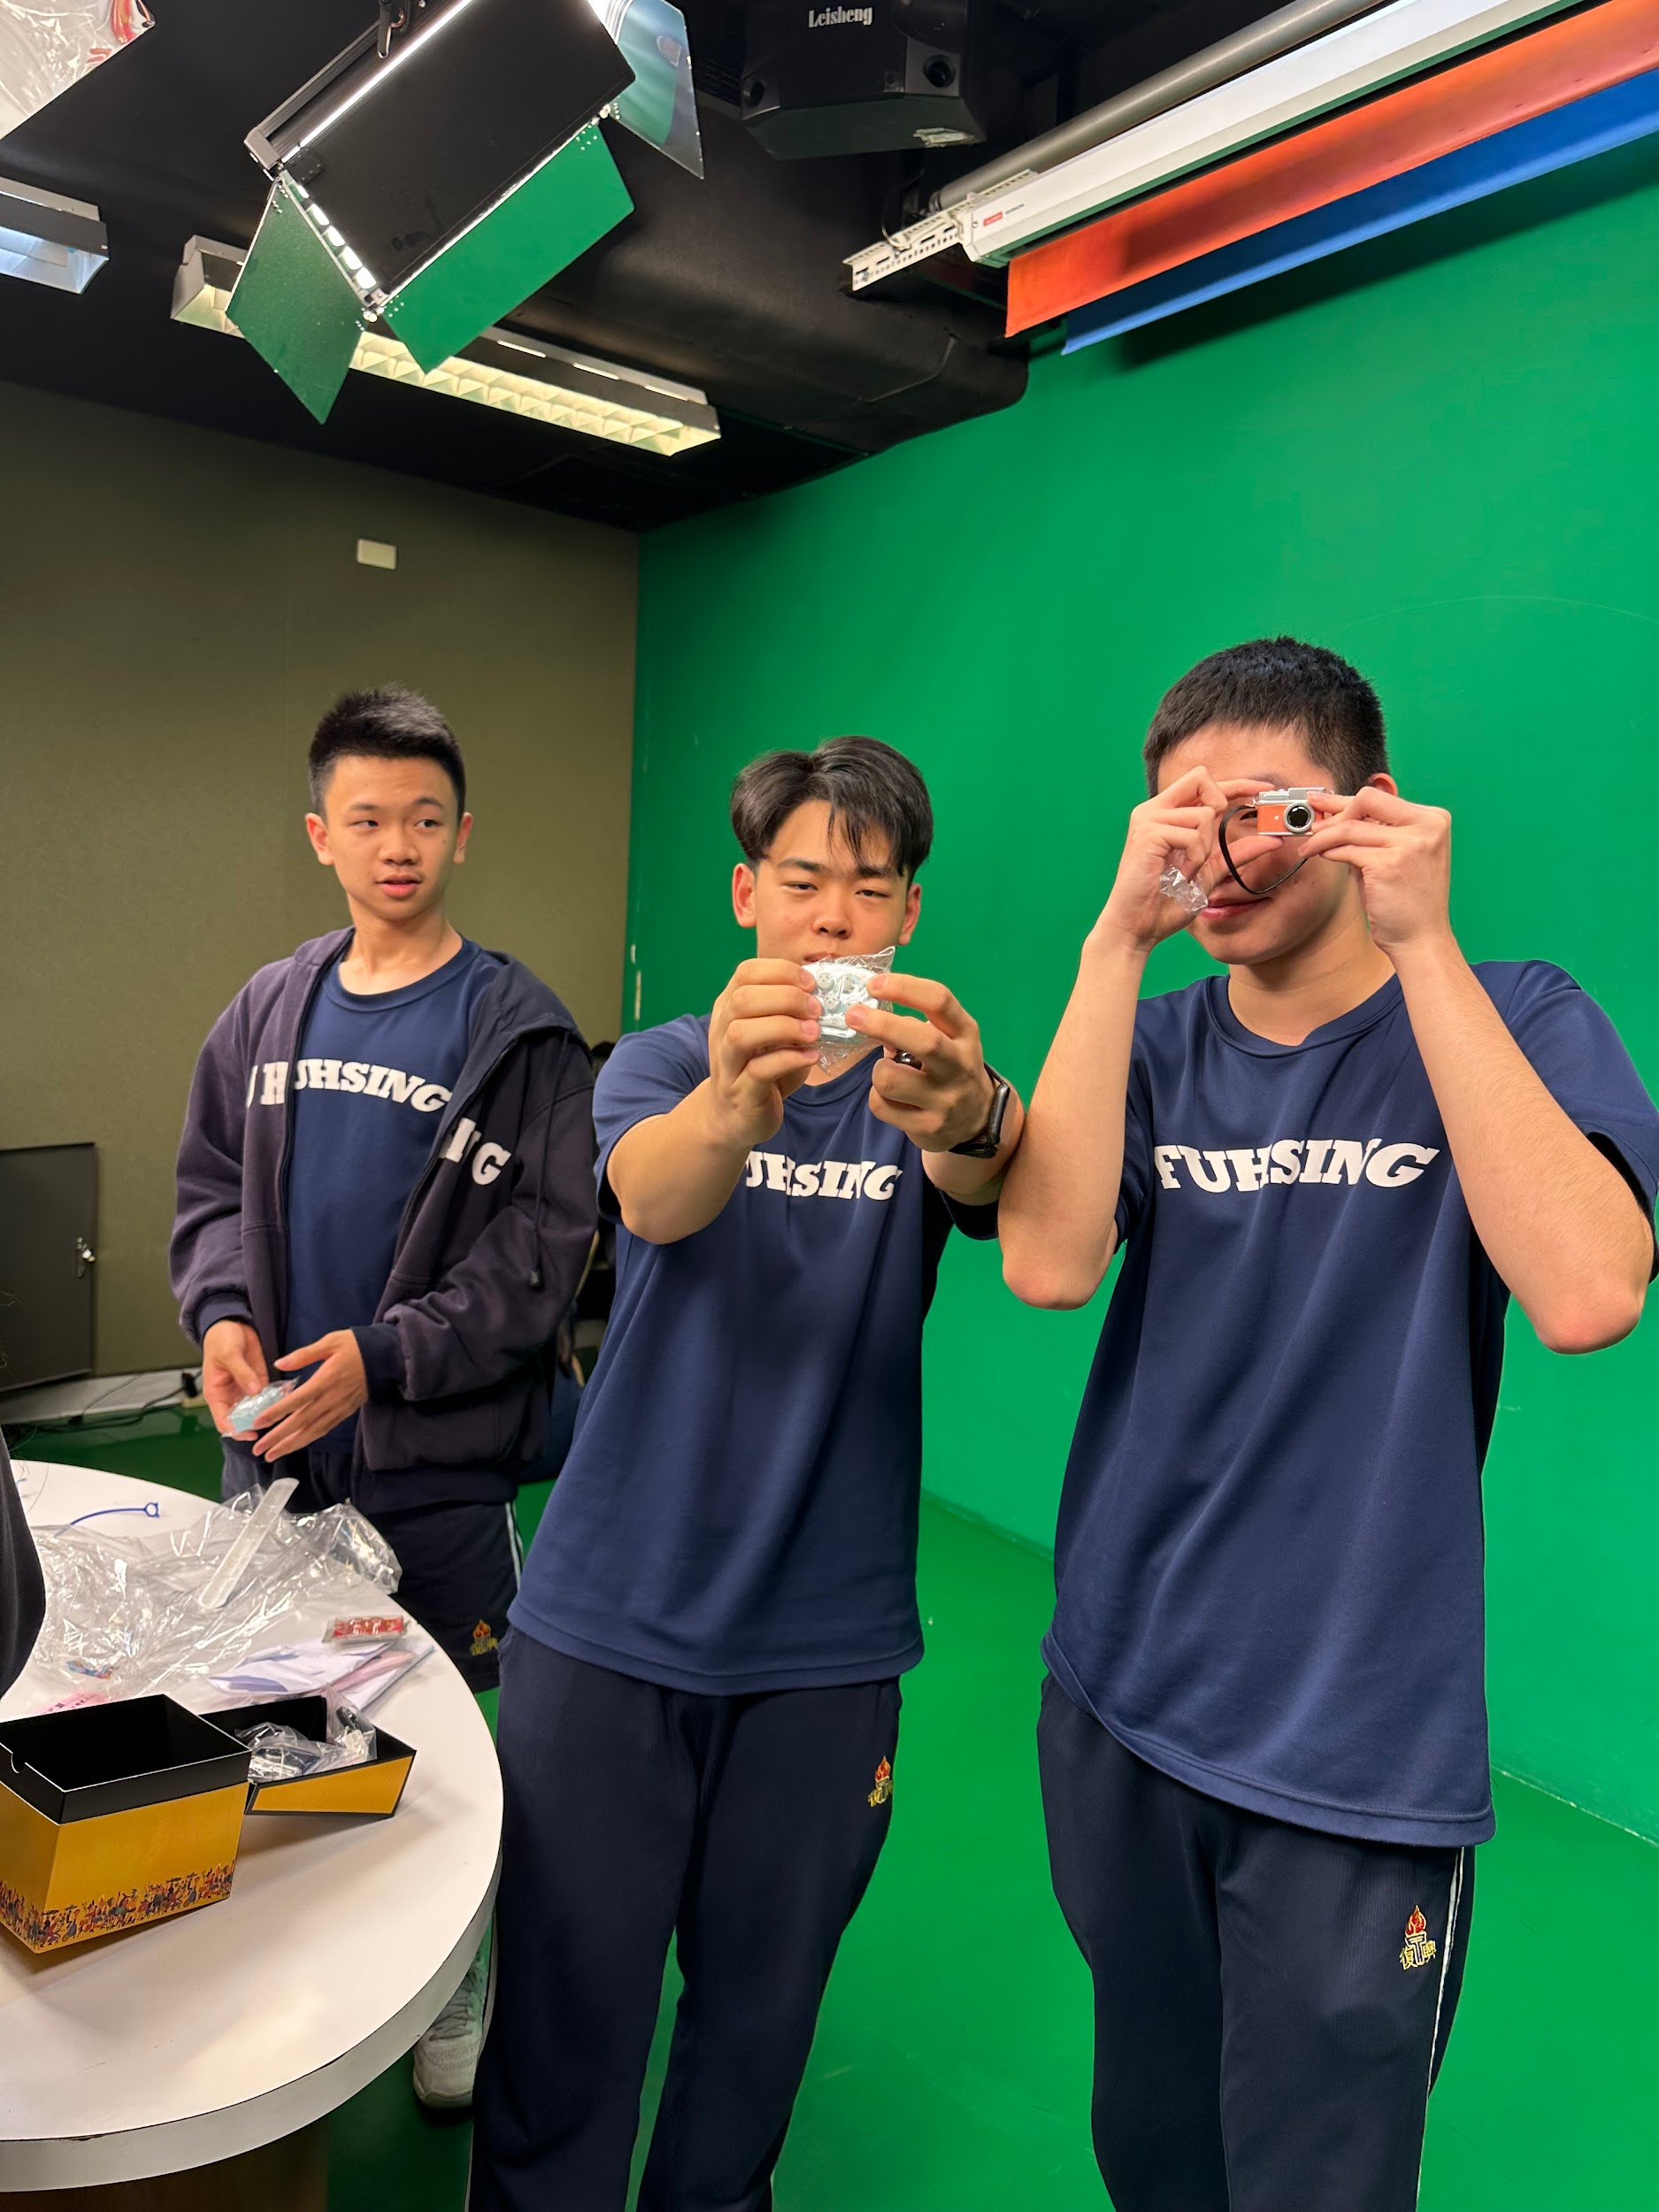
Themed Photography
SLIDESGO PHOTOGRAPHY CO
SLIDESGOPHOTO.COM
"Themed Photography” includes 5 themes (may change):
Portrait Photography 人像攝影
Low-key Photography暗調攝影
Long Exposure 長曝光
Panorama Shot 全景攝影
Macro Photography 微距攝影
The entire activity combines video teaching, shooting, submission of works and voting, allowing members to have a rich photography experience.
50MM F-0.95

Slide 9
Themed Photography Procedures
SLIDESGO PHOTOGRAPHY CO
SLIDESGOPHOTO.COM
Theme-Based Learning and Shooting:
At the start of each theme, club members watch corresponding teaching videos to gain a deeper understanding of the features and techniques of each topic.
Members then begin shooting, submitting one piece of work every two weeks before the end of each theme.
The teacher and club president evaluate members' performance through Google Classroom.
Voting and Rewards:
Among the five themes, a LINE group voting is conducted to select the champion work of each theme.
The work with the highest votes will receive a mystery gift.
End-of-Semester Showcase:
Members submit their most satisfactory photo taken during the semester.
The work must be straightforward and informal, include the author's class name, and indicate which of the five major themes it belongs to.
Captions accompanying the photos should express the members’ thoughts and feelings about their work.
50MM F-0.95

Slide 10
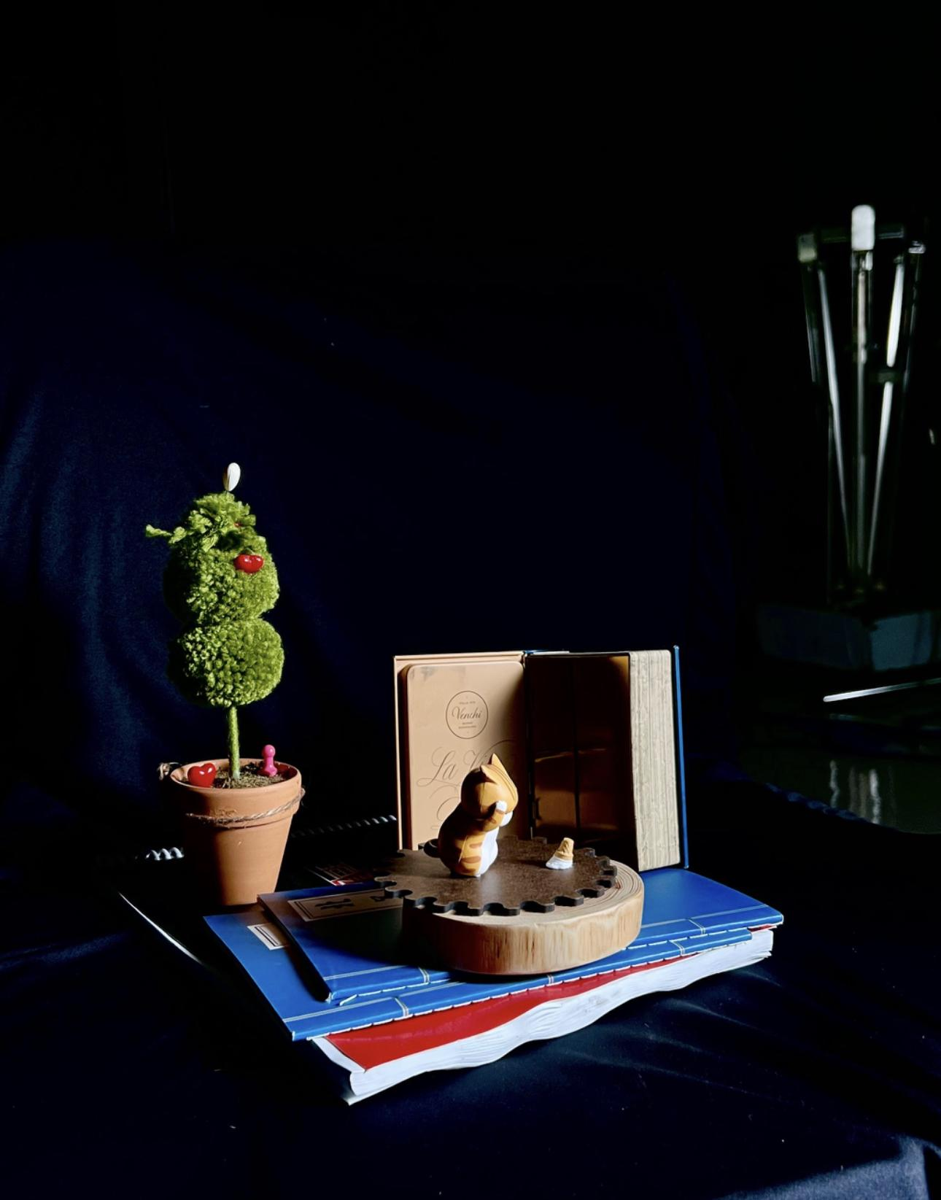
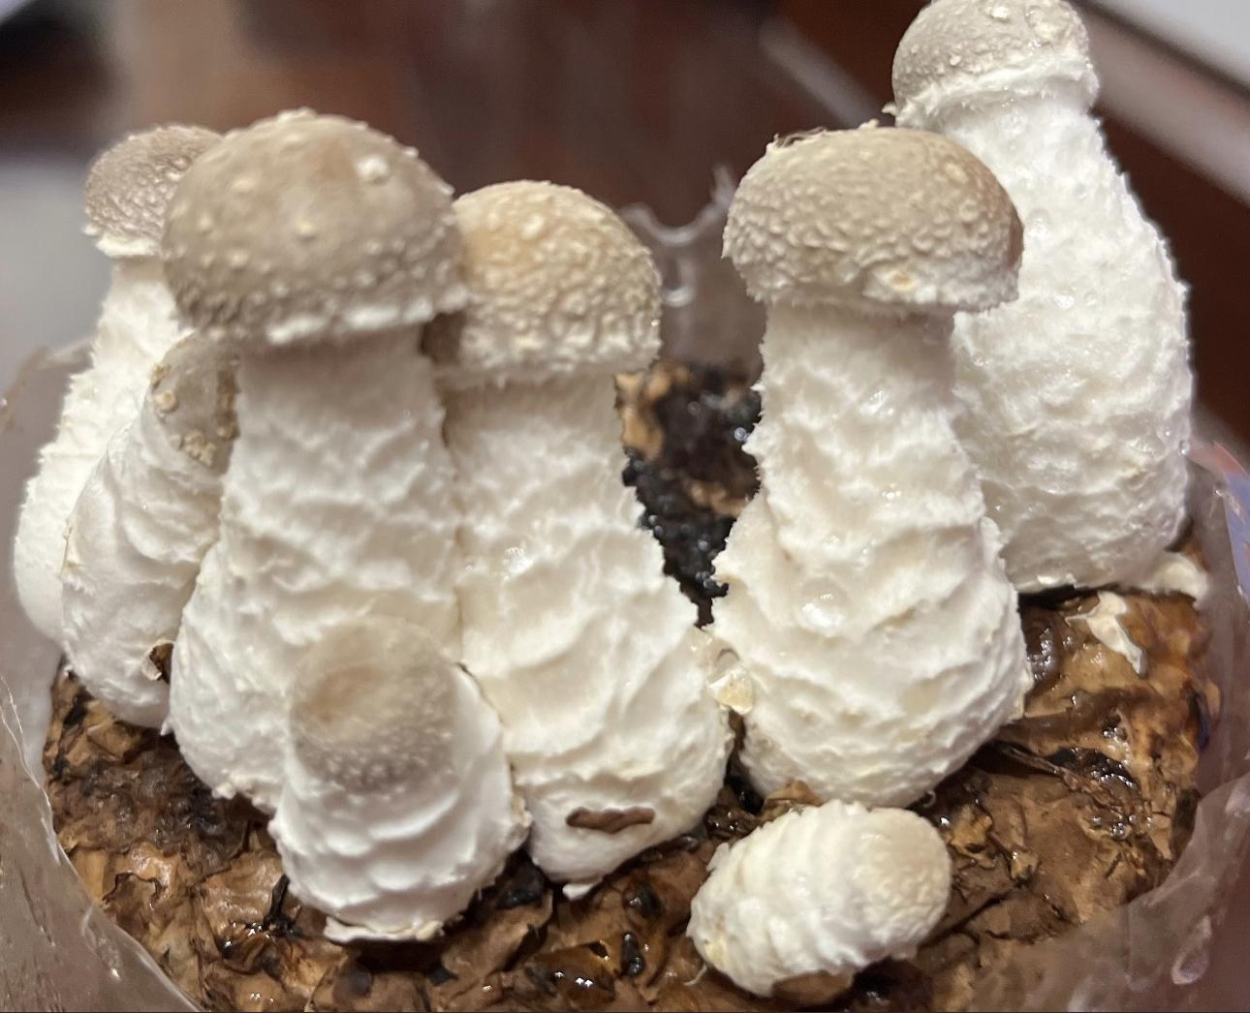
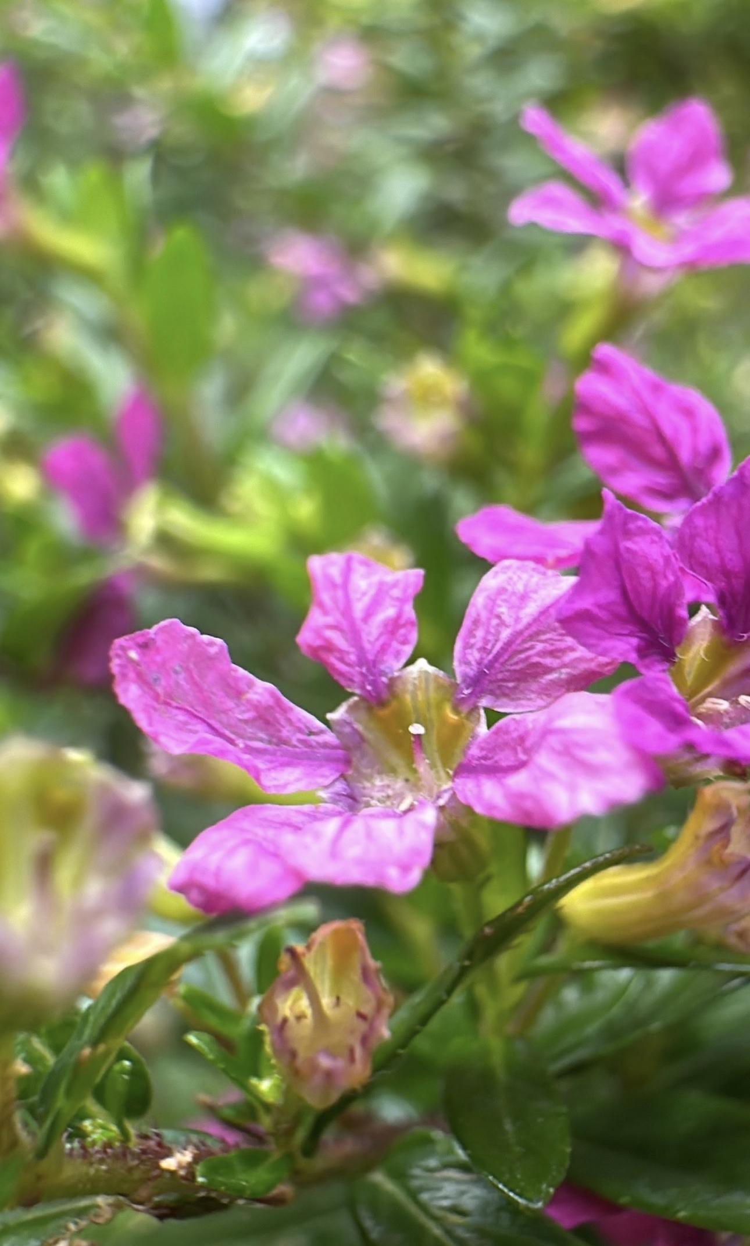
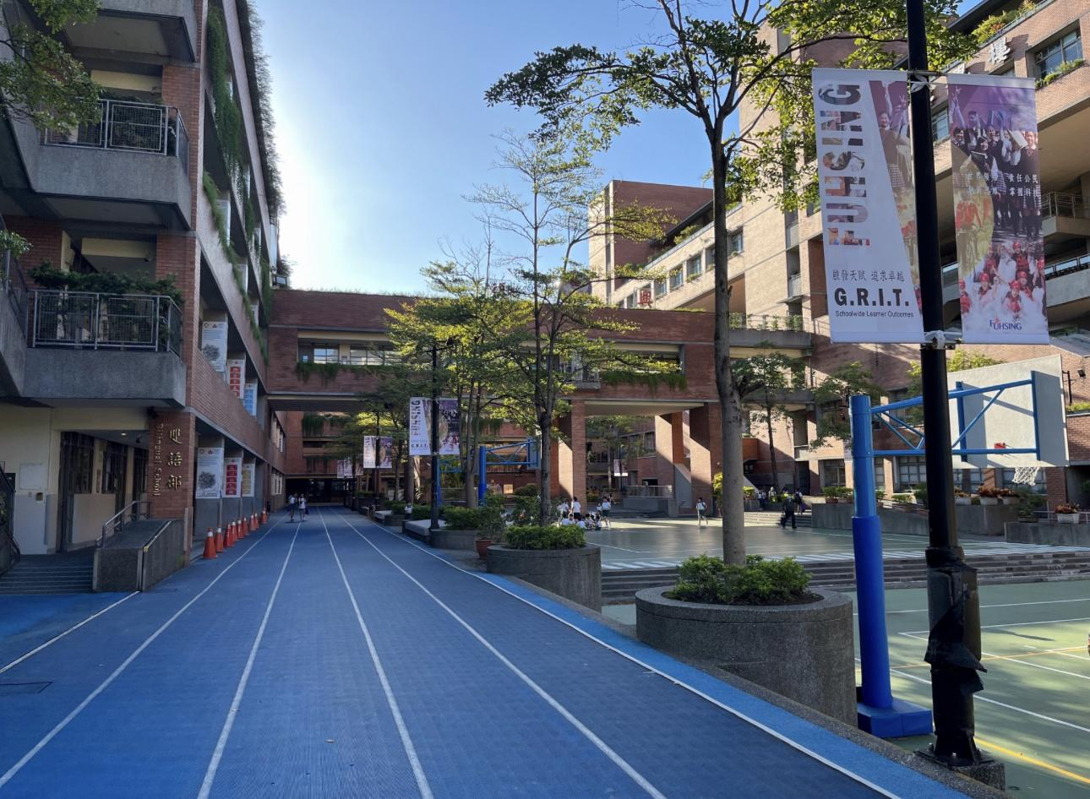
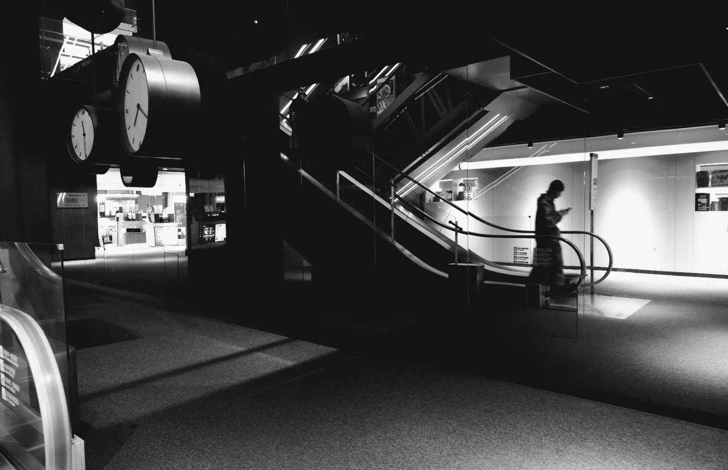

Slide 11
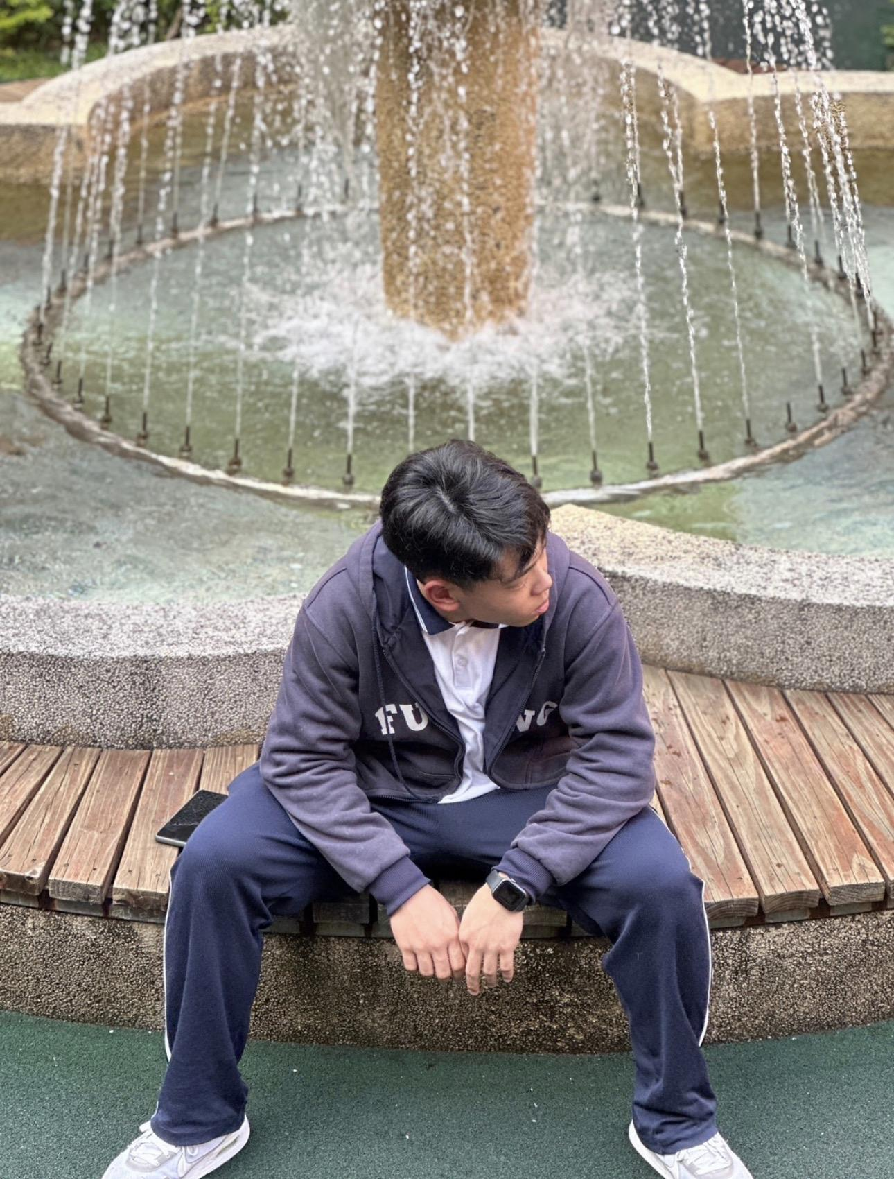
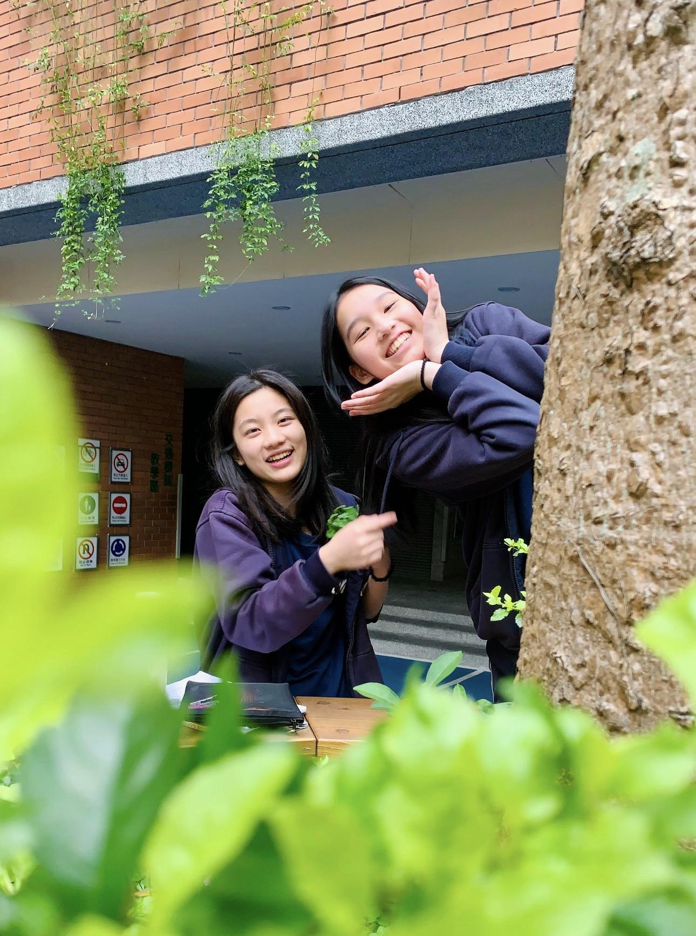
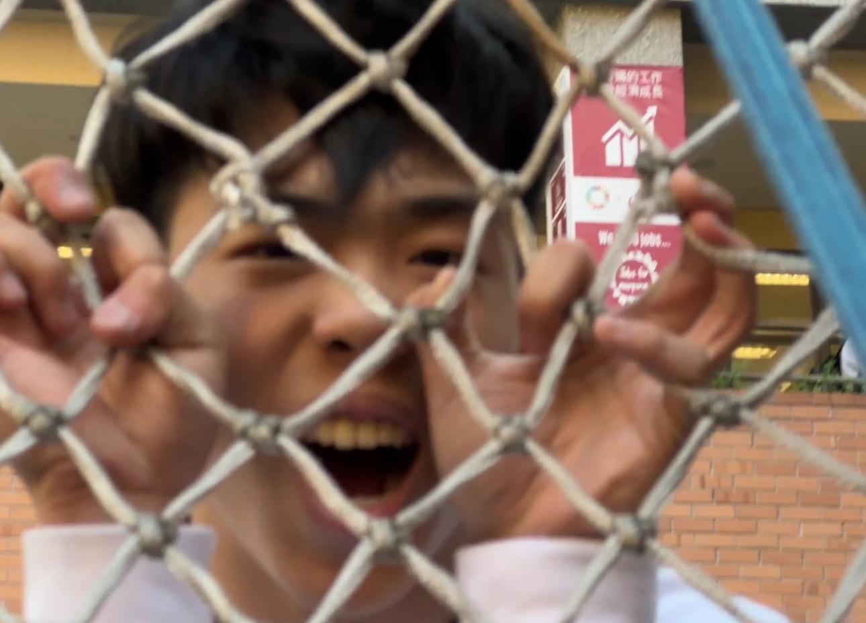
Bonus: 男生拍照實用姿勢 & 女生拍照實用姿勢
SLIDESGO PHOTOGRAPHY CO
SLIDESGOPHOTO.COM
50MM F-0.95

Slide 12
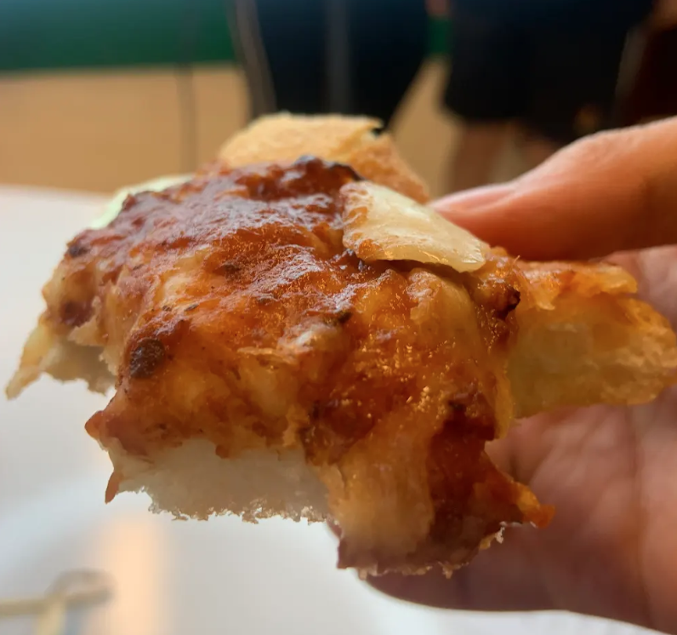
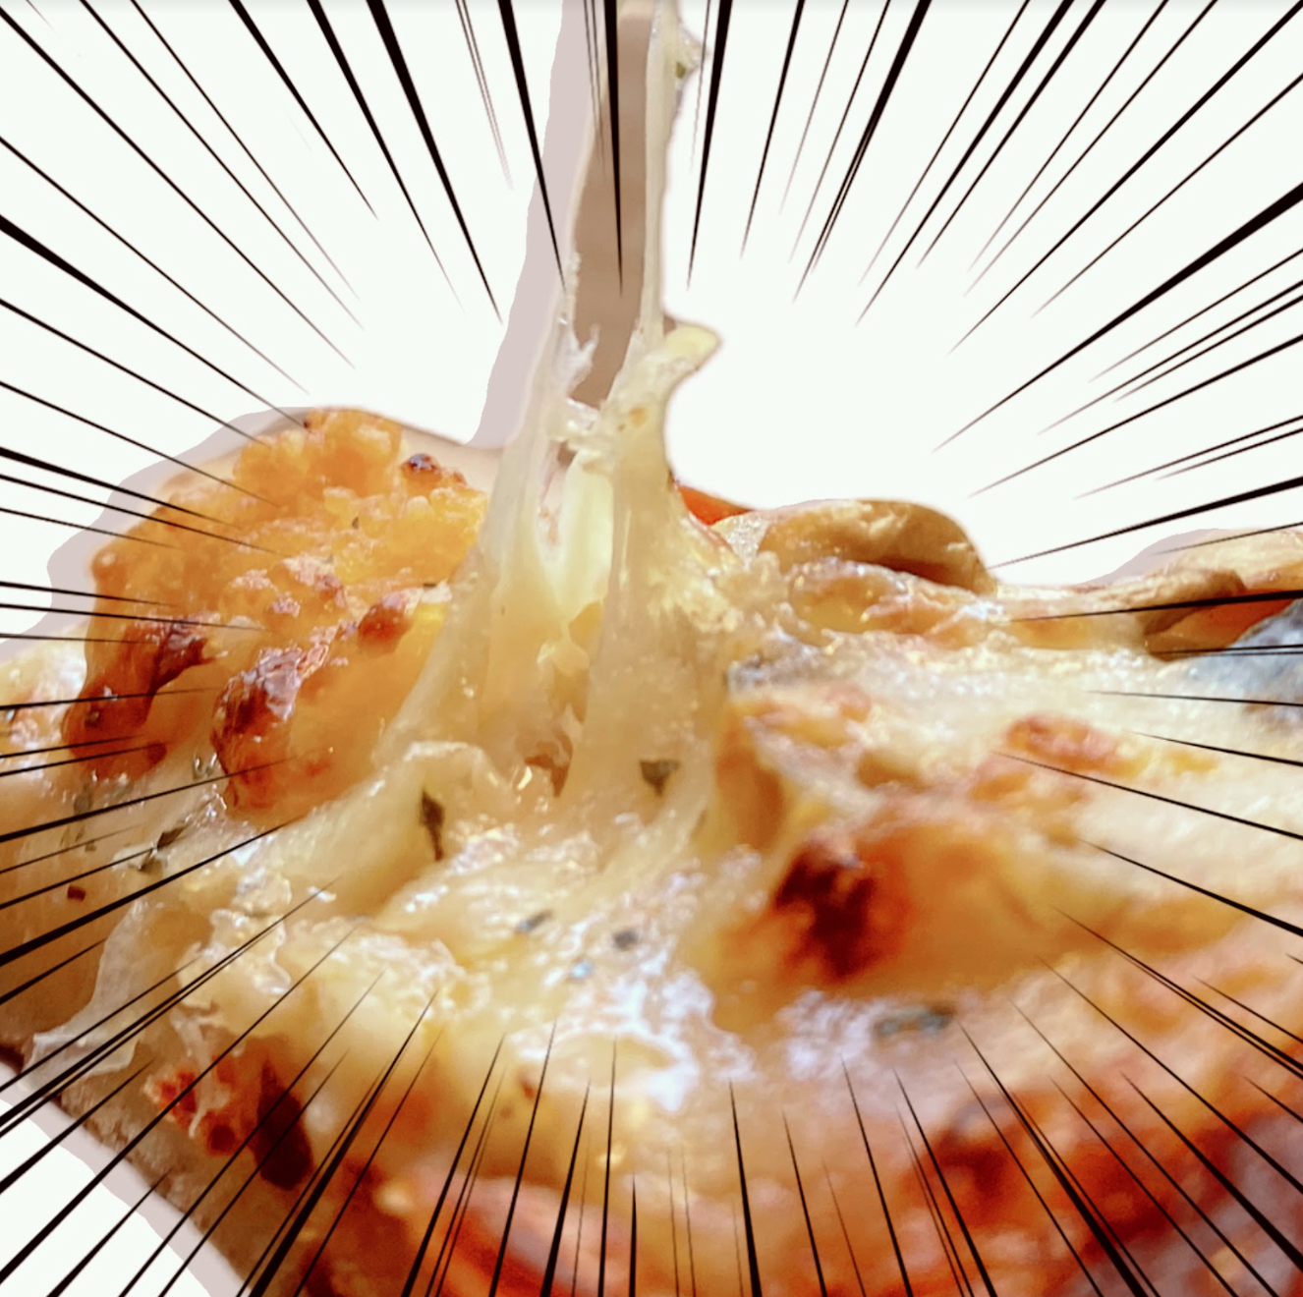
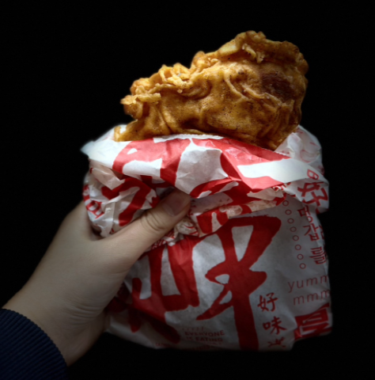
End-of-Semester Food Photography
SLIDESGO PHOTOGRAPHY CO
SLIDESGOPHOTO.COM
We will conduct a LINE voting on the selection of food -> photography -> eat!
50MM F-0.95

Slide 13
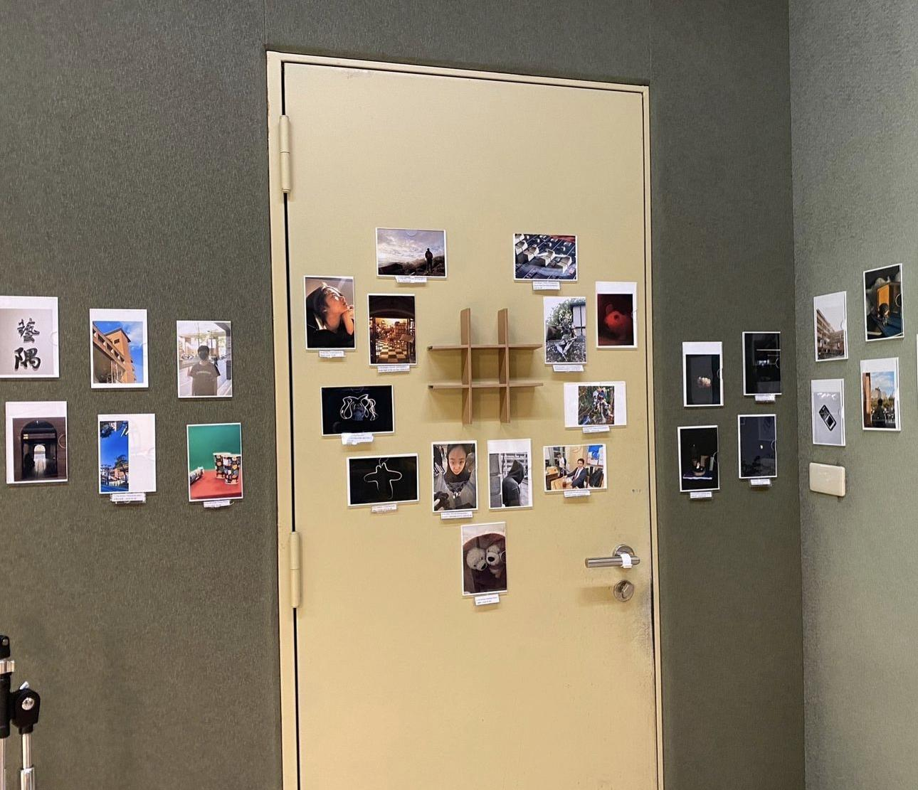
Photography Wall

Slide 14
Why should you join us?
Enhance Photography Skills:
Learn various photography techniques and styles through instructional videos and hands-on practice.
Gain insights from experienced teachers and club leaders who provide constructive feedback on your work.
Creative Expression
Community and Collaboration:
Join a community of like-minded individuals who share your passion for photography.
Recognition and Rewards:
Participate in themed competitions and have your work voted on by peers.
Portfolio Building:
Use your portfolio for future academic or professional opportunities.

