Slide 1
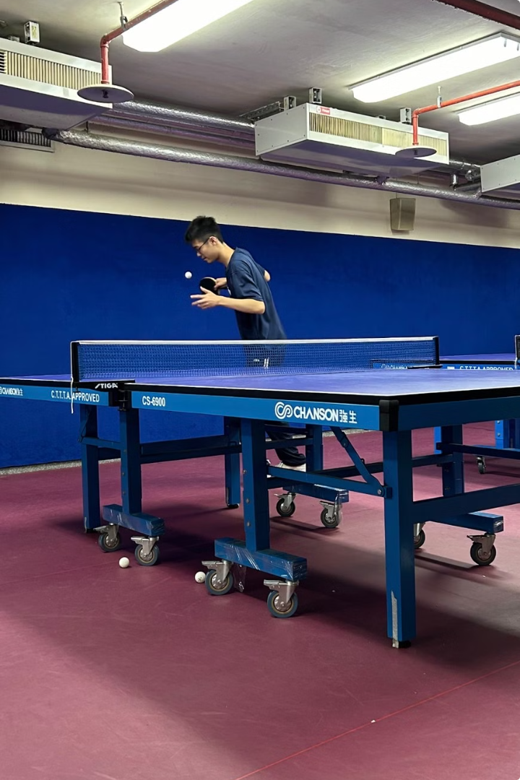
Welcome to Table Tennis Club!
Welcome to the table tennis club! This is a place for students to play and enjoy table tennis at all levels, whether you are a seasoned player or just starting out. We are passionate about helping you improve your skills and have fun playing the game.

Slide 2
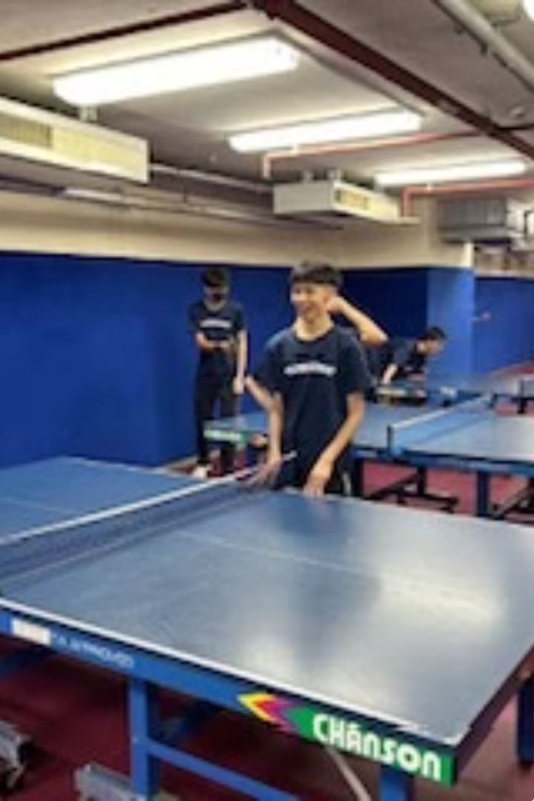
About Our Club
Passion
Our club caters to students who are passionate about table tennis. We welcome players of all skill levels and encourage a supportive and friendly environment.
Intensity
We offer competitive play for those who want to challenge themselves and improve their skills. We host regular tournaments and matches to help you test your abilities.
Casual Play
For those who just want to have fun, we also offer casual drop-in sessions where you can play with friends and meet new people.

Slide 3
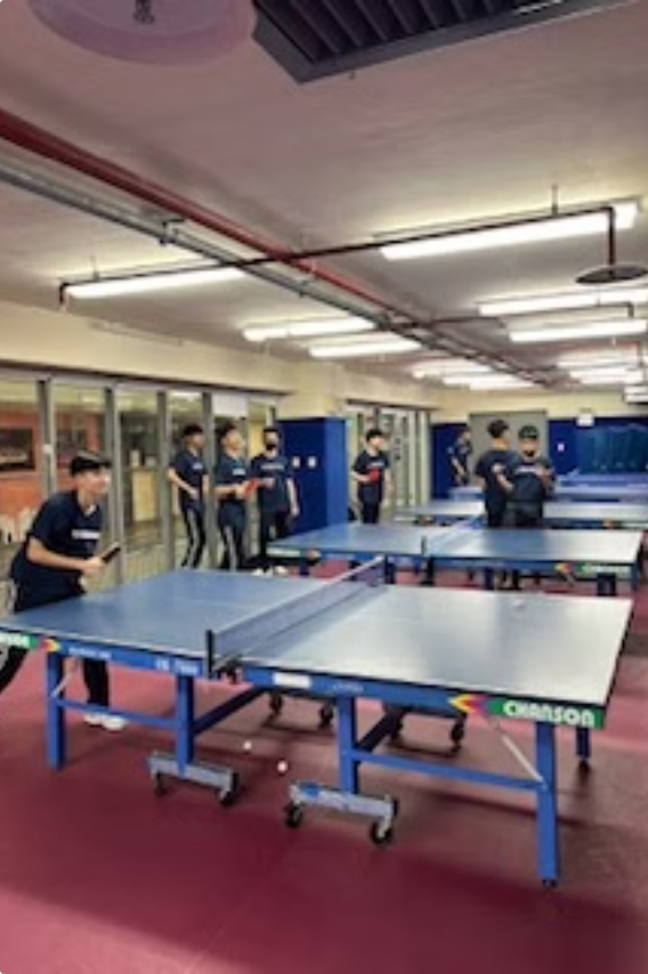
Club Activities
1
Coach Training
Our experienced coach is available for individual sessions to help you improve your technique and tactics. We work on all aspects of the game, from basic strokes to advanced strategies.
2
Mini Tournaments
We host regular mini-tournaments for club members, providing a fun and competitive environment to challenge yourself and learn from others.
3
Social Events
Beyond playing, we also organize social events for club members, fostering a strong sense of community and friendships within the club.

Slide 4
Club Goals
Breaks
Passion
Our sessions provide a welcome break from the academic routine, allowing students to refresh their minds, engage in physical activity, and connect with others.
We aim to cultivate a deep passion for table tennis among our members, encouraging them to embrace the sport and develop their skills.
1
2
3
Balance
We understand the demands of school and offer flexible training schedules that allow students to balance their academic commitments with their passion for table tennis.

Slide 5
Importance of Exercise
Physical Health
Mental Well-being
Social Interaction
Regular exercise is crucial for overall physical health. Table tennis is a fantastic way to improve cardiovascular health, coordination, and agility.
Beyond physical benefits, table tennis is also a great way to relieve stress and improve focus. The mental challenge of the game can help you stay sharp and engaged.
Table tennis is a social sport, fostering connections with others. Our club offers a friendly and inclusive environment for making new friends and enjoying the sport.

Slide 6
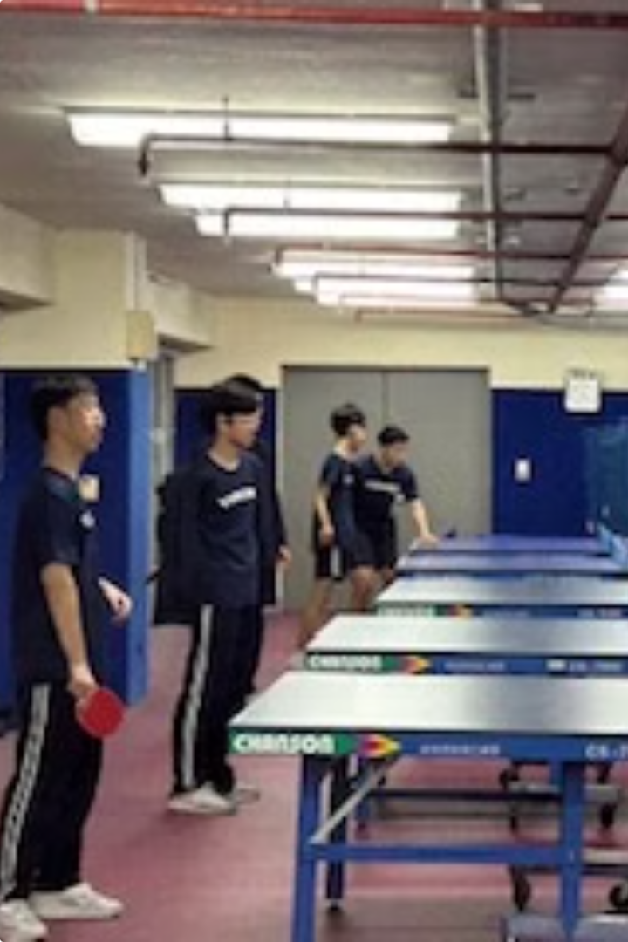
Club Fund Usage
Equipment
New rackets, balls, nets, and other essential equipment.
Coaching
Coached by experienced teachers to provide professional training and guidance.
Tournaments
Buy food and drinks as a reward for participating/winning in club mini tournaments.
Beat the Coach Challenge
A tradition for the table tennis club —> beating the coach in a short game can get you any snacks of your choice from the cafeteria.

Slide 7
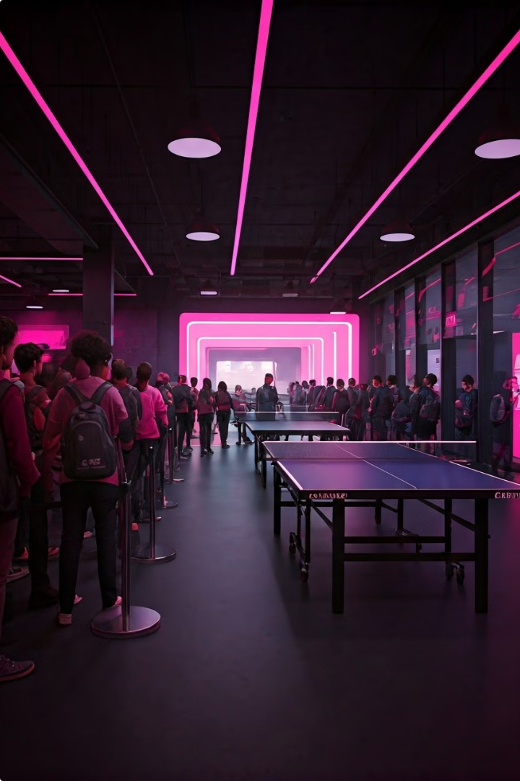
Club Popularity
High Demand
Our table tennis club consistently enjoys high demand, with a large number of students eager to join.
Full Capacity
Due to the popularity of the club, we often reach full capacity, with many students signing up late and being placed on a waiting list.
Growing Interest
The popularity of our club demonstrates the growing interest in table tennis among students. This is a testament to the sport's appeal and the engaging environment we foster.

Slide 8
Club Rules & Expectations
Enjoy the Game
Sportsmanship
Respect
Our primary goal is to have fun. We encourage a friendly and supportive atmosphere where everyone can enjoy the sport.
We expect all members to exhibit good sportsmanship, respecting their opponents and following club rules.
We value respect for our coaches, fellow club members, and the equipment. We aim to create a positive and supportive environment.

