Slide 1
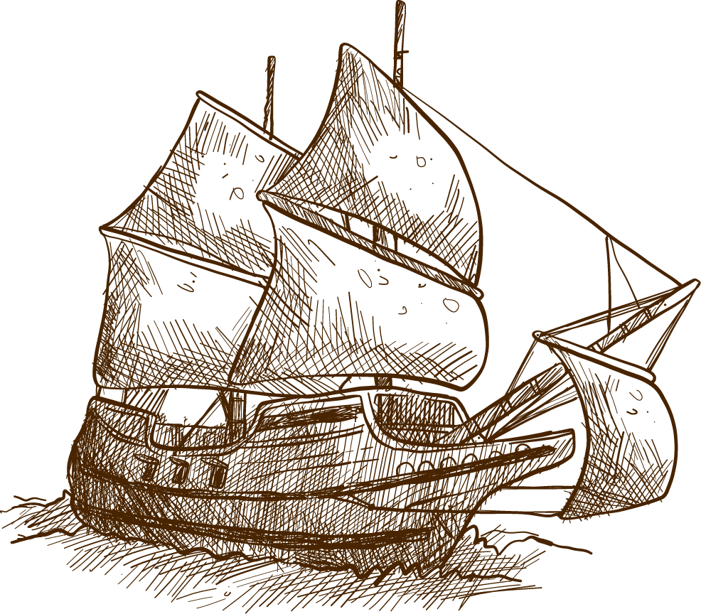
Welcome to
The History Bowl Club
Club Introduction 2024-2025

Slide 2
A Glimpse of the History Bowl and Bee
Internationally recognized (IAC)
IHBB & IHO
Regional/Asian Championships
Team and individual buzzer based history competition played over four quarters in each match.
Requires comprehensive and extensive knowledge in history across all periods and regions

Slide 3
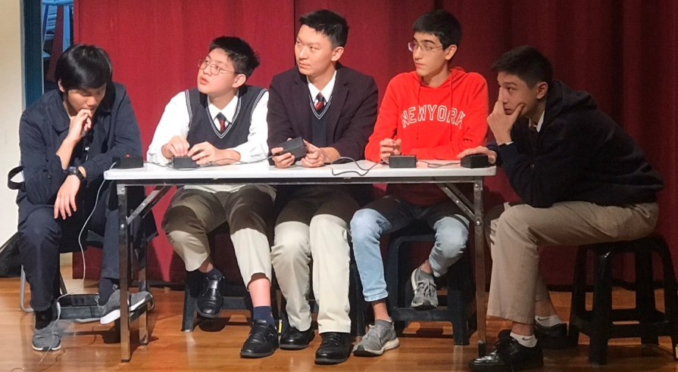
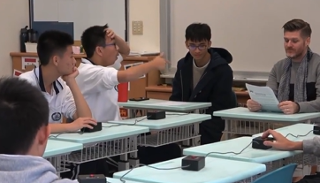
A Glimpse of the History Bowl and Bee
Question Style
The question will be read to you — listen carefully
Generally you buzz in with a buzzer to answer, but there are exceptions
Divisions
Middle School (7-8th grade)
Junior Varsity (9-10th grade)
Varsity (11-12th grade)

Slide 4
About the Club
An Authority
A Training Center
A Fun Place to be
We are the central organization in charge of representing our school in these regional competitions
We will hold regular lectures and practice quiz bowl questions to prepare students for participation in these competitions
This club is a place where history enthusiasts can have fun, showcase their knowledge of trivia, and learn some more

Slide 5
Club Activities
Practice
Games
Snack Party
Joint Activities with Other Clubs
Competitions
Using question sets from the past to practice regularly and strategy.
Fun games to play as a whole club
Every two/three weeks
Club wide, regional, and international tournaments
TBA

Slide 6
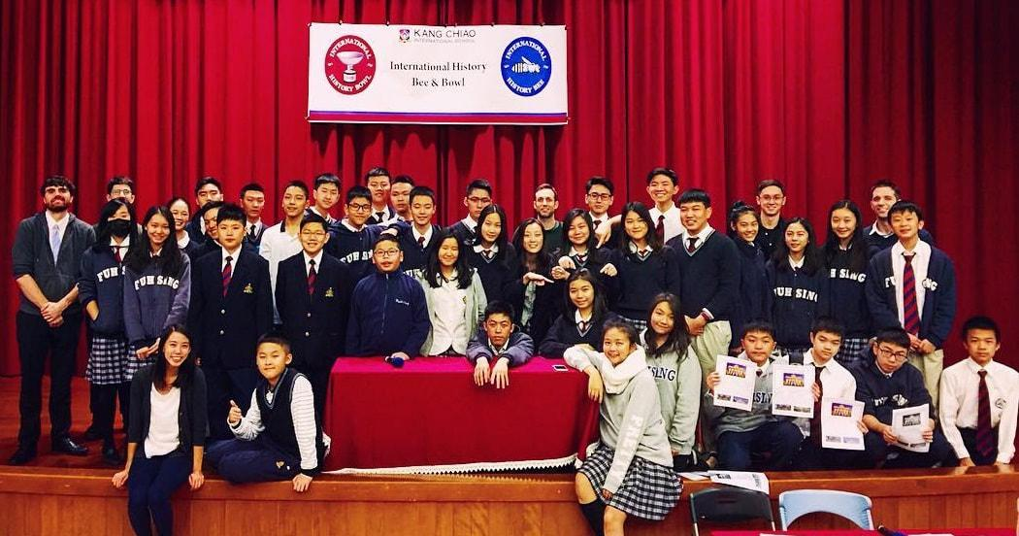
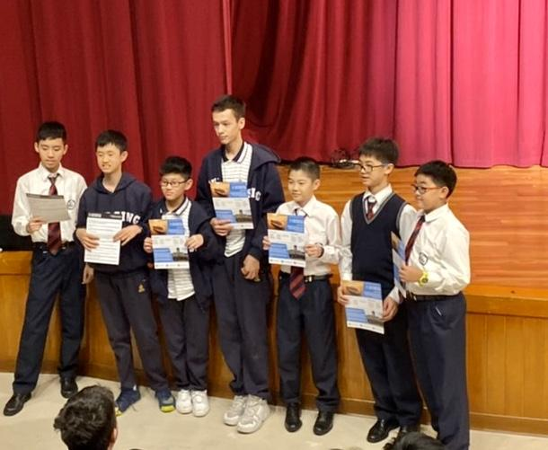
Asian Division
Achievements
Taiwan Achievements
Bowl
4 second place & 5 third place
Bee
2 Silver & 5 Bronze
Science
1 Gold & 1 Silver & 3 Bronze
Geography
2 Bronze
Bowl
4 Champions
1 Runner Up
1 Third Place
Bee
2 Gold & 5 Silver & 2 Bronze

Slide 7
What We are Looking For
200 NT Club Fee Per Semester
This pays for equipment maintenance, faculty costs, and the occasional snack party

Slide 8
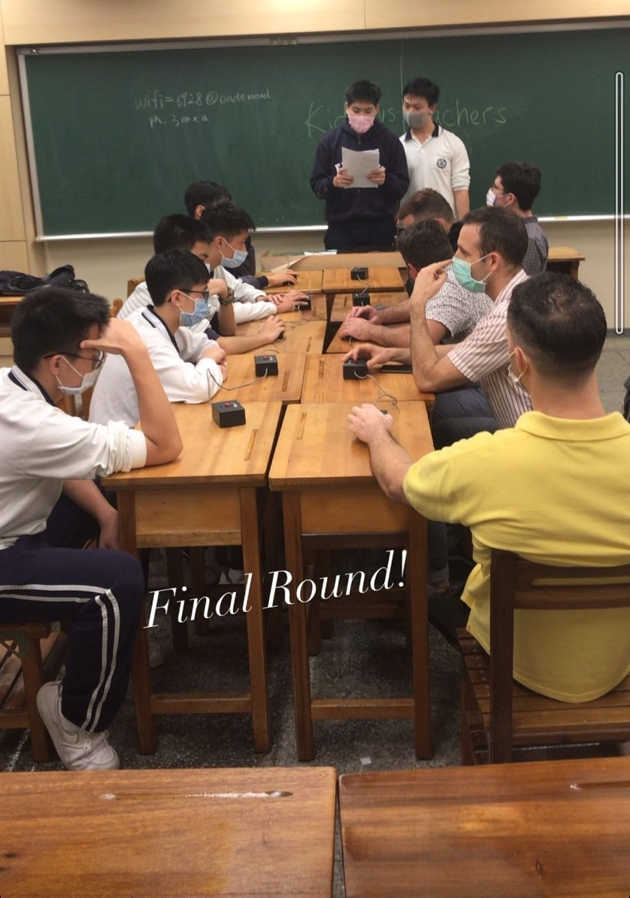
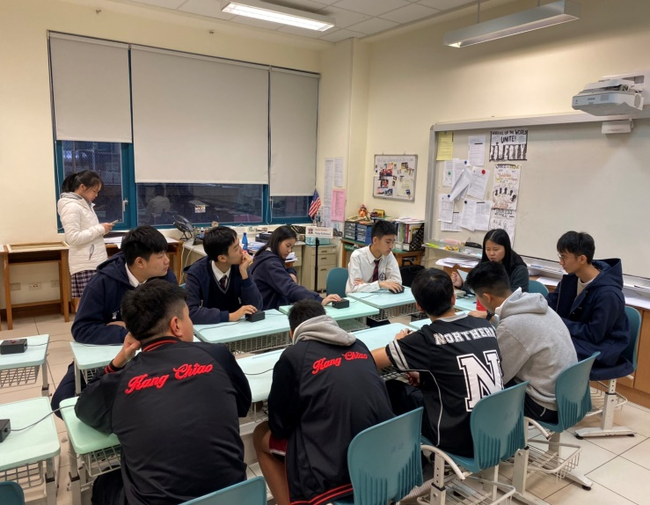
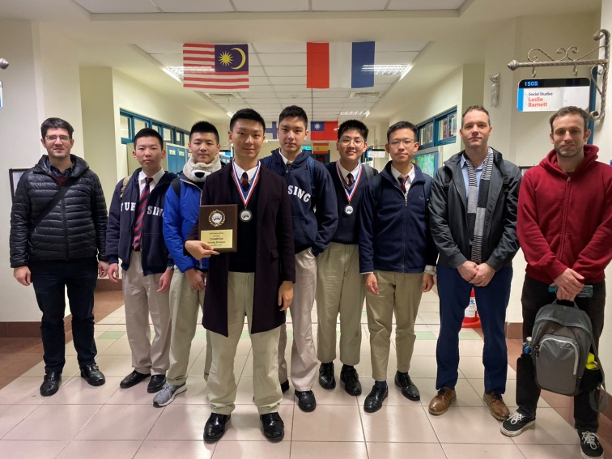
Why History Bowl
A fun experience — you might just fall in love with this competition!
A potentially impressive entry on your college application if you win
A skill set that will prove invaluable to all future history courses

Slide 9
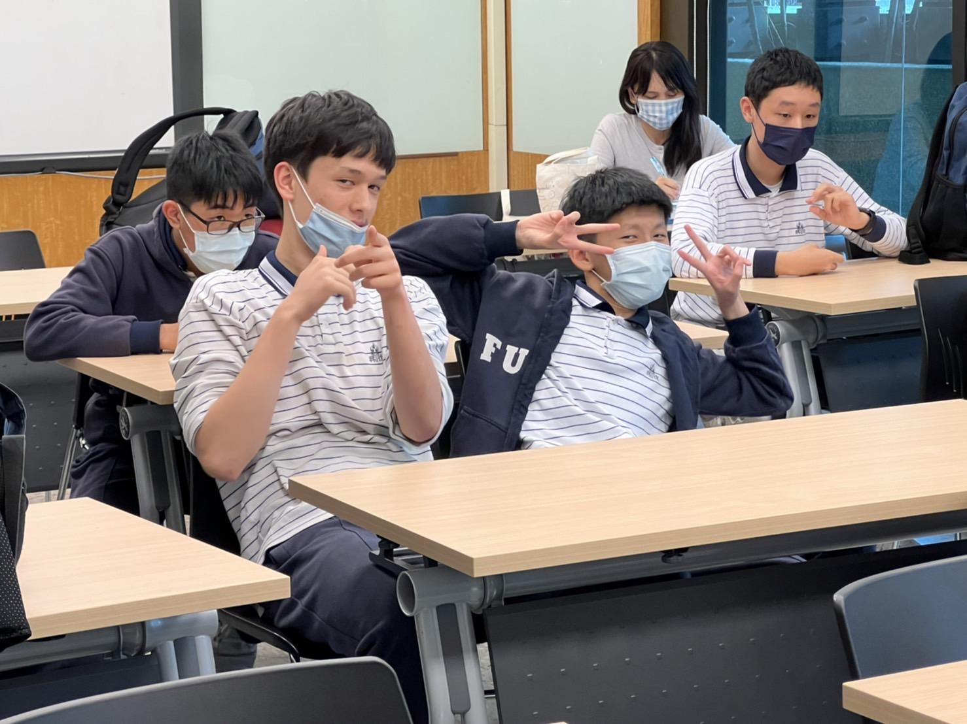
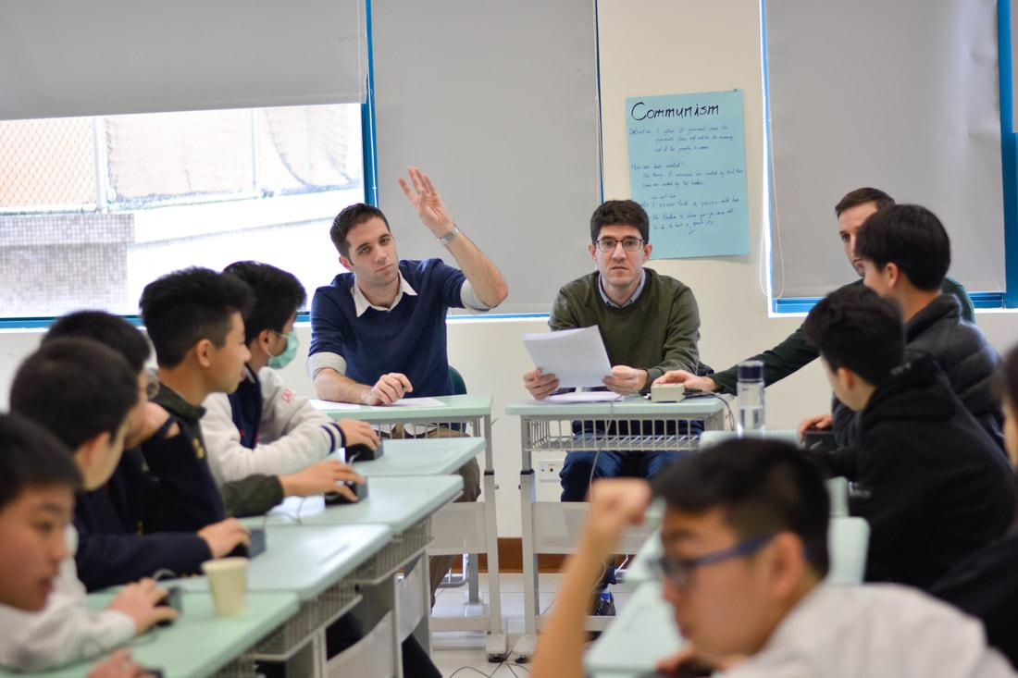
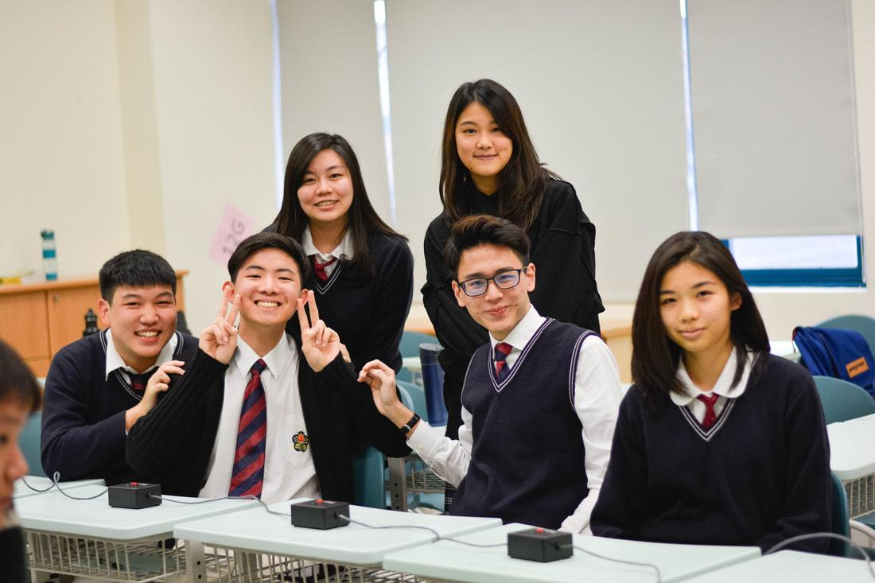
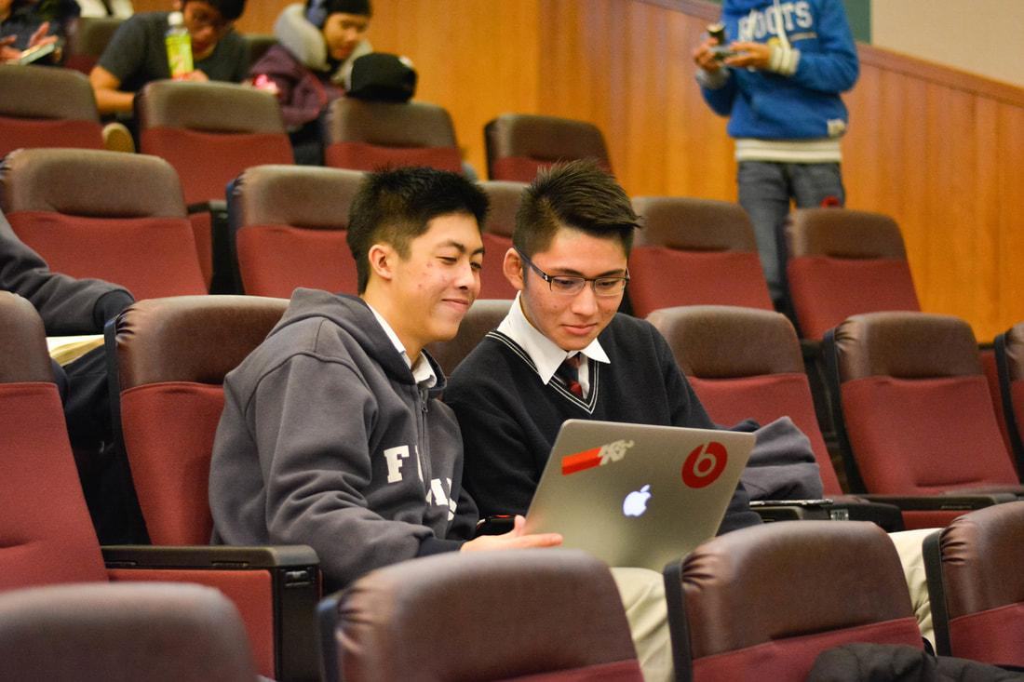
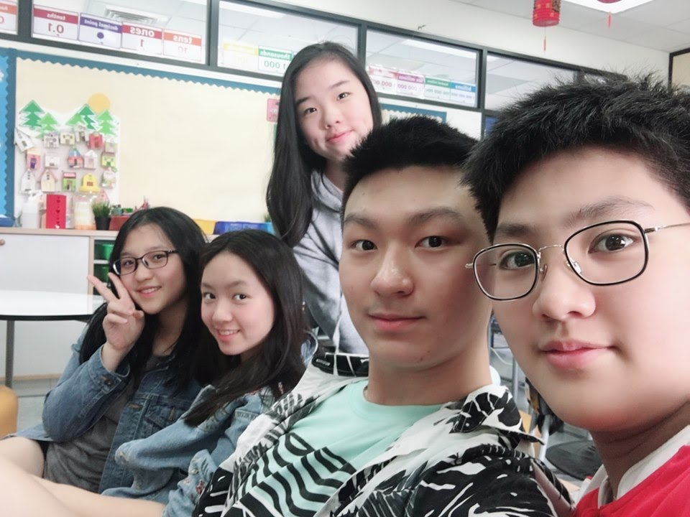
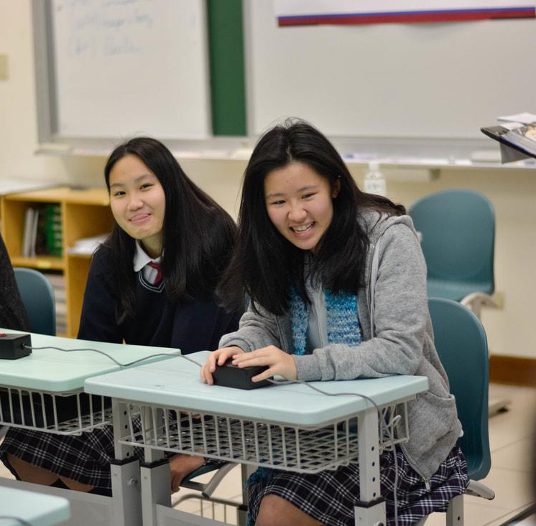
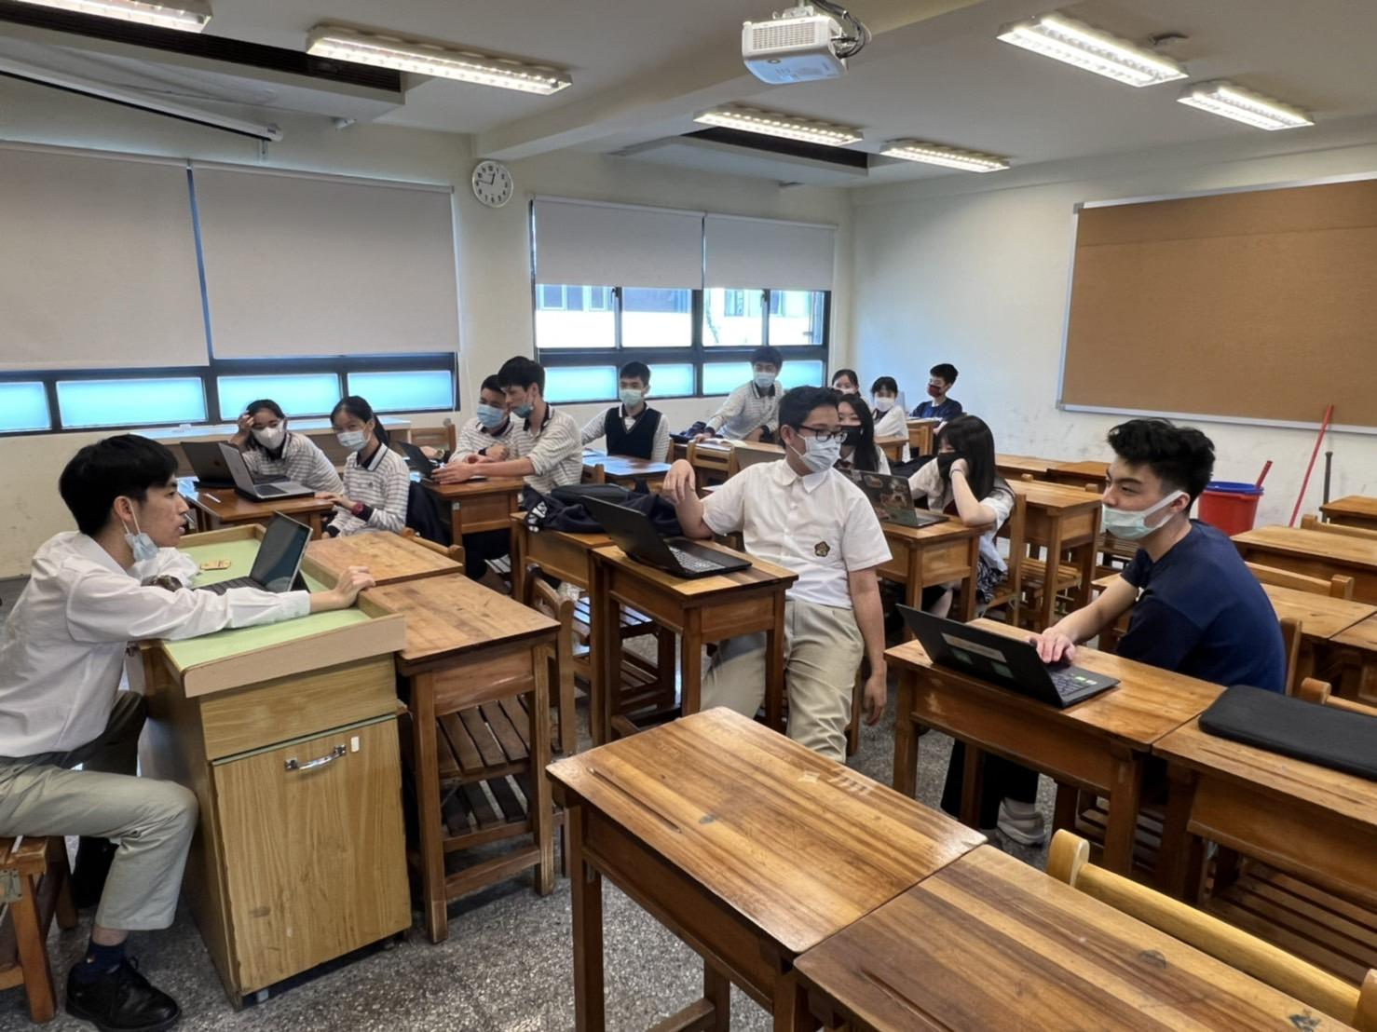
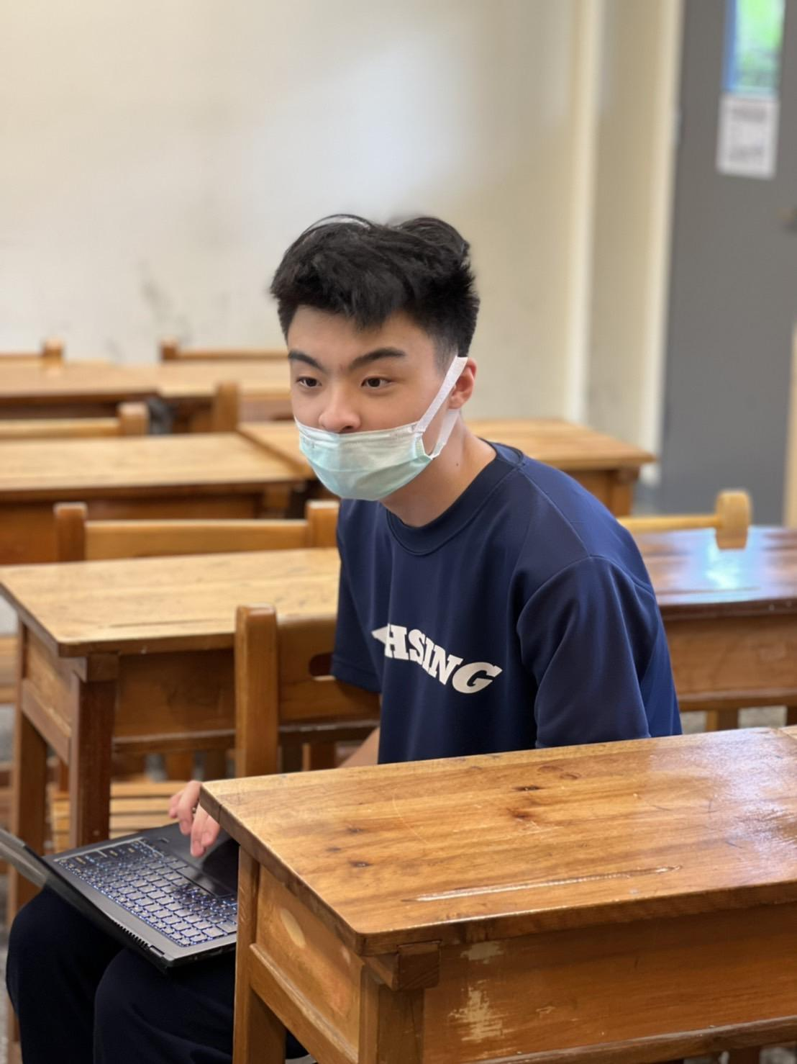
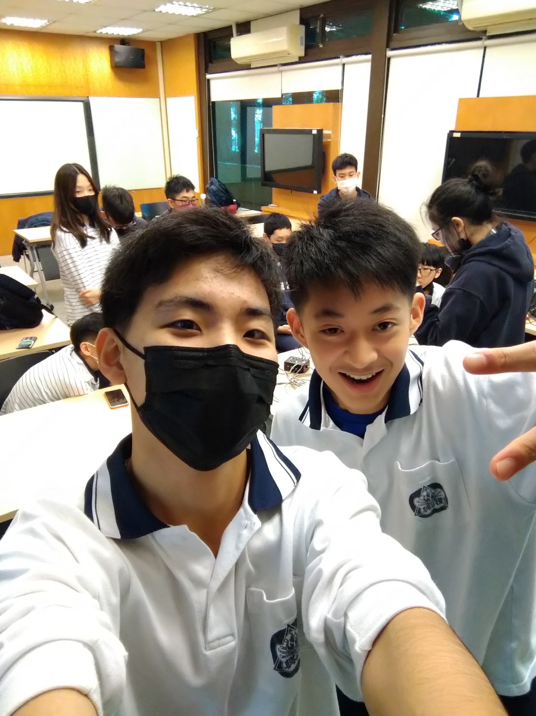
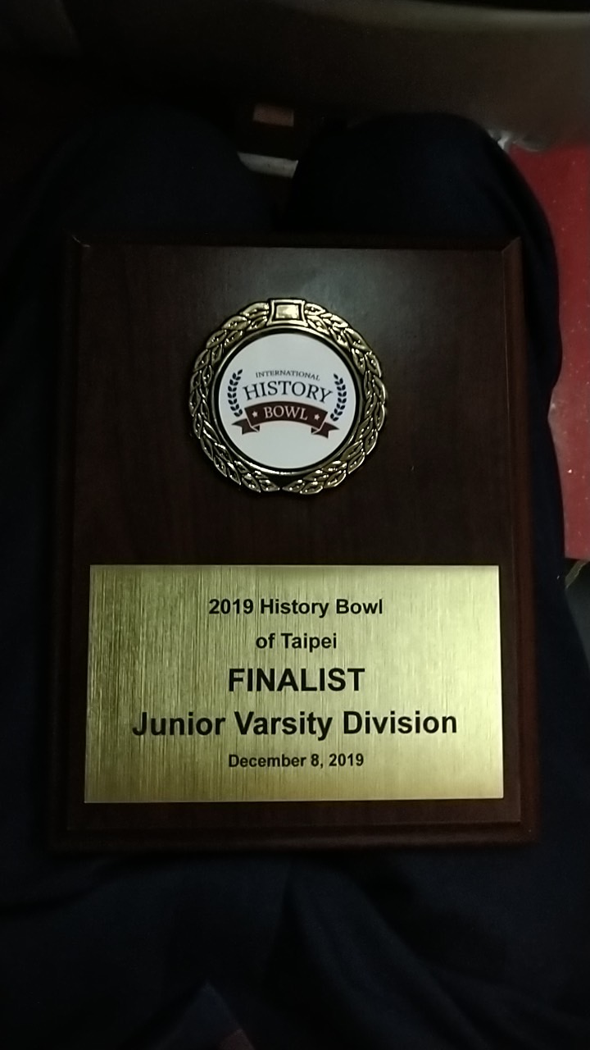
History Bowl Family In Action

Slide 10
Contact
Hung-Ting Kuo
kuohungting@gmail.com
Telvin Ju
11051017@st.fhjh.tp.edu.tw

Slide 11
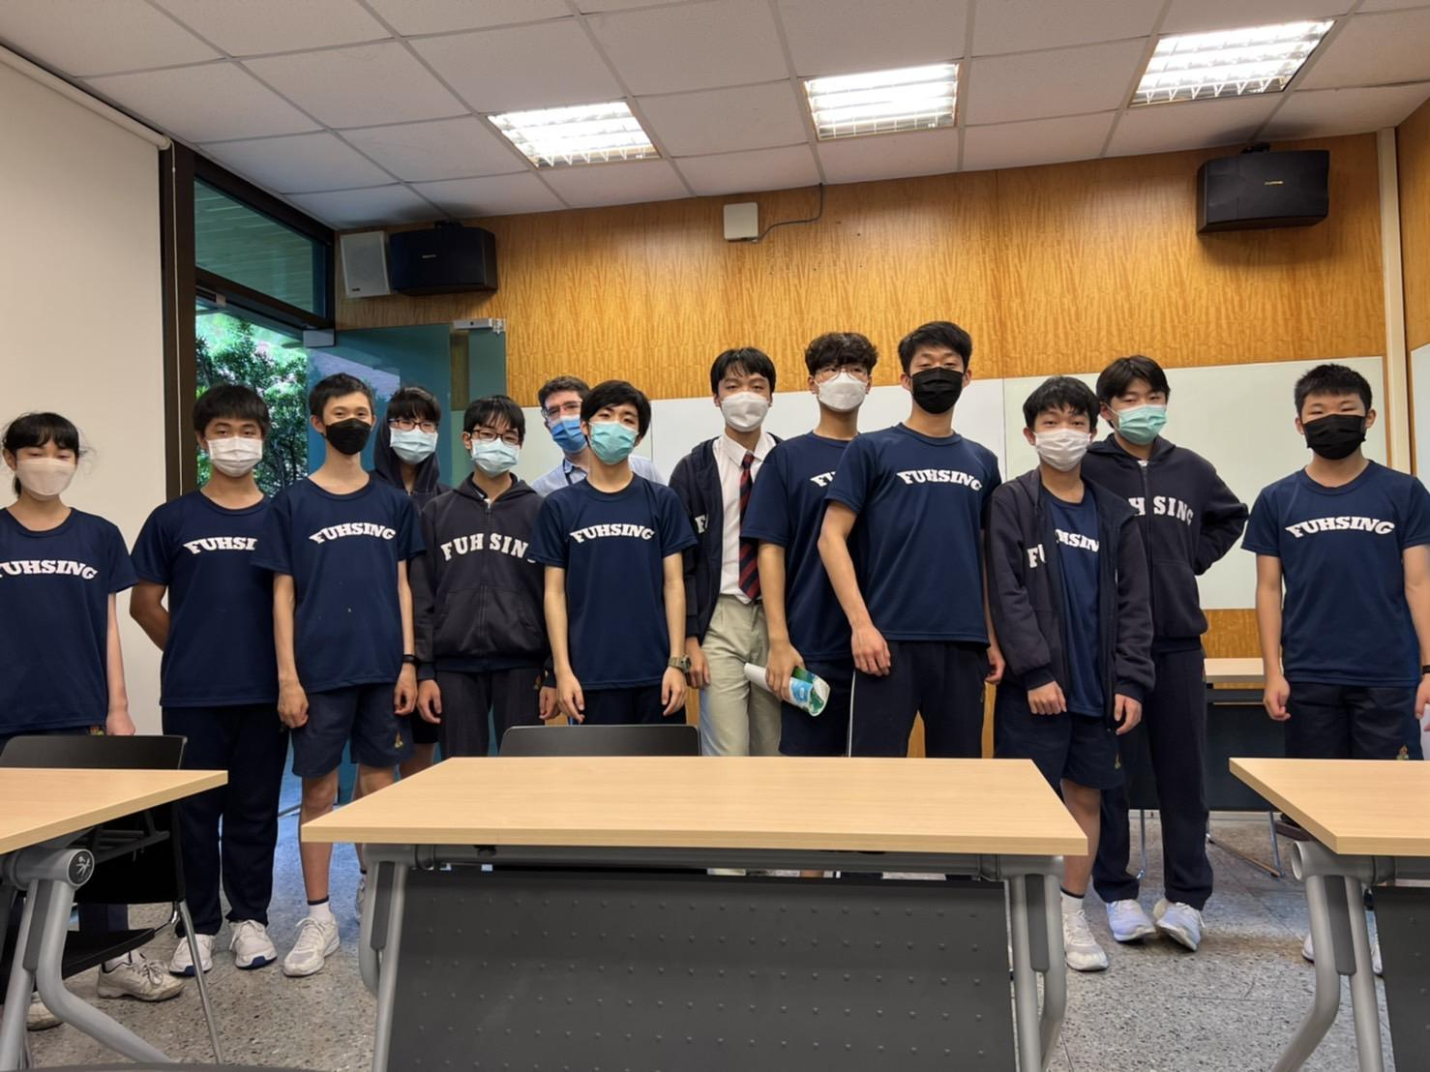
Insert group photo

