Slide 1
Software & Application
Development Club

Slide 2
Introduction
Our club was created because a small team of 3 wanted to make an interesting software project
We wanted to have more people interested in the aspect of software developing
So the club was created: Interactive Software Develpoment Club!
We invited our very own professional IT teacher to teach everyone how to make games for this year
If you are interested in developing a game, you can consider joining, even with no background

Slide 3
Our Vision
We wanted to create something something meaningful to be shown to the general public, and make a difference in the world while having fun
We think that game development is a more approachable method to start code learning for students
We decided to make a game, and bring in issues such as social conflicts, mental illnesses, and environmental problems in the backstory to increase awareness.
We hope our clubmates can learn to collaborate with many people with different talents, communicate their vision of the game and create something beautiful together.
At the same time, we wish everyone to step away from the stress from school life and just have fun

Slide 4
Skills our club will teach
Lore
UI Design
Story writing
Gameplay sequencing
Arrangement of elements
User experience
Art
Coding
3d Graphics Designing
Atmospheric Aesthetics
Integrating coding skills into designing project

Slide 5
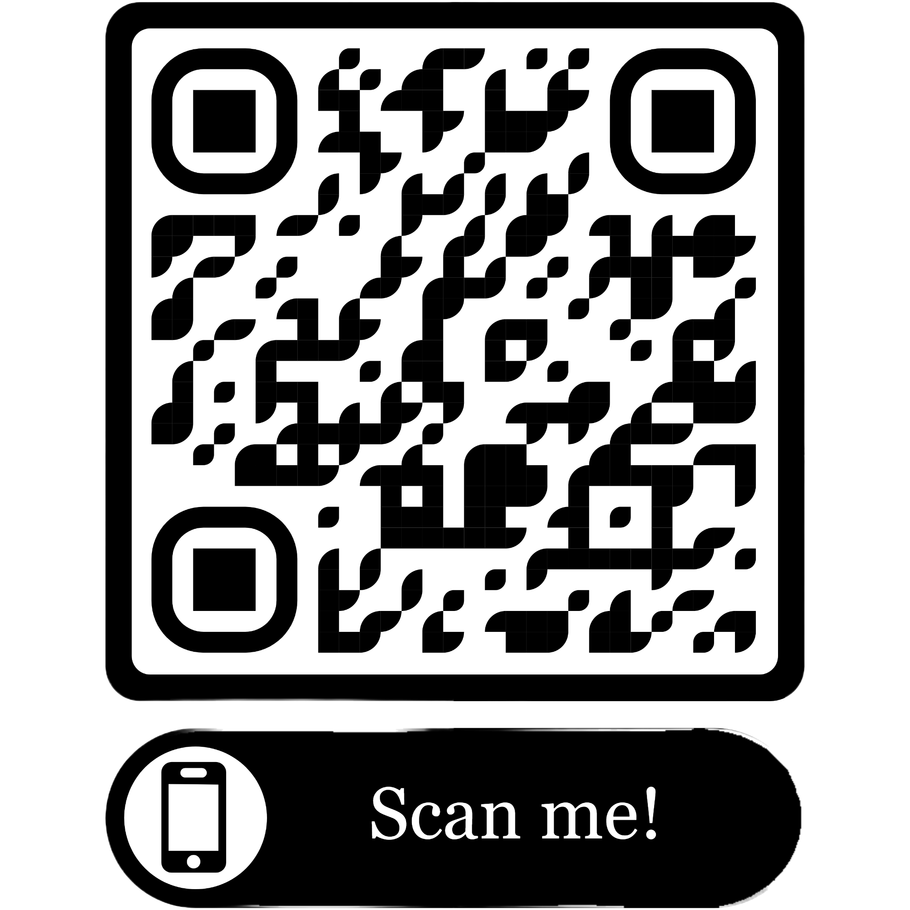
Coding
Competitions
Applying
We encourage club members to team up and apply in all different kinds of coding competitions for algorithms and game design
Do you have a talent in coding? Do you take interest in game design and gaming? Are you looking to sharpen your current coding skills by learning from a professional teacher? Scan the QR Code below to apply!
Club Time
During club time, we have 宋老師 from the IT department teaching coding team members how to traverse and code in Unity

Slide 6
Art
Tasks
Applying
Everything that looks good probably is done by you. Drawing the background, making animations, and designing characters and assets is all your job. Should be fun though.
Talented in drawing? Do you have an interest in digital 3d art? Have you always wanted to join a group to express yourself and put your art to use? Scan the QR Code below to apply!
Club Time
You can learn blender, a 3d design tool that can help you make 3d things and animations in classes.

Slide 7
UI Team
Tasks
Applying
So put stuff in the right place so it looks good and also people won’t get mad they cant find stuff like this strikethrough
Are you good at arranging elements to make them look visually appealing? Do you have a talent for designing but not as confident in your drawing skills? Scan the QR Code below to apply!
Club Time
You will learn to manage unity’s user interfaces and design a easy to understand ui

Slide 8
Lore
Tasks
Applying
Write story elements for games, or storyboard in-game cutscenes. Create an engaging and touching story for our players
Enjoying writing stories or poems? Want to see your characters come to life? Scan the QR code to apply!
Club Time
Combine with art to get your characters looking just right, or work on you masterpiece

Slide 9
Why US?
NO OTHER Thursday club choices for students interested in software development
Passionate members can collaborate and create a project together
Professional Teacher provide full course for students interested in the game developing
Students with no coding background can get into development with out classes
SDGs integration to show our care for society

Slide 10
Our Plan for the Semester
C# coding in Unity
Introduction to the club rules
Unity installation and envionment
Midterm project
Finals project
Advanced algorithm and data structures

Slide 11
FAQ
Q: What will I get to take away from club classes?
A: It really depends, software developement is a crossover of multiple abilities. You will enhance your coding skills, learn how to use unity, or pratice drawing 3d or 2d models..
Q: Do I need programming skills to join the club?
A: No, you don't need programming skills to join the club. We welcome individuals from all backgrounds, including artists, designers, writers, and musicians, who can contribute to various aspects of game development. Also, lessons are provided, so no need to worry about it.

Slide 12
Our Introduction Video
https://drive.google.com/file/d/1sEZqJxQc7-IN382-pe8ROuS4jg0rHDDB/view

