Slide 1
Fuhsing Debate Club 2024 Intro
welcome!

Slide 2
01
Events

Slide 3
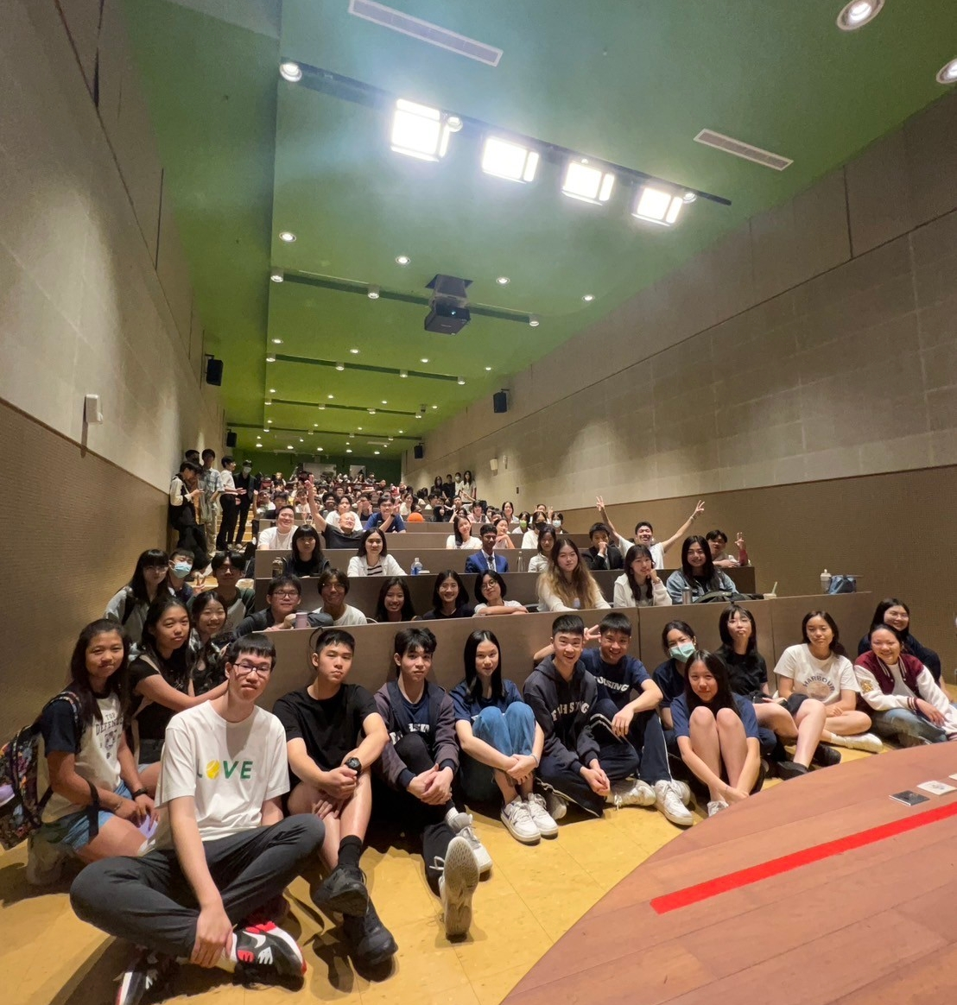
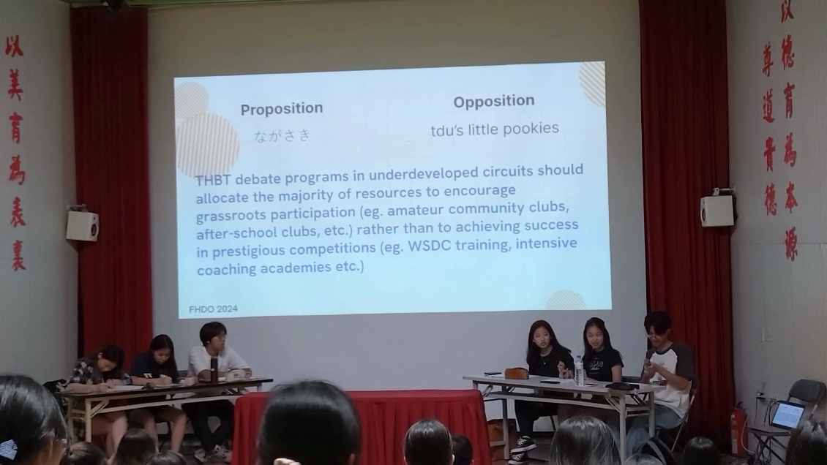
Fuhsing Debate Open (FHDO)
Annual event hosted and organized by debate club students for debaters around Taiwan
FHDO 2024 welcomed 96 debaters from Hsinchu, Tainan, Taipei, etc.

Slide 4
02
Club content

Slide 5
Club Content
Spars/Practice
Matter Session
Event Hosting
Chance to debate on fun topics with members
Introduction lectures to different speaker positions
Planning and volunteering for annual FHDO
Challenges
Mentors
Funfunfun
Compete in persuasion challenges to win boba
Link with experienced national squad debaters!
We order boba quite a lot

Slide 6
03
Why Debate?

Slide 7
Why debate?
Top academic competition worldwide
Critical thinking and understanding of the world
Gain knowledge and perspective on current and immediate global issues (feminism, climate change, AI tech, philosophy)
RECENT ALUMNI (including but not limited to!)
Georgetown
UPenn Wharton
Brown
Cornell
Northwestern
Emory
FORMAT
World Schools Debate (WSDC)

