Slide 1
FASHION & DESIGN
CLUB

Slide 3
01
02
TABLE OF CONTENTS
03
04
Introduction
What will we do
What is this club about, and what is this for?
What will we do during the club time?
Result
Benefits
What can you take away from this class?
What are some advantages for joining this club?

Slide 4
01
Introduction
What is this club about, and what is this for?

Slide 5
Main Idea
Creativity for everyone
Skill development
You will develop their design skills, from basic concepts to advanced techniques, through workshops, projects, and collaborations.
We welcome all levels of creativity, whether you're an artist or just starting to explore your creative side.
Community & collaboration
Personal growth
Our club aims to facilitate personal growth and self-discovery through the transformative power of fashion and design.
Our club fosters a sense of community and encourages collaboration among members, creating a supportive environment for creativity to flourish.

Slide 6
02
What will we do?
What will we do during the club time?(syllabus)

Slide 7
Fashion
Portfolio
Design
Putting all the masterpieces you’ve done into this portfolio !
Creative!
This is an impeccably curated portfolio that showcases your unique style, creativity, and expertise

Slide 8
Design Ads
Create captivating ads to promote your very own product, showcasing your design skills and entrepreneurial spirit, perfect for high school students seeking to unleash their creativity and business acumen !!

Slide 9
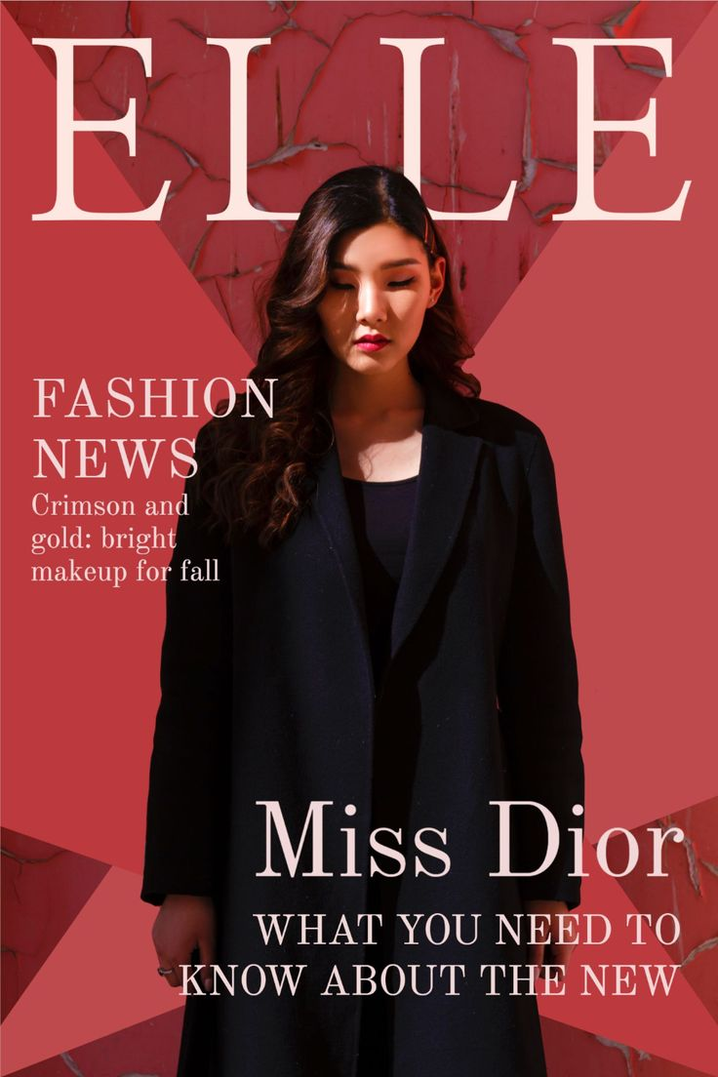
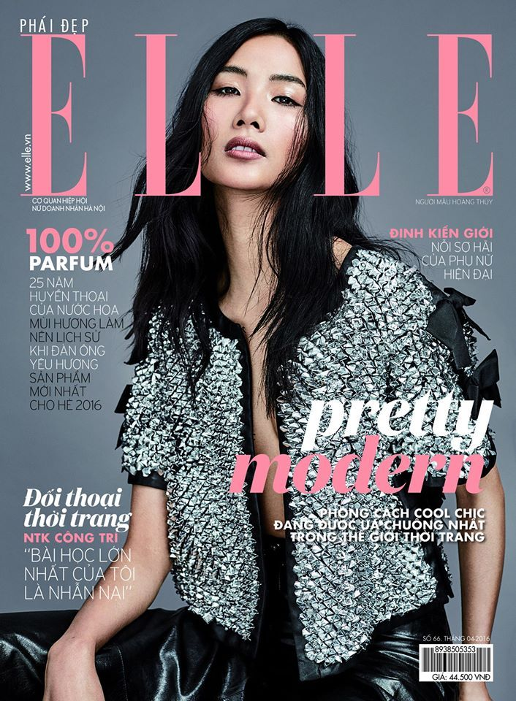
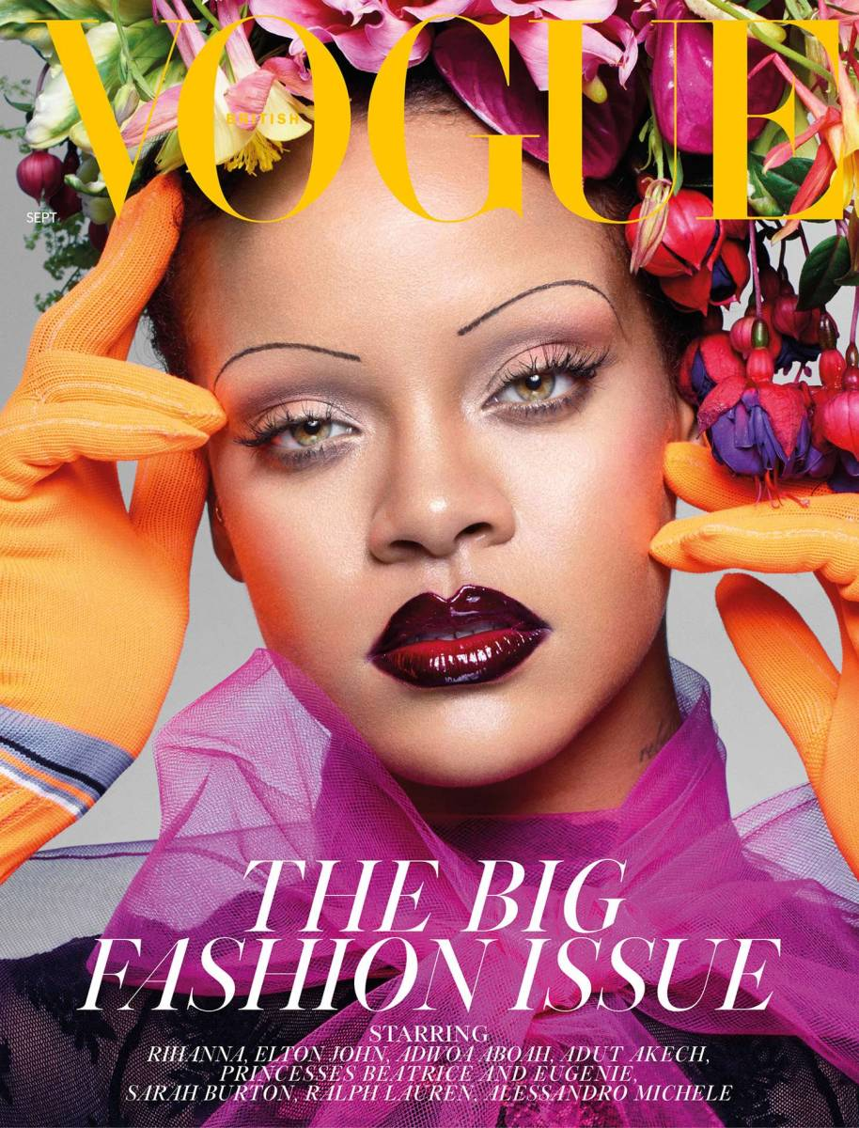
Design Magazine Cover
You will design your own VOGUE cover based on the work you have created.
Whether you're inspired by bold, eye-catching graphics, you'll have the chance to let your imagination run wild and create posters that reflect your unique style.

Slide 10
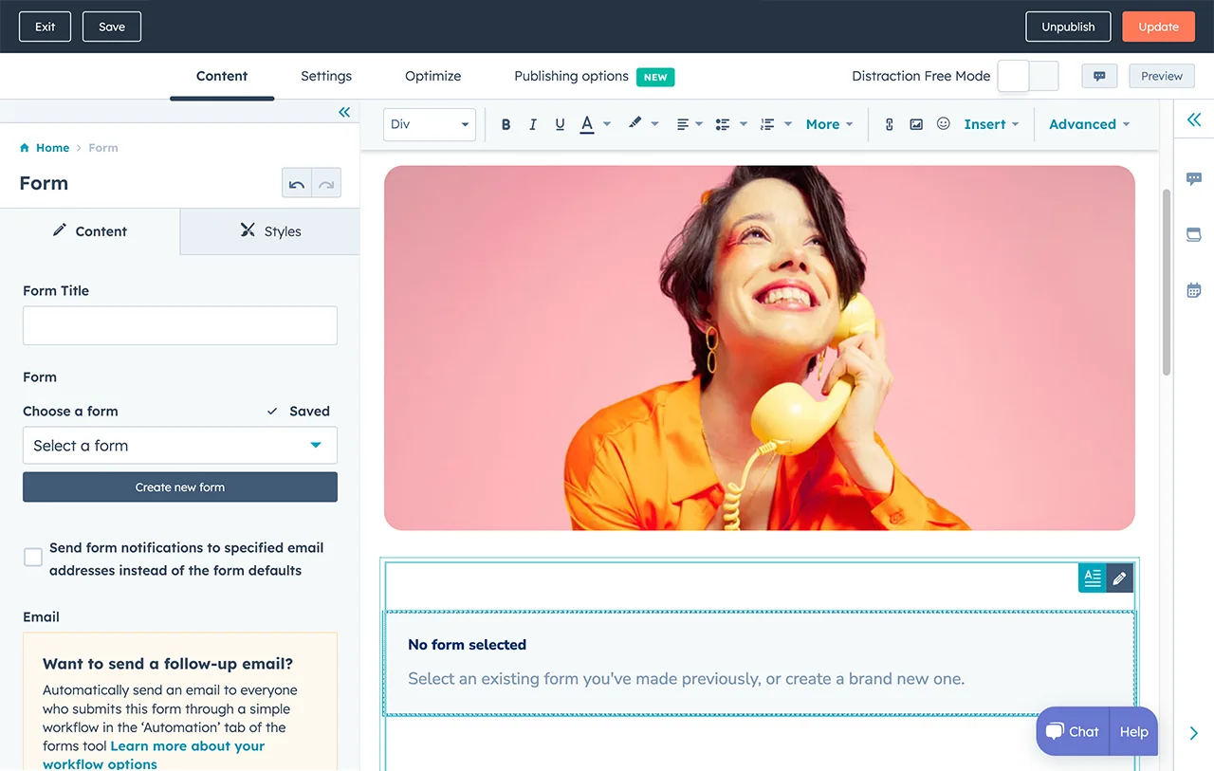
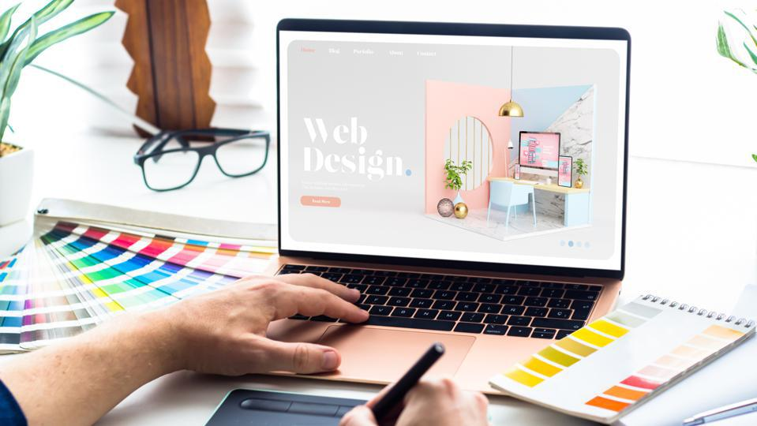
Create Blog Page and Sites
01
02
03
04
Our club will teach you how to create a website just for you.
We are going to post all the works on here !
Enrich your extracurricular activities !
Beneficial for future college application !

Slide 11
Be Your Own Model !
Experiment with various outfits and capture your distinctive fashion shots.
Design your posters by incorporating your fashion photographs along with your imaginative concepts.
Don’t worry, all clothes will be provided!
Welcome to bring your unique clothes too!

Slide 12
03
How to chose your clothes?
Trend | Fashion | 2024

Slide 13
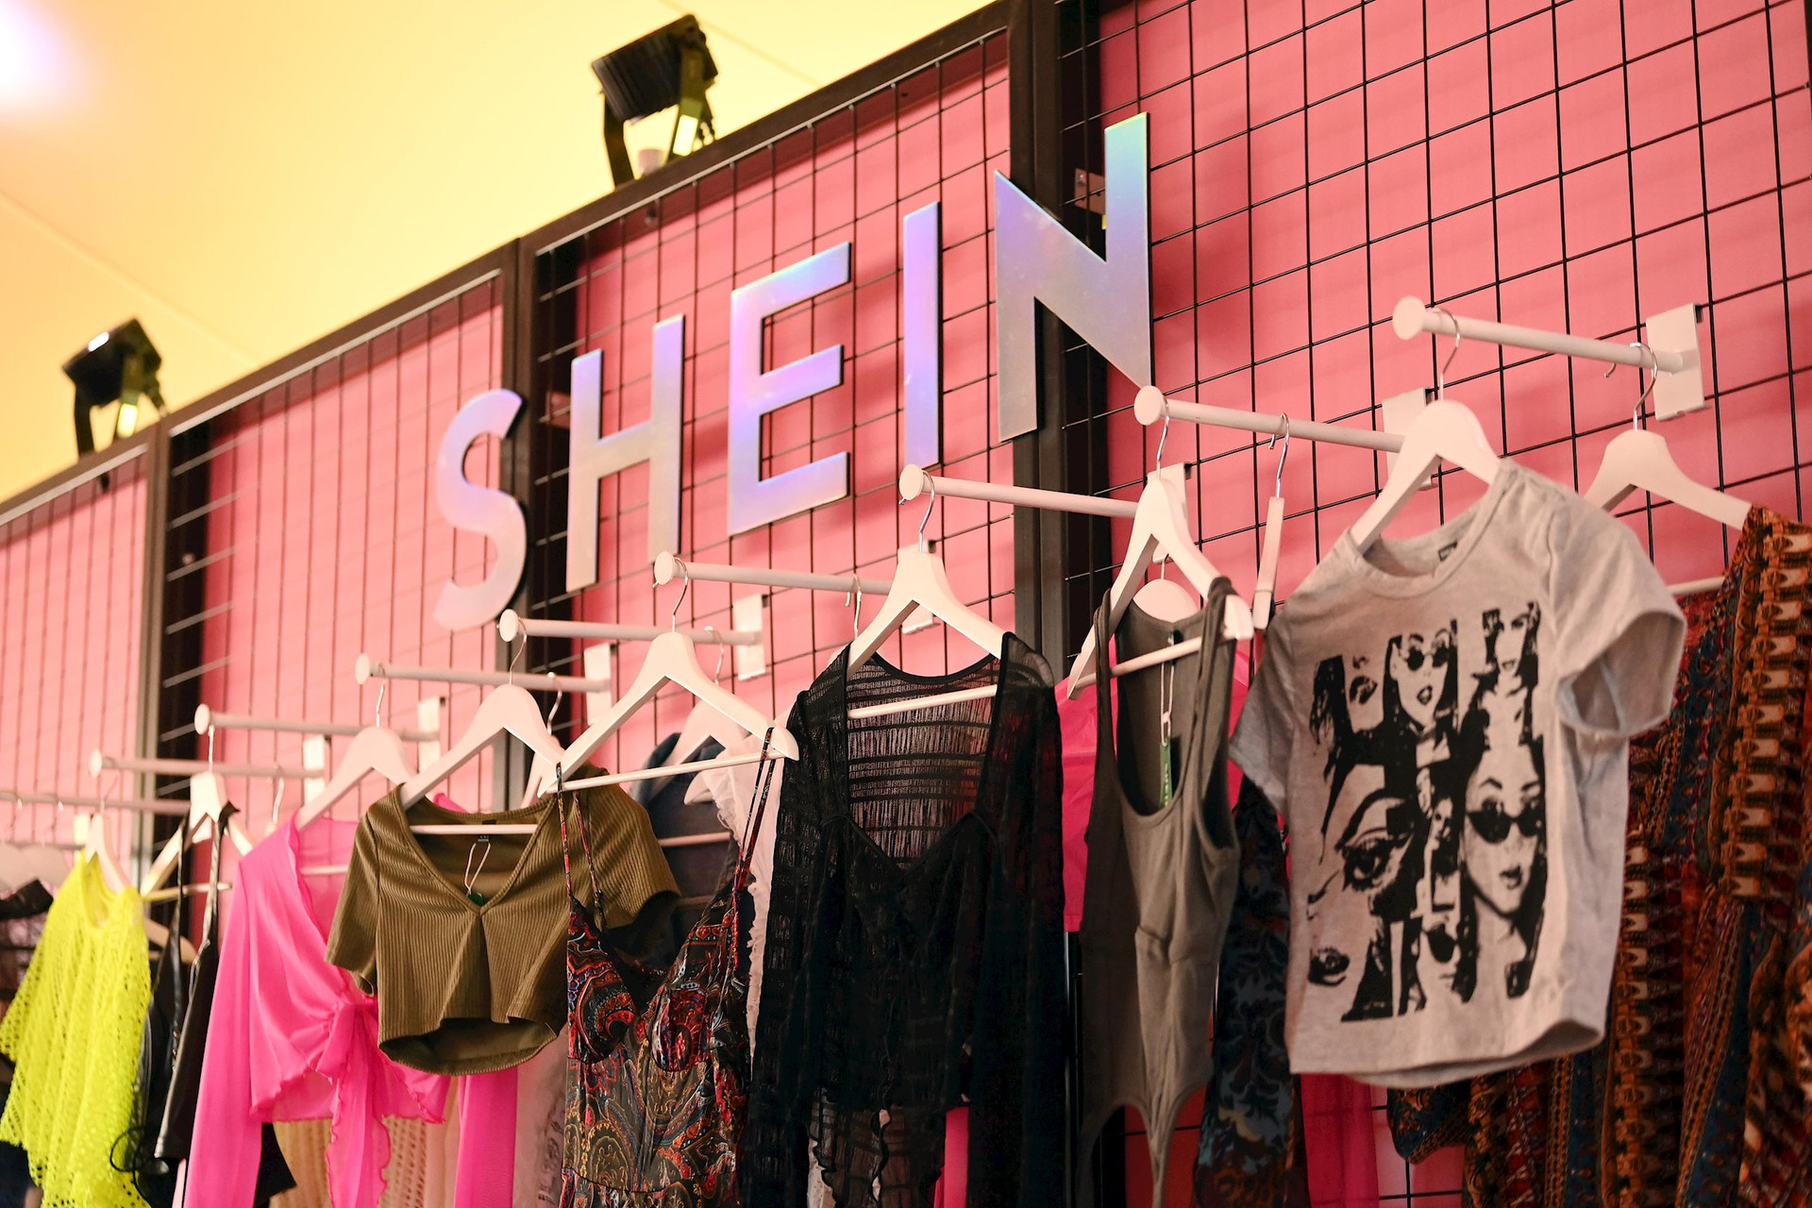
SHEIN
Please keep this slide for attribution

Slide 14
MORE…
Explore a myriad of stylish garments, awaiting your selection.

Slide 15
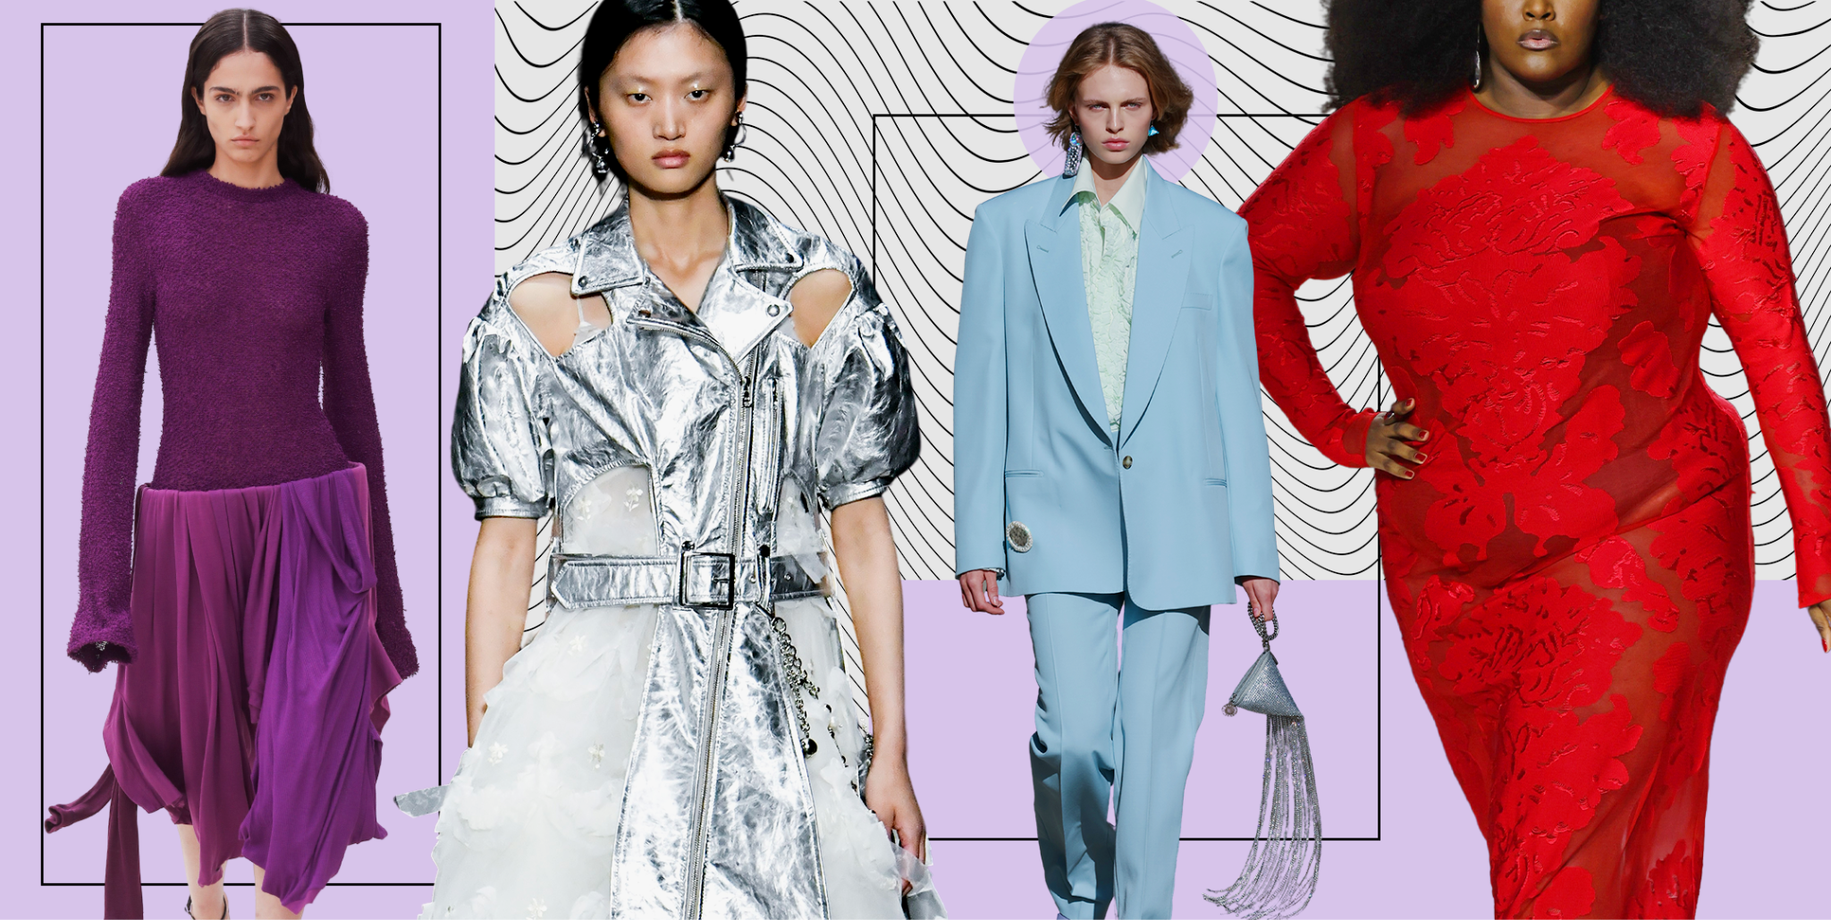
4
Benefits
What are some advantages for joining this club?

Slide 16
Benefits
Skill Development
Enhance your marketing and design skills through hands-on projects and workshops.
Portfolio Building
Create and showcase your work in a professional portfolio.
Resource Access
Gain access to valuable resources, such as design software, marketing tools, and educational materials.
Leadership Skills
Take on leadership roles within the club to develop management and organizational abilities.
Creativity Boost
Engage in creative activities and challenges that stimulate innovation and out-of-the-box thinking.

Slide 18
Looking forward to having you join us!
See Ya!

